Slide 1
Direct X : A Brief Overview
Zhan Yu
Computer Graphics and Imaging Lab
University of Delaware

Slide 2
What is DX?
Direct3D and D3DX
DirectInput and XInput
Direct2D
XACT, XAudio2, X3DAudio, XAPO, XAPOFX

Slide 3
Examples using DX : X3 Reunion

Slide 4
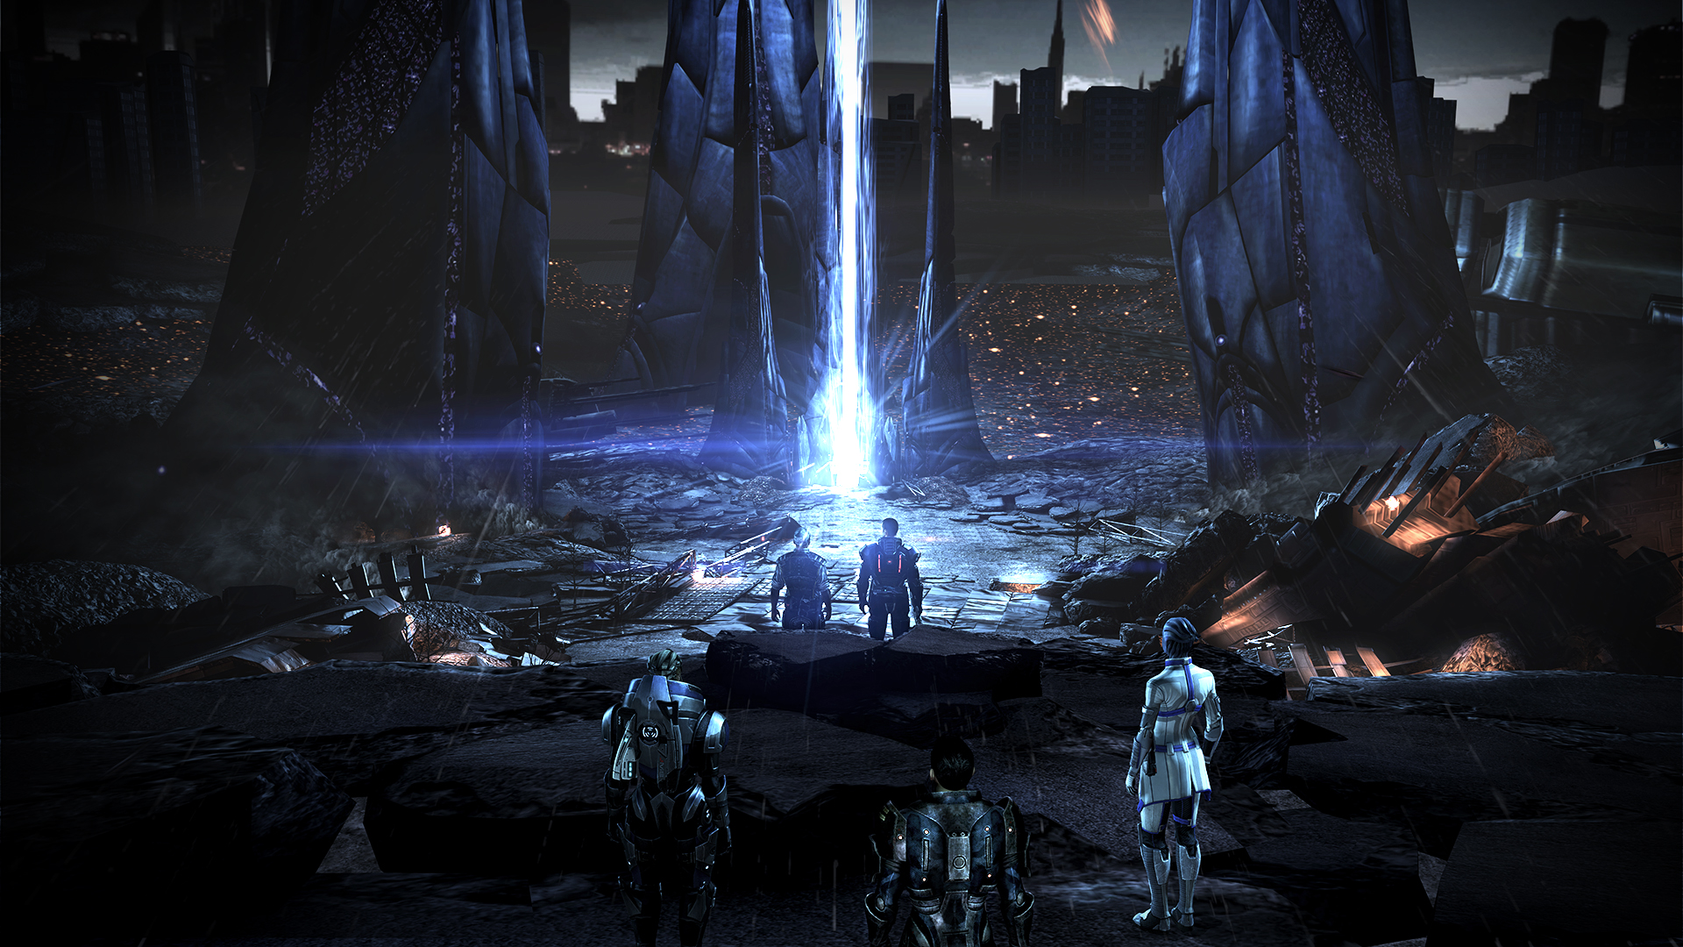
Examples using DX : Mass Effect 3

Slide 5
Examples using DX : The Legend of Heroes VII

Slide 6
Examples using DX : Tomb Raider 2013 (Realistic Hair)

Slide 7
What is DX?
Direct3D and D3DX
DirectInput and XInput
Direct2D
DirectSetup
XACT, XAudio2, X3DAudio, XAPO, XAPOFX

Slide 8
Why D3D?
D3D
Controlled by Microsoft; frequent updates
Optimized to MS products
Frequently updating (11 Versions in 10 years)
COM – based (OOP)
OpenGL
Controlled by OpenGL ARB; only a few updates
Not as efficient as D3D on MS products
C-based (Not OOP)
Cross platform

Slide 9
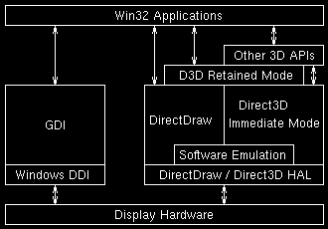
D3D Pipeline

Slide 10
Setup DirectX
For Programmers
Download and install DirectX SDK from MS (latest version June 2010)
Add header and libraries to your project
For Users
Download and install DirectX runtime (embeded in Windows)

Slide 11
Program with D3D on Windows
Define a window using Windows API
Create a D3D device and associate the device with the window
Load Shaders (VS, GS, PS)
Setup 3D Geometry, Matrices, Textures, etc.
Draw when the window is idle

Slide 12
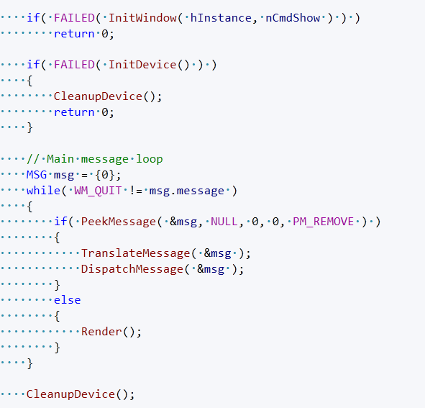
Program Overview

Slide 13
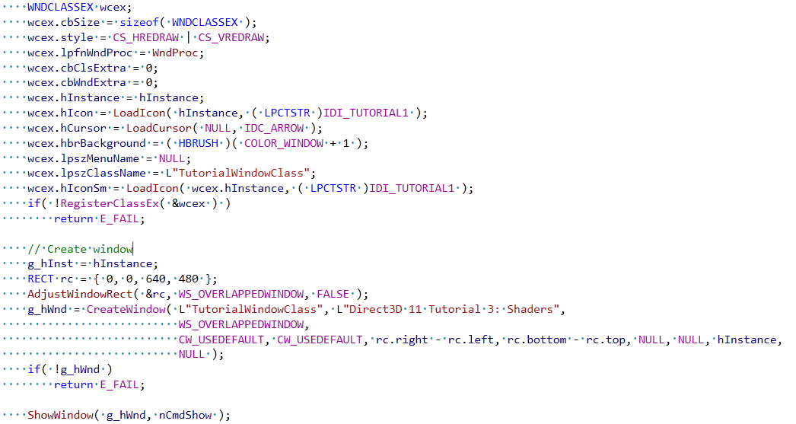
Define a window

Slide 14
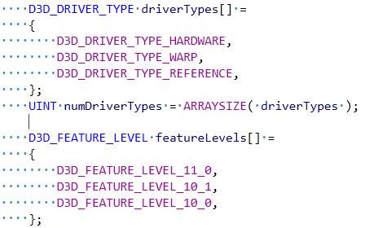
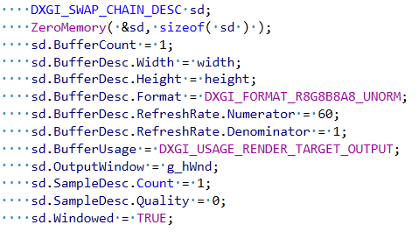
Creating a D3D device and associate with the window

Slide 15
Loading Shaders

Slide 16
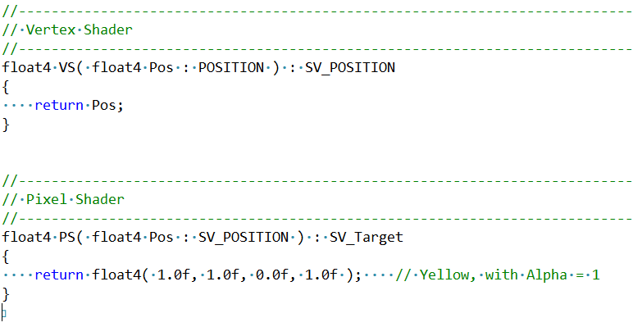
Shader Code

Slide 17
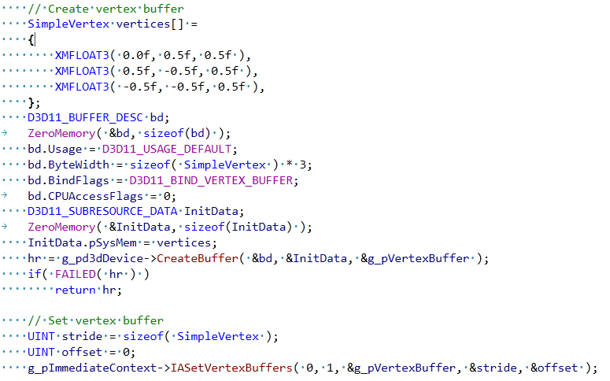
Setup 3D Geometry:

Slide 18
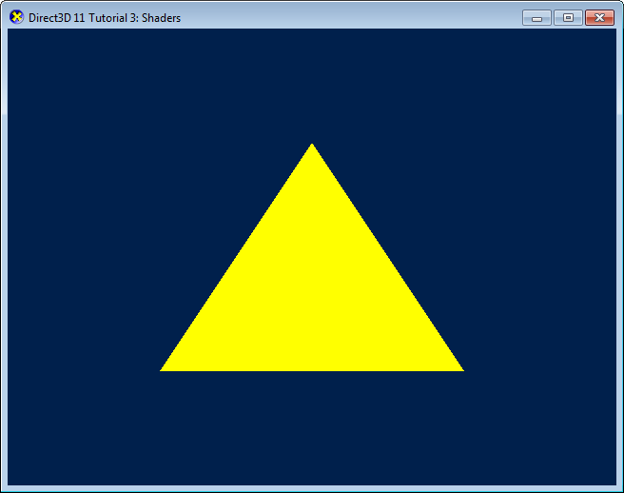
Rendering

