Slide 1
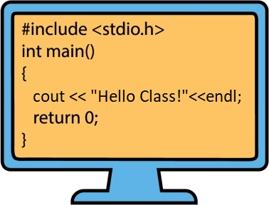
Syllabus Page 1
Inclusivity
In this class I am committed to creating an inclusive environment in which all students are respected and valued. I will not tolerate disrespectful or exclusive language or behavior on the basis of age, ability, color/ethnicity/race, gender identity/expression, marital/parental status, military/veteran’s status, national origin, political affiliation, religious/spiritual beliefs, sex, sexual orientation, socioeconomic status or other visible or non-visible differences.
What a boring world this would be if everyone was the same race, culture, religion, gender, had the same abilities, held the same opinions, etc. Being grateful for the differences includes not just being respectful of those possessing those differences, but truly valuing what those differences bring to our classroom, to our learning experience, and to our lives.
If anyone experiences anything that makes them uncomfortable, either from fellow students, TAs, or myself, please let me know immediately. Equally, if there is anything I can do within reason to make this class more inclusive, please let me know.
Communication
Discord: CISC220
Class email: 220datastr@udel.edu
Office/Discord Hours LInk: https://www.eecis.udel.edu/~yarringt/CISC220/Fall22/OfficeHoursDiscord.html
TAs:
Christopher Bennett
Mar Tejedor-Ninou
Sydney Hester
Blair Felker
Colin Stetler
Mathias Heider
Weibin Ma
Zheyuan Yu
Make sure you are receiving Canvas Notifications for this class!
:
CISC220 Data Structures
Professor: D. Yarrington
Spring 2023
Course
Class Web Site
Check here for ALL course assignments, videos,and class updates!
https://www.eecis.udel.edu/~yarringt/CISC220
48%
38%
10%
4%
A > 90.5
B > 80.5
C > 70.5
D > 60.5
Projects
Exams/Quizzes
(Course grade will
Not be greater than
One letter above
Average exam/quiz
Grade)
Homeworks/
Class assignments
Grading Scale
SYLLABUS
Lab/Class/Discord
Participation
Exam Dates
Due Dates/Late Penalties
Mar 15 (midterm 1)
Apr 26 (midterm 2)
Final (TBA)
All homeworks, labs, and projects are due Friday at midnight unless otherwise notified.
You may turn in everything through Sunday without penalty (tech gliches happen)
Late: you may turn things in Monday night with 20% penalty
After that assignments will not be accepted

Slide 2
Class Rules
Projects must compile in order to be graded!
Grades must be contested within 2 weeks of being released!
All assignments/projects must be turned in via Canvas
Your final grade cannot be more than one letter grade above your average Exam/Quiz grade
You must complete at least 3 of the 4 quizzes. (You may miss only one without penalty)
Lab Attendance is required.
You may miss up to 3 labs throughout the semester without penalty. After that you will receive a 0 on lab attendance.
Listen! Do not interrupt other students! Be polite, respectful, and courteous at all times!
No one cares how much you know. They care how you treat them.
Office Hours Protocol:
If you need general concept help:
Rewatch the videos/go over the powerpoints
Write down your questions (and be as specific as possible)
Don’t be intimidated to ask!!!
If you need help with your code, have:
Lapptop open, code up and running
Print statements at the beginning and ending of each function/method (see the Getting Help document)
Specific questions on exactly what you expected to happen and what isn’t happening
Turning in Assignments
Include a screenshot of your running code
(This confirms that your code compiles if your compiler is different than the grader’s compiler)
If you are turning in multiple files, zip (compress all files and turn in the compressed file.
If you work with a partner, both you and your partner should turn in a copy, with both your names in the comments at the top of the project
(so there’s a back-up if one of you experiences technical difficulty or turns in the wrong version, etc.)

Slide 3
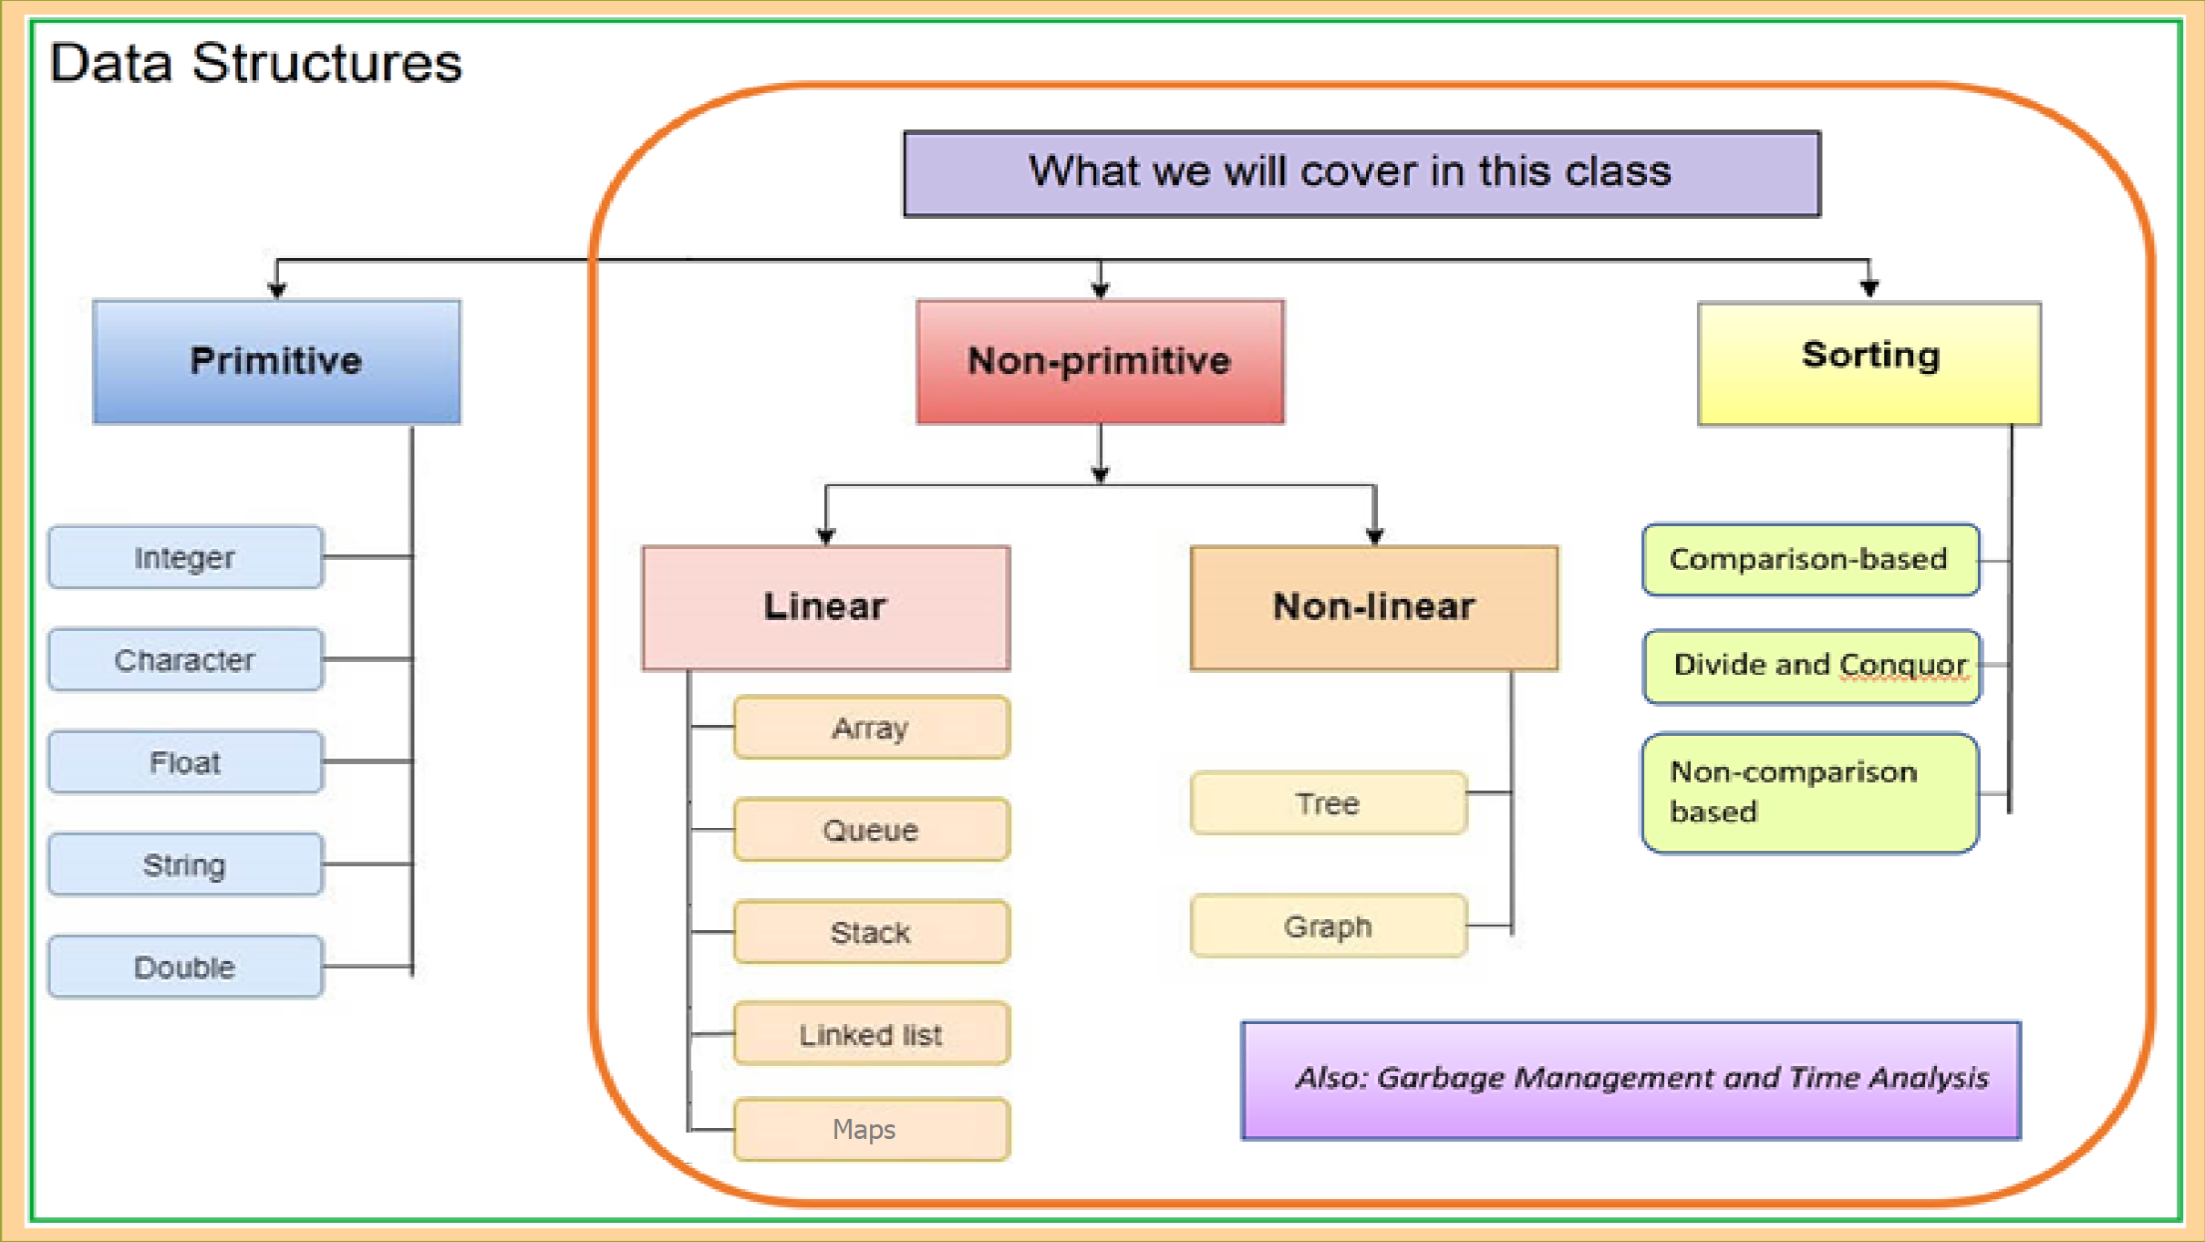
Syllabus Page 2
?
Academic Dishonesty
Don’t Cheat!
The bottom line is that this field requires you to know/understand the material covered in this course both conceptually and in practice. Using or turning in anything that is not your own work and not something you understand will be to your own detriment, both in future couses, in the interview process, and in the work environment. Plus this is challenging but interesting and fun material. Take the time and effort to learn it!!!
What constitutes cheating?
Turning in code you didn’t write/don’t understand! (This includes allowing your partner to do all the work/doing all the work for your partner)
Enabling people to use or turn in code they didn’t write/don’t understand!
Copying anything from someone else’s exam/project/homework
Sharing your exam/project/homework answers.
IF SOMEONE POSTS THE ANSWER ON AN ONLINE ANSWERING SERVICE (E.G., CHEGG, etc.) AND YOU VIEW IT EVEN ONCE, THAT IS CONSIDERED CHEATING.
We are monitoring online tutoring/question answering services. Online question answering services will provide us with the name of the person who posted the question and the name of all students who view the answer.
Anyone who cheats will be prosecuted in accordance with the University's Policy on Academic Honesty.
Not cheating (and encouraged!)
Working with/explaining and sharing code with your partner
Explaining concepts on discord
Explaining/teaching concepts you understand to fellow students
Asking for fellow students to explain concepts, on Discord or in person
Googling and reading about concepts on the internet
ANY PROCESS THAT ALLOWS YOU TO LEARN/UNDERSTAND/EXPLAIN TO OTHERS

