Slide 1
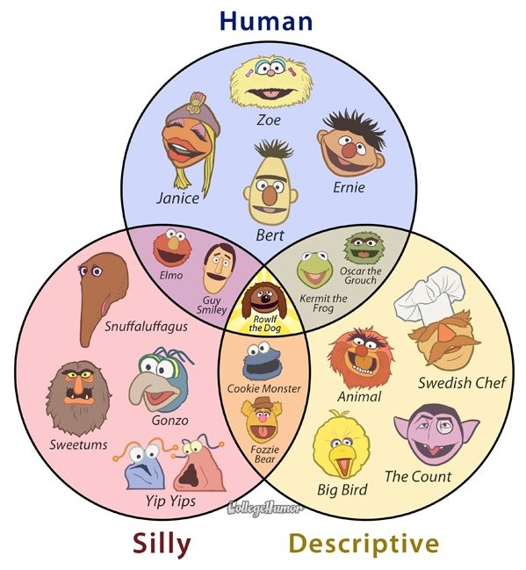
Sets Intro
A new ADT!!!
(5 weeks left!!! You got this people!!!)

Slide 2
So Far:
Lists:
Arrays: best for finding at the kth index:O(1)
Also easy to traverse (but O(n) )
LL: Things that can be done inO(1):
joining 2 lists
Pushing
Inserting
Removing
DLL: popping
Not good for finding at the kth index (O(n))
Not good for: finding x(O(n))
Trees:
AVL BST:
Find x, insert, and remove in O(log n)
Joining t2o trees – not great! – O(n log n)
Pushing and popping – don’t even exist with trees
Finding at the kth index – again, doesn’t exist

Slide 3
ADT: Sets
See, no duplicates!!
Sets:
All Data must be unique
No duplicate data
Unlike lists, trees
Data Unordered
Unlike lists
Also, no beginning,aka root
(like trees)
Largely designed for querying (finding data!)
74
No order to the data!
42
36
12
21
17
19

Slide 4
Let’s focus on Finding x:
Finding x in our data structures so far:
Linked lists – have to go through all the data from beginning to end to find x
both singly and doubly
O(n)
Arrays - also have to go through all the data looking for x
O(n)
Trees: if it’s a binary search tree, at least we have a more systematic way of finding x
if x is less than the data in a node, go left
if x is greater than the data in a node, go right
continue until we find x, or find x isn’t in the tree
IF THE TREE IS BALANCED, we only have to compare x to one node on each level, and at most with n total nodes in the tree, there will be log n levels.
so finding in a balanced binary search tree is log n

Slide 5
Focus on Finding x:
We’ve got all the students here at this university and we want to find information about one of the students.
That’s all we want to do – find info about one student at a time.
Once students are here for the semester, the actual set of students doesn’t change that much
(So inserting and deleting aren’t priorities)
How do we do it?
Array?
Linked List?
Binary Search Tree?
AVL Tree?
Our best so far is O( log n)
We want something better...

Slide 6
Take-Aways:
Sets: A new ADT!
No duplicates
No order
All data is of the same type
Finding:
So far, no awesome solution to this!
Balanced Trees: not bad (O (log n)
Especially if we want to insert and delete regularly too (also O(log n)
What if we just want to find (mostly)?
How do we implement a set?

