Slide 1
HashMaps:
Hash Functions

Slide 2
Hash Maps So Far:
Hash function maps the data to an index in an array
Function takes key (something unique about the data) as input and calculates a number that can be used as an index into an array.
to find values associated with key
Last step in any hash function:
Mod by array size
So key maps to index within bounds of array
Pick a prime number for array size!!!
Spreads data throughout array
Less likelihood of collision
Even Better:
Pick an arraysize double the amount of data
And go up to next prime number
Arrays that are about half full is a good goal
In creating a hash map, we must worry about:
Hash function
Array Size
Collisions

Slide 3
1. Hashing Function
Key fn number array at number values
A good hash function:
Computes quickly
Computes consistently
Distributes keys evenly throughout array
Maps all keys to indices within the array!
Avoids collisions
Two keys mapping to the same index
Note: There are many hash functions. Some are better than others. None are perfect… yet…

Slide 4
Hash Functions:
Key fn number array at number values
There are many, many hashing functions
You can come up with your own…
Remember the function needs to be:
Quick to calculate (the point is to find data fast!)
Evenly distributes keys within a range (don’t want collisions!)
Consistently map a key to an index (so no random numbers)
Example 1:
Could just take any number in the key and mod by the array size
E.g., if you have a student with id 324938748
324938748 % 11 would result in index: 2
This is what we’ve seen so far…
Remember – any pattern or trend in the numbers could lead to uneven distribution of indices
Why is this bad? Because if the function leads to the same indices again and again, we have more collisions!! (which are bad…)

Slide 5
Hash Functions:
Key fn number array at number values
Example 2:
Add Digits (I like this one):
Could add the digits in a number and mod by array size
E.g., 3284 = 17 % arraysize.
If arraysize is 11, 17%11 = 6 so index would be 6
Remember – any pattern or trend in the numbers could lead to uneven distribution of indices
Why is this bad? Because if the function leads to the same indices again and again, we have more collisions!! (which are bad…)

Slide 6
Possible hash functions on ints:
Key fn number array at number values
Power hash:
take the key, take each digit in the key to the power of its place in ascending order:
E.g., if key is 324:
324 = 3¹ + 2² + 4³ = 3+4+64 = 71 % arraysize
Works best with smaller numbers…
(could quickly surpass maximum int size)
MANY hashing functions involve shifting bits…

Slide 7
Possible hash functions on ints:
Key fn number array at number values
Middle r:
square the key, (possibly convert to binary), and use the middle r bits or numbers (then mod by array size)
E.g., if key is 44:
44²=1936,
maybe take the middle 2 numbers, so you’d have 93 % arraysize
MANY hashing functions involve shifting bits…

Slide 8
Possible hash functions on ints:
Key fn number array at number values
Folding (I personally like this one too!):
divide the number to equal sized pieces and add the pieces (then mod by arraysize)
(e.g., 328-444-2870 becomes (32 +84 + 44+28+70 )%arraysize
MANY hashing functions involve shifting bits…

Slide 9
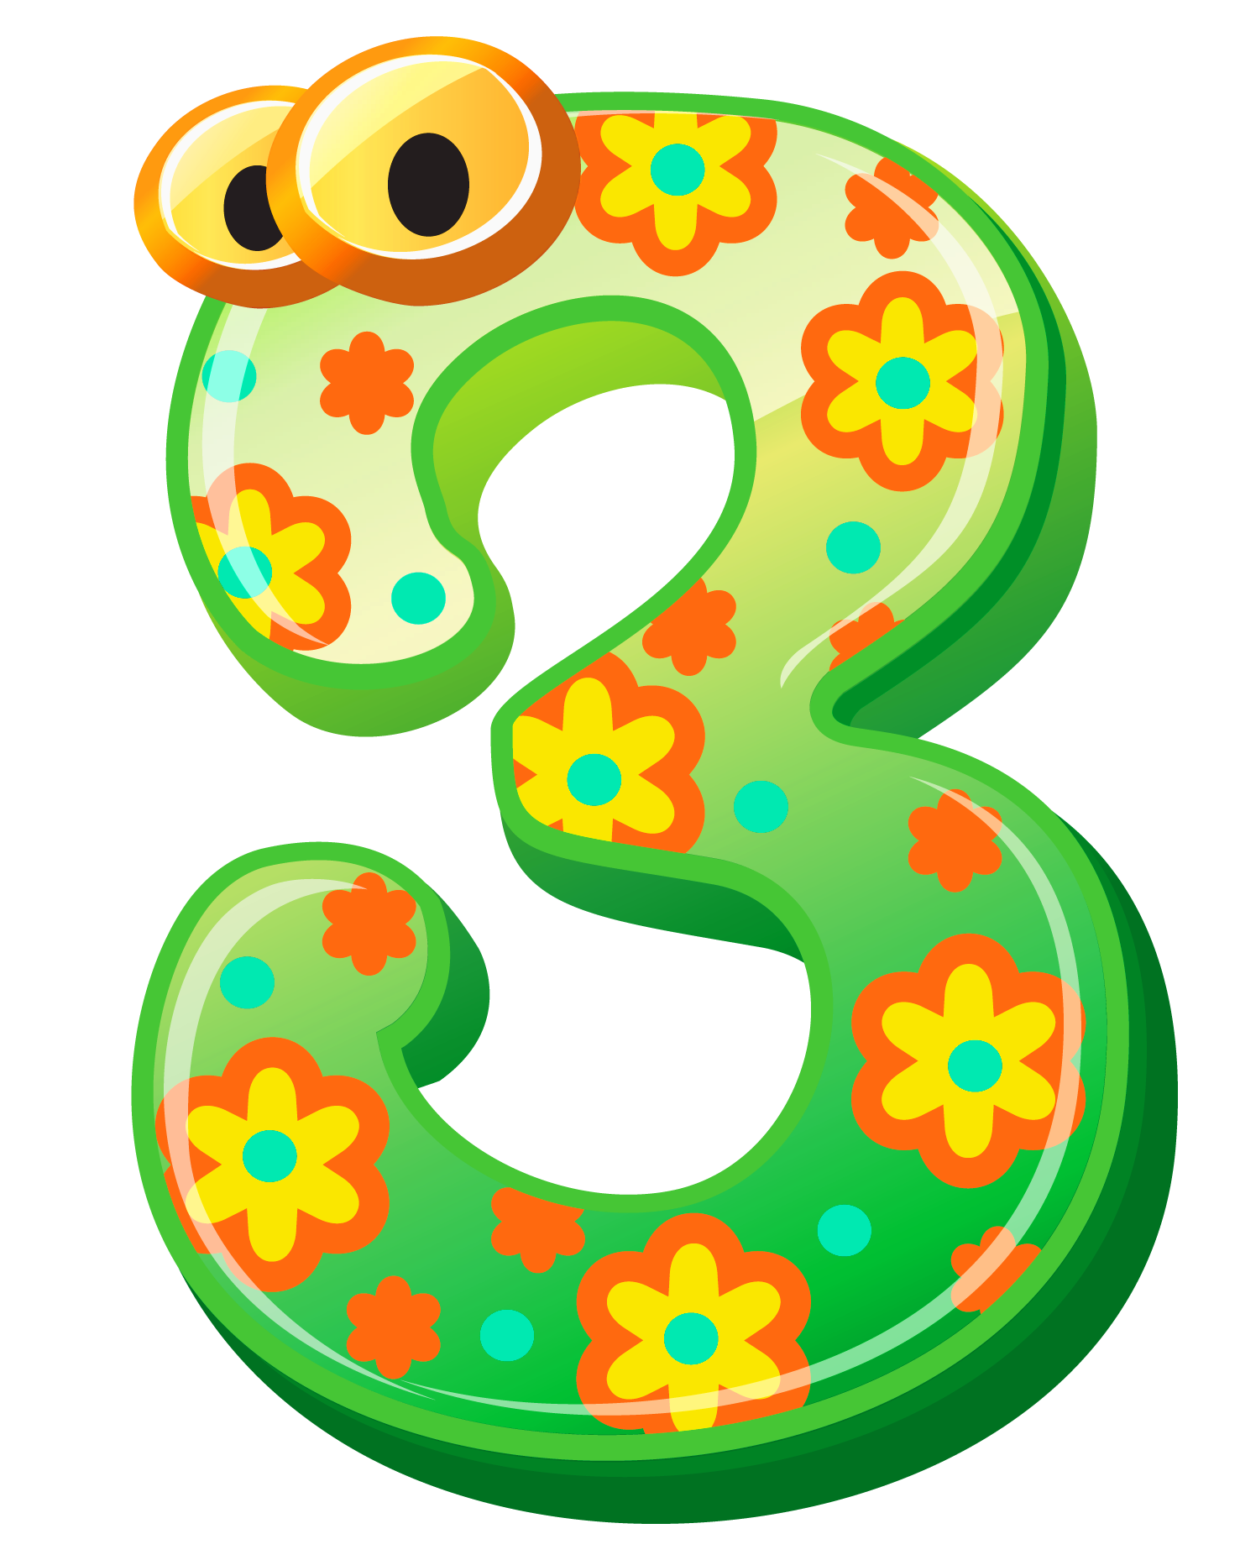
Take-Aways:
fn
Hash maps: unique data->function->mod arraysize ->index into array
Last step of all hash functions must be to mod by array size
So pick a prime, ideally about twice the size of the amount of data
There are many, many hash functions!
Hash functions must be:
Replicable (gives you the same result every time for a key)
Quick to calculate
Distribute keys evenly (aka generate indexes that are evenly spread throughout the array)
We’ve seen:
Add digits
Power Hash (but gives big numbers)
Middle r digits
folding

