Slide 1
HashMaps:
Array Size

Slide 2
Hash Maps So Far:
Hash function maps the data to an index in an array
Function takes something unique about the data as input and calculates a number that can be used as an index into an array.
That something unique is known as the key
In the array we store values associated with the key
In our example:
the key is the student id,
values are student name, year of graduation, etc.
In creating a hash map, we must worry about:
Hash function
Array Size
Collisions

Slide 3
Hash Map:
Key fn number array at number values
data in a hash map must be UNIQUE
E.g. student objects – each student is unique
Goal: to be able to find data in as close to O(1) as possible
E.g.,Student gives you their id, you type it in, and up pops their info!
When you type in the id, the hash function uses it to find the index, then the program goes to the index, and returns the value at that index.
Key (unique part of data) goes into a function.
The function calculates a number.
That number is used as an index into an array to access data at that index
That data (the values associated with the key) are accessed.

Slide 4
1. Hashing Function
Key fn number array at number values
A good hash function:
Maps all keys to indices within the array!
Distributes keys evenly throughout array
Avoids collisions
Two keys mapping to the same index
Computes quickly
Computes consistently
Note: There are many hash functions. Some are better than others. None are perfect… yet…

Slide 5
Potential Hash functions:
Key fn number array at number values
Gives you the remainder
Function 1 (not great, but we have to start somewhere):
Take the key (whatever it is, it can be represented as a number – this is the computer) and then mod by arraysize
E.g., student.id % arraySize
% arraysize means function will always result in an index that falls within the bounds of the array!
Problem:
Array size below is 10
Function is: key %10
E.g., 71%10, 81%10, 75%10, etc.
Could end up with many numbers hashing to the same value
E.g., array is 100 and keys are all multiples of 10
81 collided with 71, 89, 29, 99, and 79 all collided!
Key index
x=71 f(x)= 1
x= 81 f(x)= 1
x= 75 f(x)= 5
x= 89 f(x)= 9
x= 29 f(x)= 9
x= 99 f(x)= 9
x= 79 f(x)= 9
x= 72 f(x)= 2
0 | 1 | 2 | 3 | 4 | 5 | 6 | 7 | 8 | 9
 | 81 | 72 |  |  | 75 |  |  |  | 79

Slide 6
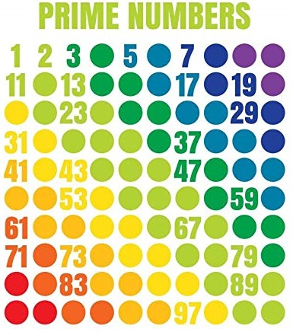
2. Better Hash Functions: Make Array Size Prime!
Key fn number array at number values
Hash functions and array size are intricately connected.
Because the last step of any decent hash function is % array_size
This ensures the hash fn returns a number that will be usable as an index into the array
Make Array Size be a Prime Number!:
Why?
We know: we’re not going to be able to fill the array perfectly
we’ll have some unfilled spaces
We know: the last step in the hash function has to be mod-ing by the array size…
So: pick a good array size!
Make it a prime number
Spreads remainder out more evenly through array

Slide 7
2. Prime Number Array Size
Key fn number array at number values
Hash functions and array size are intricately connected.
Here: array size = 11 (prime number)
(works even better with larger primes that aren’t close to powers of 2)
Watch what happens with 8 random numbers between 0 and 100, hash function is number%11:
Already we’ve got a better hash function!!!
Even better array size: double the amount of data, then to go the next largest prime
Key index
x=71 f(x)= 5
x= 81 f(x)= 4
x= 75 f(x)= 9
x= 89 f(x)= 1
x= 29 f(x)= 7
x= 99 f(x)= 0
x= 79 f(x)= 2
x= 72 f(x)= 6
0 | 1 | 2 | 3 | 4 | 5 | 6 | 7 | 8 | 9 | 10
99 | 89 | 79 |  | 81 | 71 | 72 | 29 |  | 75

Slide 8
TakeAways:
Hash Function:
Converts key (Unique data) into an index in an array
Index must fall between 0 and the length of the array
SO last step: mod by array size
Works better when array size is prime number
Spreads values out more evenly
Even better: double amount of data and then go up to nearest prime
About half full is a good goal

