Slide 1
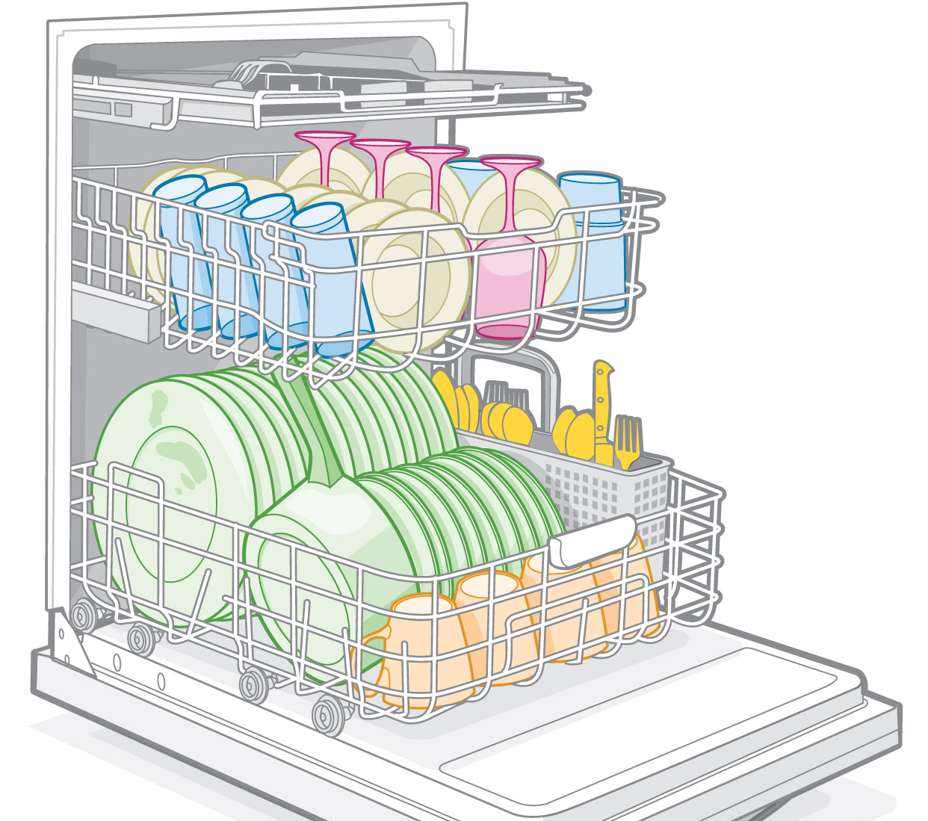
HashMaps: Load Factor and rehashing
When and how should you re-hash the keys?

Slide 2
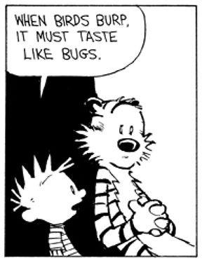
So Far We’ve discussed:
Optimal Hash Array Size (hint – it’s a prime)
Hash functions (convert keys to numbers to be used as indices)
Special considerations for hash functions and strings
Different options for dealing with collisions
THE SAME HASH FUNCTION AND COLLISION HANDLING system is used for both finding and inserting
What about removing?
Things could be worse… at least your burps don’t taste like bugs!!!

Slide 3
Remove From a Hash Map?
With chaining – not an issue – just find, then remove from the linked list
With Open Addressing: We have an issue.
Why?
Hashing: 20,22,32,43,42,55,66,53
Function: num%arraysize (bad hashfunction)
Array size 10 (bad arraysize)
Results:
32 43 55 66
42 53
HOW WOULD YOU FIND 53? (Or, how would you find 64 IS NOT in the hash array)?
What if we removed 42? Now how do you find 53?
0 | 1 | 2 | 3 | 4 | 5 | 6 | 7 | 8 | 9
20 |  | 22 | 32 | 43 | 42 | 55 | 66 | 53

Slide 4
Removing with Probing:
To find a key-value pair:
Redo the hash function on the key, get the index
start looking there.
If that location is full, and it isn’t the value you’re looking for, you look at the next probe-defined location
(linear probing – next index, double-hashing – the value rehashed)
You know the value is not in your data set IF YOU FIND AN EMPTY SPACE
Otherwise that’s where the data would have been placed in the hash map.
But what if you removed, and that’s why there’s an empty space???

Slide 5
Removing with Probing:
What if you’ve removed?
What to do about the empty space?
so it doesn’t confuse future probes for a different key…
Quick and Dirty Solution: “Dummy value”
Dummy value - some value that won’t ever occur in your data set
When you remove, mark the slot as “removed” somehow
Mqybe -1 ?
Different from an empty slot
So when probing during a find, continue to search past “removed” slots (with dummy values) until either the value is found or a slot is empty
Note: The array must have an empty value!
Why?

Slide 6
Removing with probing:
Problem: could have a hash array with very few values, yet search could take a while
Because lots of dummy values
May need “compaction”
Sort of like “defragging”
Remove all values from the hash array
and rehash everything that is a legitimate value (not the dummy values!)
If amount of data is much smaller than array size, and we’re rehashing everything anyhow, we might want to create a smaller array
When? How empty?

Slide 7
Load Factor:
There’s usually a trade-off between the number of collisions and the size of the array:
Huge arrays with little data should mean fewer collisions
But too much wasted space!!
Small arrays with large amounts of data mean more collisions
But less wasted space
We’ll need to keep track of how full the array is.
Load factor:
number of indices filled(n) / total number of slots (m)
Indicates how full the array is

Slide 8
Removing: How empty before rehashing?
If amount of data is much smaller than array size, and we’re rehashing everything anyhow, we might want to create a smaller array
When? How empty?
If LOAD gets to be under 25%,
Make a new array half the size of old array, up to nearest prime
Rehash all values
O(n) ( bleck, Ugh!)
But… it means that future inserts and finds can be done in close to O(1) without a lot of wasted space!
SO it’s a trade-off…

Slide 9
Back to inserting:
What is the best case for insertion?
What is the worst case for insertion?
When does this happen?
Clearly the more we avoid collisions, the more efficient hashing is (and we want efficient!)
Usually, the more elements in the hash array, the more collisions
Rule: When a hash table(array)’s load is over 70%, we want to:
Allocate a new array
New Size: double the previous array’s size (up to next prime)
Take all the key-value pairs and rehash
Mod by new array size
Time: 0(n) Ugh!
Again, the trade-off is now future finds and inserts should be close to O(1)

Slide 10
Overall: Hash Tables:
Good for:
data that can handle random access
Data that is unique! (1 per hashmap)
When mostly you need to find data (and quickly)
As opposed to anything else!
Not so good for:
Data that must be ordered
Finding the largest, smallest, median value, etc.
Dynamic data
A lot of adding and removing of data
Don’t want to rehash too often
Data that doesn’t have unique keys (i.e., duplicates)

Slide 11
Hash maps Usage:
Encryption – for authentication
Hash a digital signature, get the value associated with the digital signature,and both are sent separately to receiver. The receiver then uses the same hash function on the signature, gets the value associated with that signature, compares the messages. If the same - authentication
Database access
Names->phone numbers
Author->articles (or books)
Topic->articles
usernames->passwords
Social Security Number->everything about you
Zip codes->regions
Translation
Anagrams (how?)

Slide 12
Take aways
Hash maps: Implementing the ADT Set
Unique values, no order to the data
How it works:
unique key -> hash fn (mod arraysize) -> number -> used as index into hash array -> values associated with key
Many, many hash functions!!
But you will always have collisions
when multiple keys hash to the same index in the array
Many ways of dealing with collisions!
Collisions are costly in terms of time (and we want to find things fast!)
Usually, the larger the hash array (and thus the more wasted space), the fewer collisions.
Does it pay to change the array size and rehash all the values?
Sometimes…
Load factor – number of values in the hash array/ total size of hash array
Load factor under 25%? Time to rehash with an array half the size of the current array
Load factor over 70%? Time to rehash with an array double the size of the current array
-always go up to the nearest prime for the arraysize!
Hang in
There
People!
You got
This!!

