Slide 1
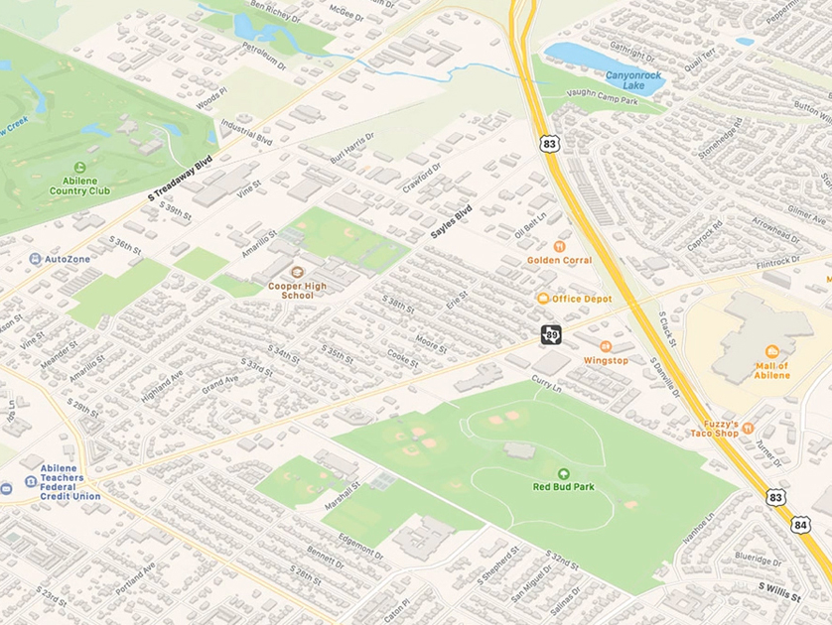
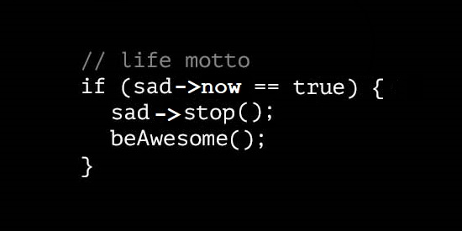
Hash Maps Intro
An extremely well-used data Structure!

Slide 2
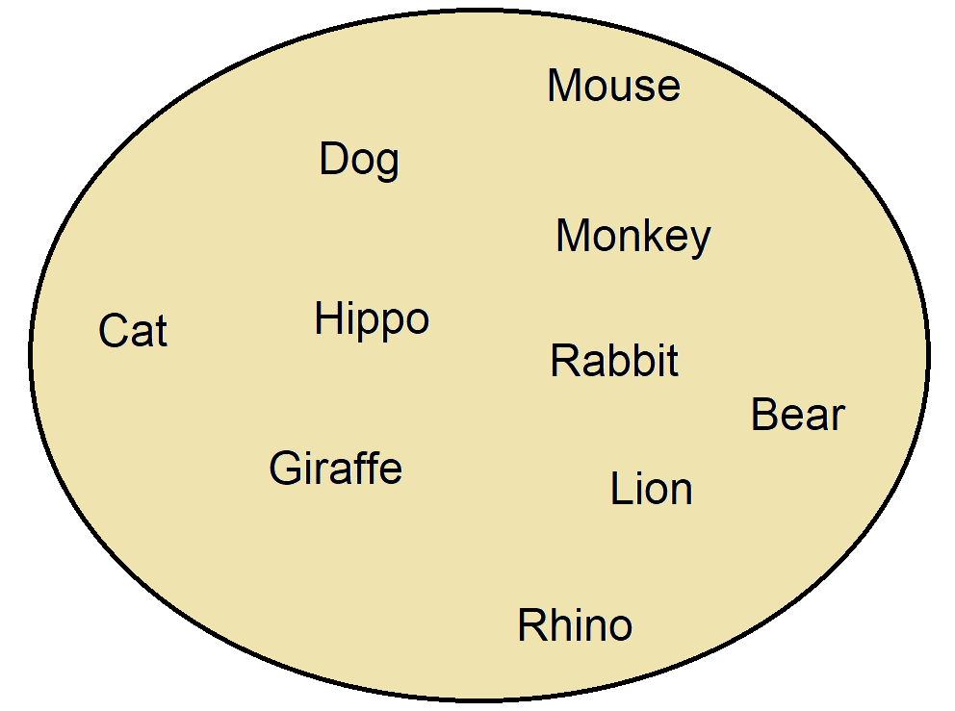
ADT Sets:
Every data in a set is unique
No duplicates
No order to a set
No first, no last
No this comes after this…
Finding:
So far the best we can do is O (log n)
With balanced trees

Slide 3
The problem of finding x:
Let’s go back to arrays:
Arrays allow us to access data at an index quickly (O(1))
a. If all the students are in an array and
b. we know what index in the array a student is located at, (e.g., Cruella is at index 4)
c. we can access the student info in 1
We need a way to MAP (HASH) each student (or other data) to an index in the array
Note that each student is unique – no two students with exactly the same data
Malfoy, Draco 2023 638428112 | Munster, Herman 2025 302956473 | Adams, Morticia 2024 493238281 | Dracula, Vlad 2024 3894928171 | DeVille, Cruella 2023 693842813 | Thanos, Bert 2025 992834764 | Bates, Norman 2025 492837123

Slide 4
Hashing:
Example:
We’ve got 5000 students, each with a unique student id that’s 9 digits long.
Could we use the student ids as the index into an array?
Can you think of a reason why we shouldn’t?
Mapping:
a way of taking a unique key (in this case, the student’s id) and mapping it to an index (a number)
In other words, we are mapping a student to an index in the array.
In this case using their id.
Hashing function maps the unique key to an index
That way we can find the student by looking at the index created by the key and the hashing function
takes one step!! O(1)
Needs to be one seriously huge array!!
Using student ID as INDEX!
index
… | 302956473 | … | 389492817 | … | 492837123 | … | 493238281 | … | 638428112 | … | 693842813 | … | 992834764
 | Munster, Herman 2025 |  | Dracula, Vlad 2024 |  | Bates, Norman 2025 |  | Adams, Morticia 2024 |  | Malfoy, Draco 2023 |  | DeVille, Cruella 2023 |  | Thanos, Bert 2025

Slide 5
Problem:
Problem
How long is your student id?
If all student IDs are that many digits, what is the largest possible id?
Assuming 9 digits, 999,999,999 is the largest possible id
To use the id as an index into an array, we’d need an array that is as long as the largest possible id. (so 999,999,999)
How many students are there at the University?
About 25,000
We’d have A LOT of blank spaces (wasted space) in the array.
VERY INEFFICIENT in terms of space.
BUT VERY EFFICIENT in terms of finding data about a student – just go the index that is their id number in the array and there’s the information about the student!
We probably don’t want to waste that much space, though…

Slide 6
Hashing (in our dream world):
Goal:
to take x unique keys (e.g., student ids) and map each key to a different index in an array of size x
(so the array size is exactly equal to the total number of students)
(No extra, wasted space)
This would be a perfect hashing function
It ain’t gonna happen
Terminology: Key-value pair:
The key is something unique about the data
in this case student id
remember – we’re talking about sets – no duplicates!
The values associated with each key is the information about the student

Slide 7
Hashing:
Hashing Function:
formula that takes key (e.g., student id) and calculates a number that can be used as an index in an array
Hopefully, formula calculates numbers within a reasonable range
So we can use a reasonably sized array
(e.g., somewhere between the length of the total number of students and the length of the largest id)
Collisions:
When the hash function calculates the same number for more than one key
causes more than one key (student id) to maps to the same index in an array
We need to worry about 3 things:
Hashing function itself
Array Size
How we handle collisions

Slide 8
TakeAways:
Hash function: takes a key (a unique thing about the data) and calculates a number that can be used as an index into an array
That’s where we put the values
The data associated with the key (e.g., first name, last name, gpa, year of graduation, etc.)
Hash function could lead to collisions
When two keys end up at the same index in an array
We’ll need to figure out how to handle collisions efficiently
Point: to find (and insert, remove) things in as close to O(1) as possible!!
We worry about: the hash function, the array size, and what to do when there’s a collision

