Slide 1
Hash Functions: Strings
Everything is
figureoutable

Slide 2
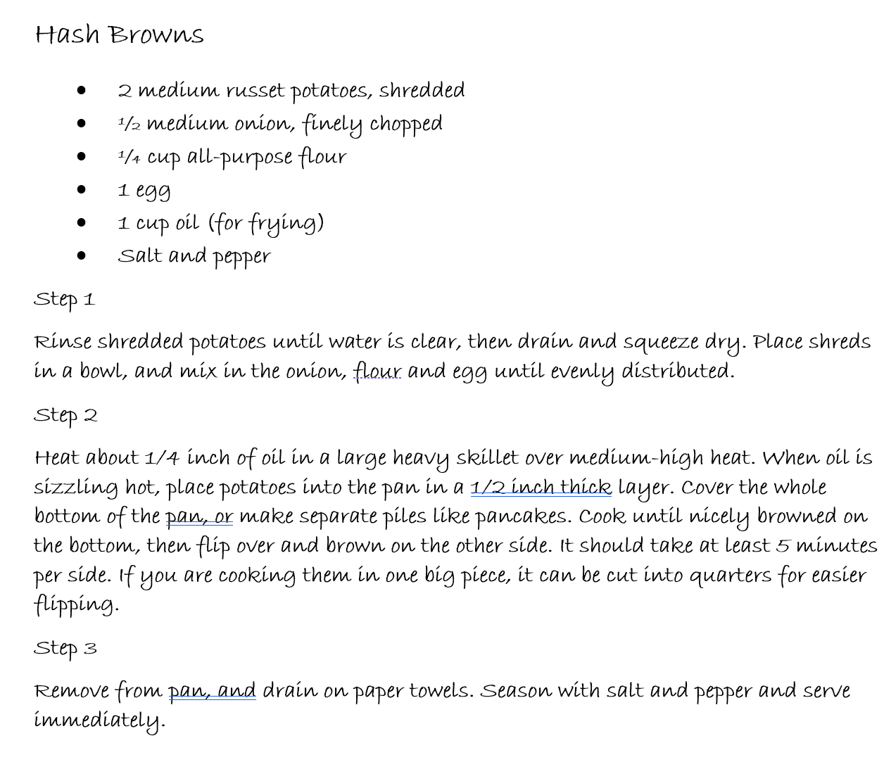
Hash Maps so far:
We’re implementing the Set ADT
No order to the items in a set!
No duplicates (every item is unique!)
All the same type.
Hashing:
Taking something unique about data (the key),
sending it into a hash function,
% array size,
using the returned number as an index,
and getting values associated with the key from the array
Note that you use THE SAME hash function to both find the values associated with a key (the unique thing about your data) AND to put the values into the hash map array in the first place!!!

Slide 3
Potential Hash Functions on Strings
So far, we’ve assumed that the key would be a number
EVERYTHING can be converted to numbers on the computer
But what if we’re starting with strings?
Last names, unique words in a document, dictionary or thesaurus words?
Example: Thesaurus
Key: Unique word that you’d look up: maybe cantankerous
Resulting values: synonyms of cantankerous, e.g., bad-tempered, irascible, irritable, grumpy, grouchy, crotchety, testy crusty, curmudgeonly, ill-tempered, ill-natured, ill-humored
Still: Last step to mod by array size

Slide 4
There are problems unique to Strings!!!
Simple String hash fn: Add ascii (numeric) value of each character
E.g., “abcd” = 97+98+99+100 = 394 % ArraySize
Potential problems:
Anagrams will map to the same index
h(“listen”) == h(“silent”)
Small strings may not use all of array (the larger problem)
The vast majority of words are 4 characters or less.
hashfun(“a”) < 255 (a’s ascii is 97)
hashfun(“I”) < 255 (I’s ascii is 73)
hashfun(“be”) < 510 (ascii of b + e is 98 + 101, or 199)
There are about 3000 words we use in English
Our array should be double data size, then next prime
6007
If our array is 6007, the hash function will skew the indexing towards the beginning of the array
97%6007 = 97
73%6007 = 73
Short words will all end up at the beginning of the array
Potential for a lot of collisions

Slide 5
Hashing of Strings (2.0):
Treat first 3 characters of string as base-27 integer (26 letters plus space)
Key = (s[0] + (27¹ * s[1]) + (27² * s[2])) % ArrayLength
You could pick some other number than 27… (otherwise numbers get big fast…)
Addresses short word issue
Calculated quickly (good!)
Problem with this approach:
It’s better, but there are an awful lot of words in the English language that start with the same first 3 letters:
record, recreation, receipt, reckless, recitation…
preclude,preference, predecessor, preen, previous...
destitute, destroy, desire, designate, desperate…
This isn’t as likely to happen with numbers…

Slide 6
Hashing with strings (3.0)
Example hash function:
Use all N characters of string as an N-digit base-b number
Choose b to be a prime number
i.e., b = 7,11
len = string.length
h = 0;
for i = len-1; i >0; i-- {
h_ind = (11*h_ind + (int)string[i]) % hashArrayLength
}
// (int) string[i] converts the character in the string at index i to its ascii value!
Code:
int main() {
string strarr[10]={"release","quirk","craving","cuckold","estuary","vitrify",
"logship","vase","bowl","cat"};
string hashmaparr[23];
for (int i = 0; i < 10; i++) {
unsigned long int h = 0;
int L = strarr[i].length(); //gets num of characters
for (int j = 0; j < L; j++) {
h = (h*11 + ((int)strarr[i][L-j-1])) % 23;
}
maparr[h] = strarr[i];
}
return(0);
}

Slide 7
Hashing function on Strings:
Array length: 23 (double data amount, then up to next prime)
STRING | Hashed index
Release | 14
Quirk | 20
Craving | 7
Cuckold | 11
Estuary | 8
Vitrify | 14
Logship | 2
Vase | 8
Bowl | 7
Cat | 22
0 | 1 | 2 | 3 | 4 | 5 | 6 | 7 | 8 | 9 | 10 | 11 | 12 | 13 | 14 | 15 | 16 | 17 | 18 | 19 | 20 | 21 | 22
 |  | logship |  |  |  |  | bowl | vase |  |  | cucold |  |  | vitrify |  |  |  |  |  | quirk |  | cat
Problems:
longer calculations, especially for longer words:
Even with this wacky hashing function we have a collision! (when more than one key hashes to the same index)

Slide 8
Take-aways:
You use the same hash function to both:
Put a value into the hash map array
Find a value in the hash map array
The unique key may be a string (as opposed to an int)
ANYTHING can be converted to an int on the computer
Functions on strings must be careful of:
The large number of shorter words (be, hi, it, so, no, at, …)
Prefixes (and suffixes) that many words have in common
No matter what, there will be times when 2 unique keys get hashed to (aka the function results in) the same index in the hash array!
Collisions! We’re going to have to deal with that.

