Slide 1
Hash Maps: Collisions
When 2 keys map to the same index

Slide 2
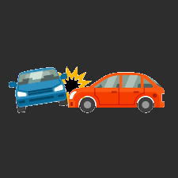
So Far:
Hash Function:
used to take a unique key and convert it to a number that can be used as an index into an array
To make finding items faster
Could be an int, could be a string…
Use the same process to both find and insert the data in the first place!
Last step of any hash function is to mod by the array size
so number generated can be used as an index into the array!
MANY different hashing functions!!!
NO MATTER WHAT, there will be collisions

Slide 3
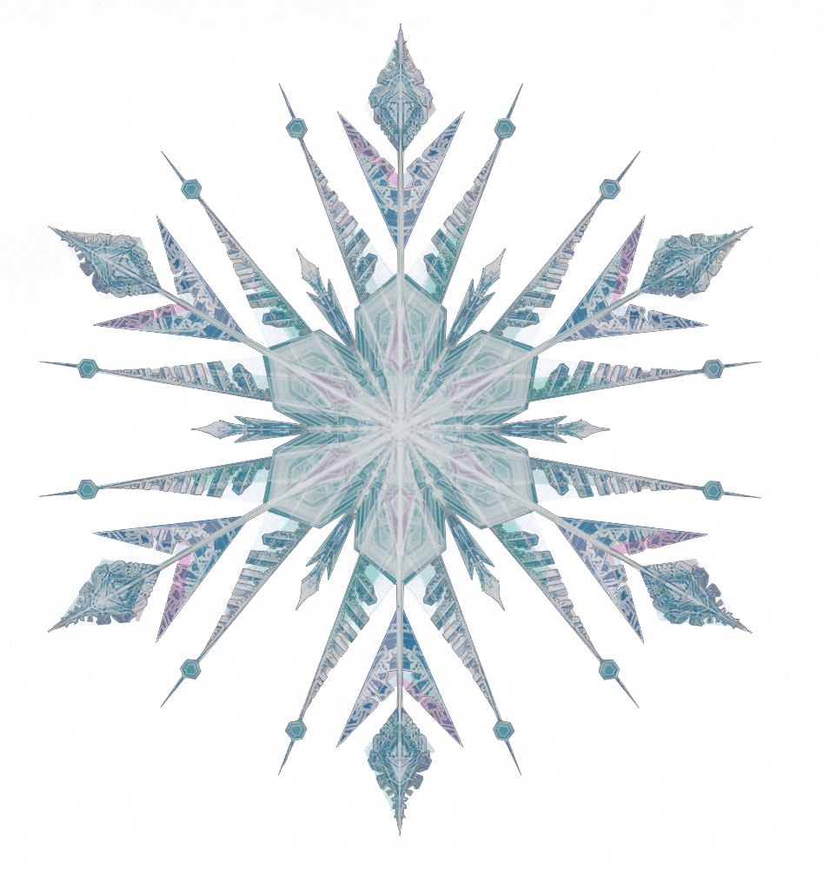
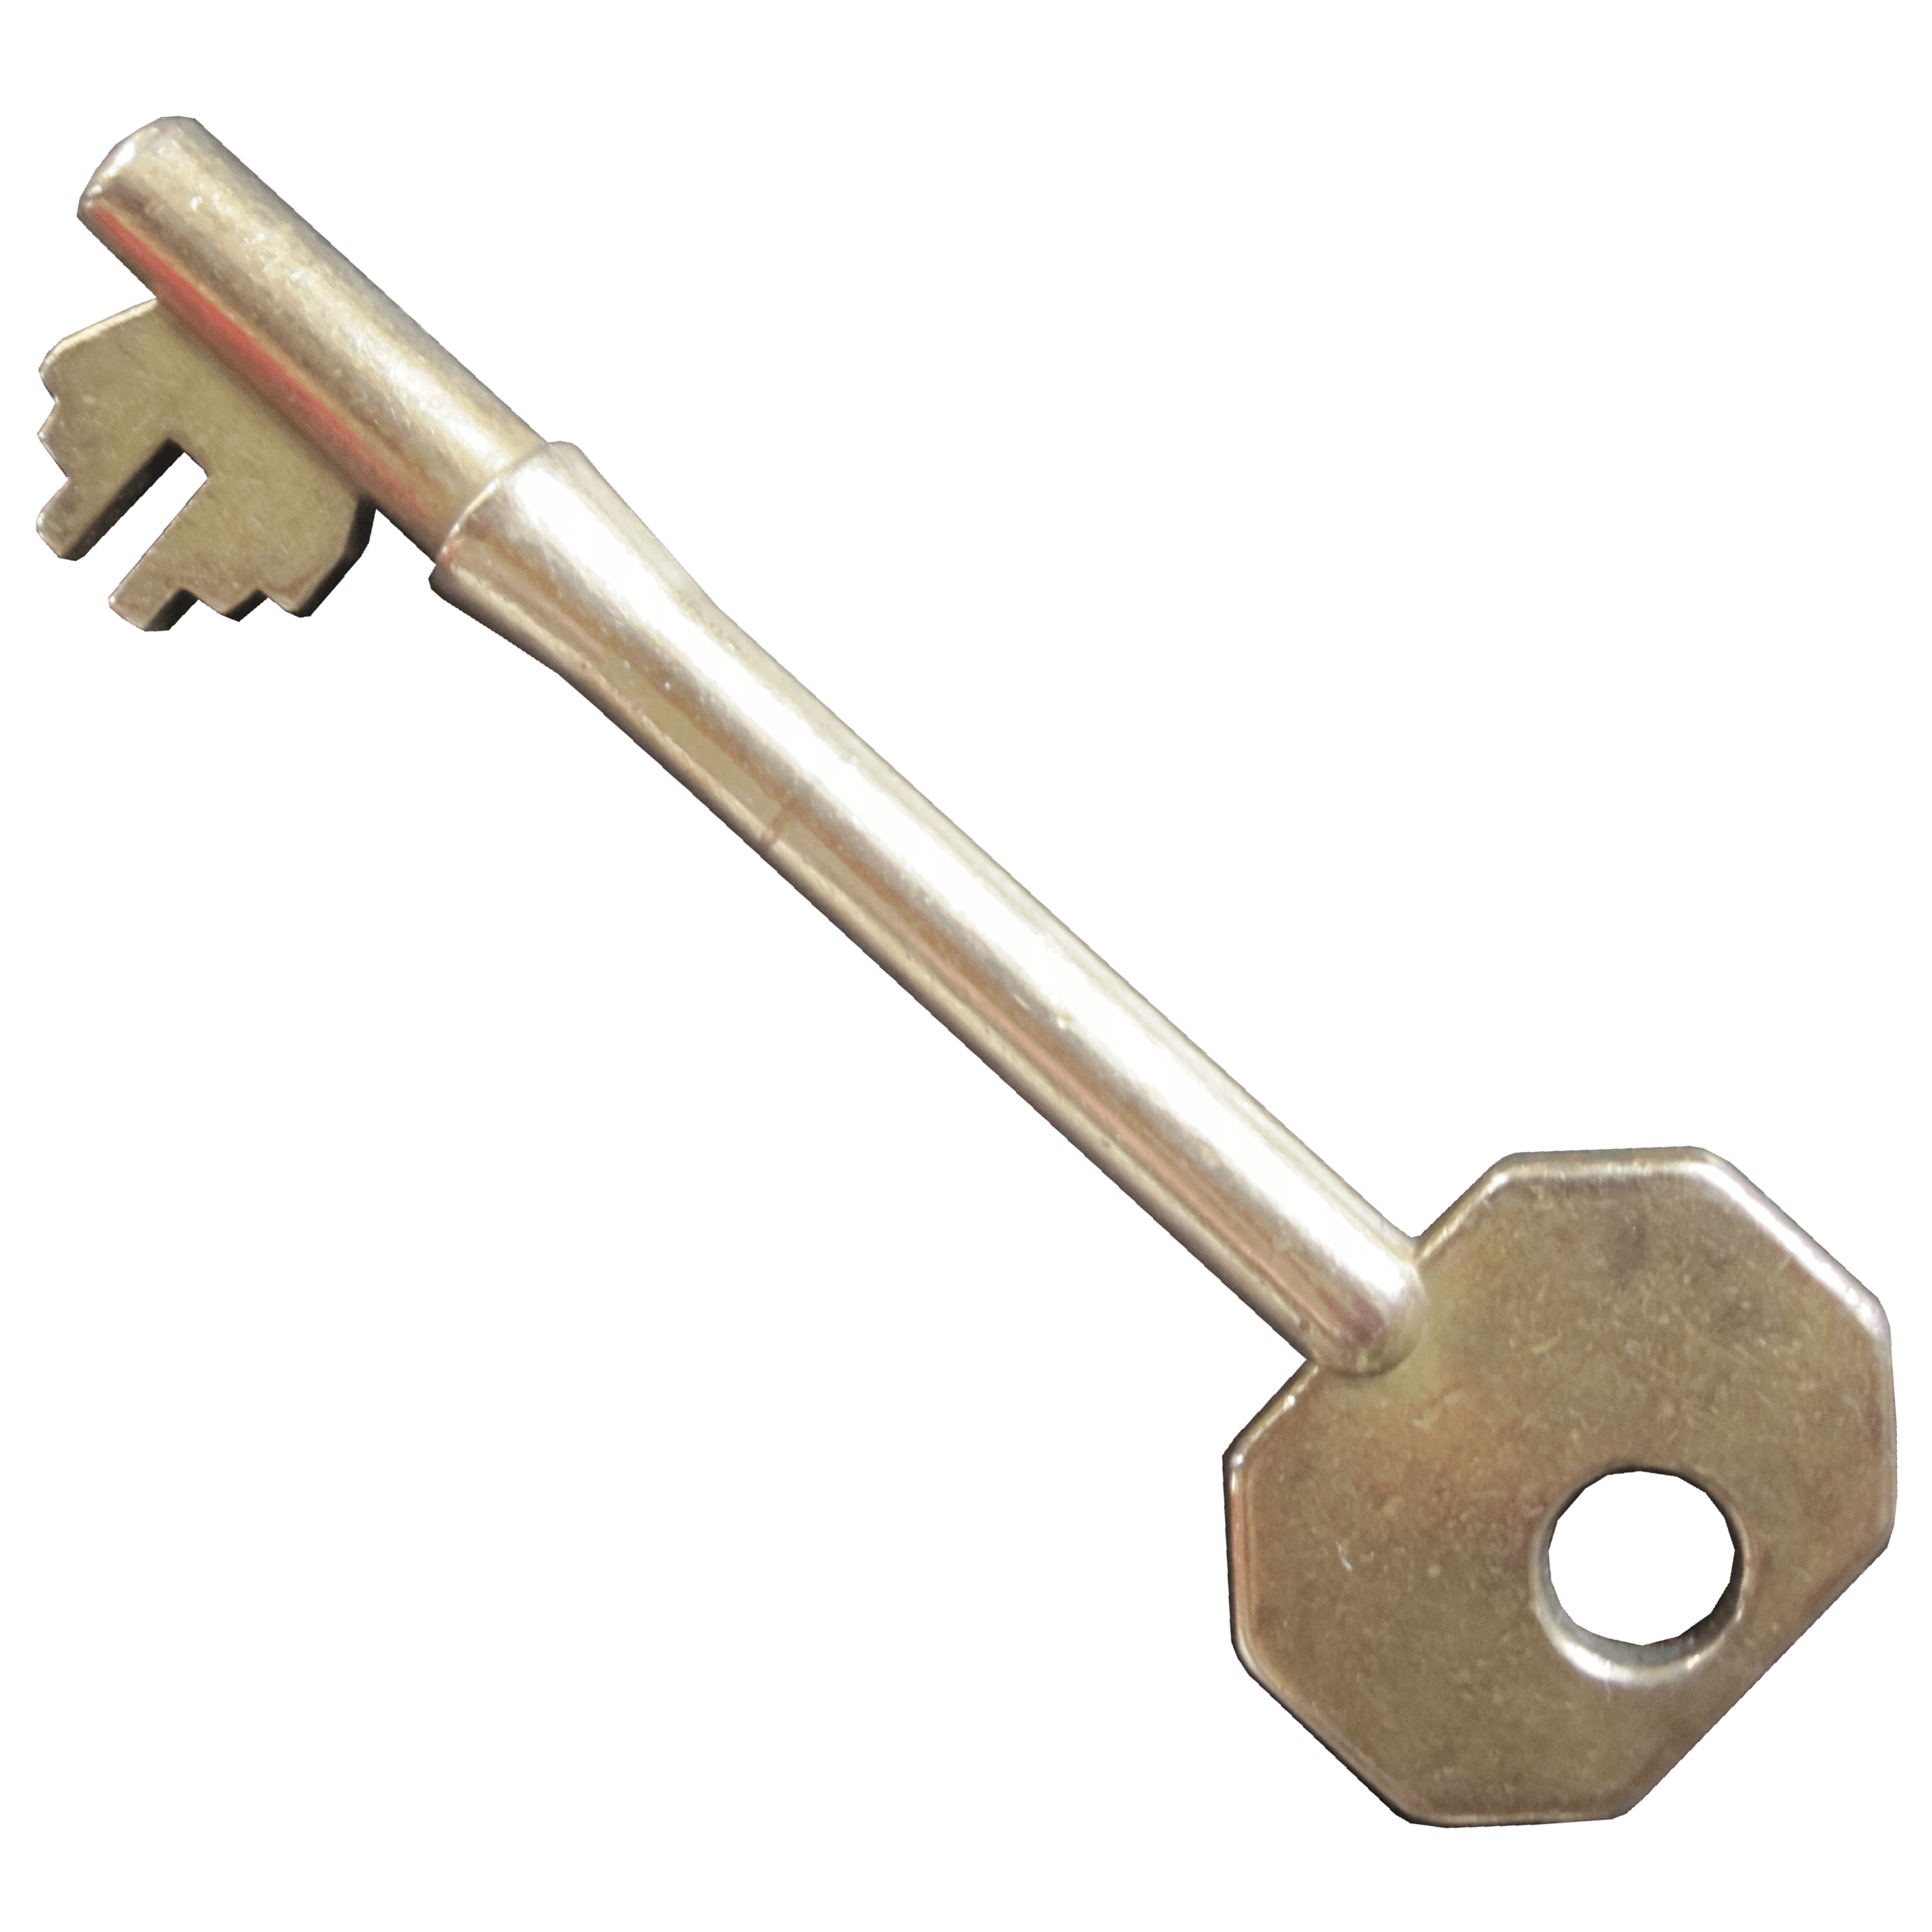
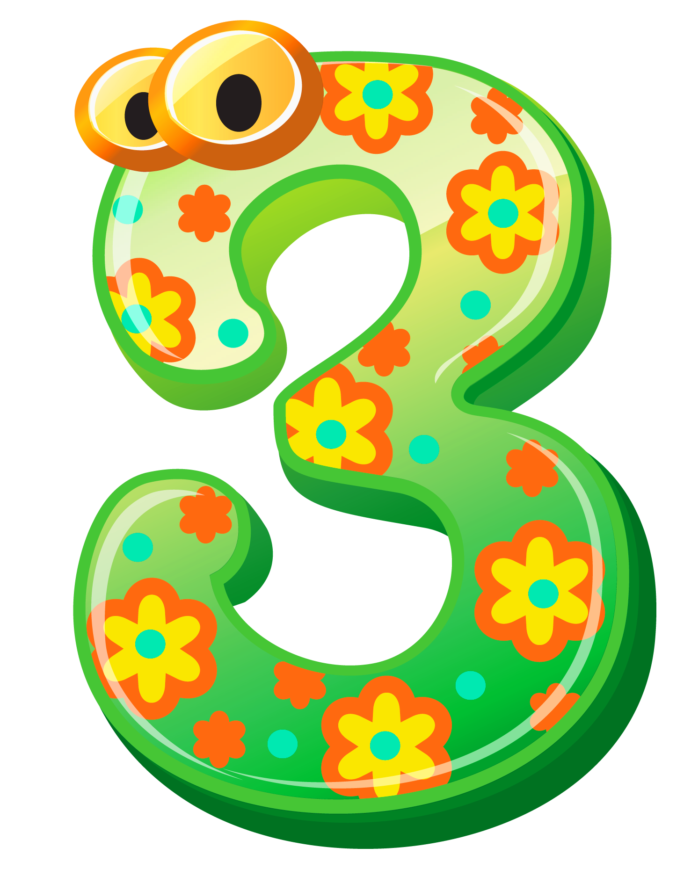
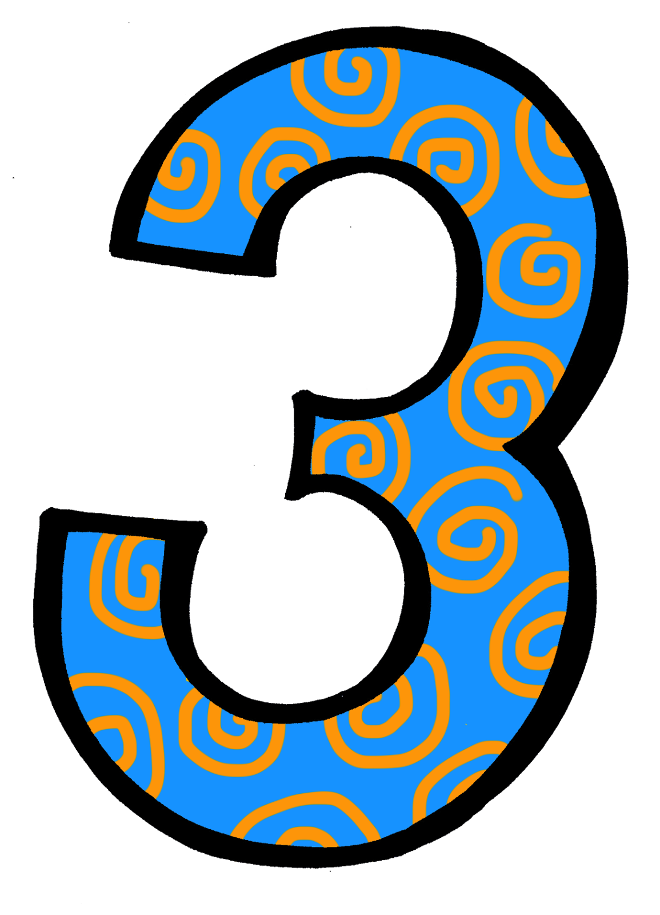
3. Collisions
Multiple keys map to the same array index.
E.g.,
Hash function: add digits in key, then mod by array size
Array size: 7 (a prime)
Key1: 37248
Fn: (3 + 7 + 2 + 4 + 5)%7 = 3
Key2: 63912
Fn: (6 + 3 + 9 + 1 + 2)%7 = 3
There will always be collisions!
How do we deal?
fn

Slide 4
Handling Collisions:
There are many ways to handle collisions, e.g.,
Chaining
linear probing
quadratic probing
double hashing
etc.

Slide 5
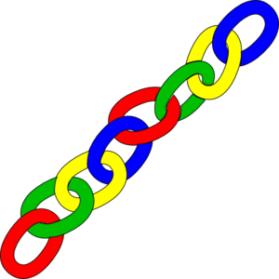
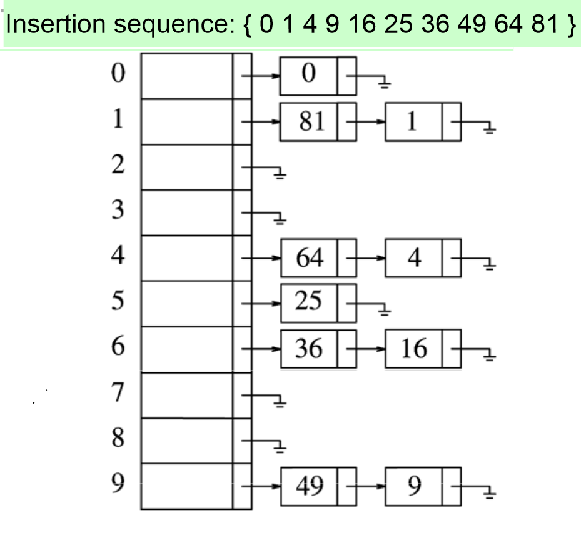
Collisions: Chaining
Make each entry in the hash array be a pointer to a linked list
(You thought we’d escaped pointers for a while, huh).
HashArray is an array of linked lists
Insert values into linked list at index generated from key
e.g., arraySize = 10
H(k) = k % 10
Insert: 0, 1, 4, 9, 16, 25, 36, 49, 64, 81
(I’m just showing the keys (in this example, the insertion sequence) )
Note: you shouldn’t pick 10 as an array size –
it was used for easy demonstration

Slide 6
Chaining downfalls:
A bit more memory because of pointers
Must allocate and deallocate memory (slower)
Linked lists could get long
What if all keys map to the same index or few indices?
Absolute worst-case :
All N elements in one linked list! (so O(n) to find and insert! – bleck, ugh!)
That would have to be one seriously bad hash function!

Slide 7
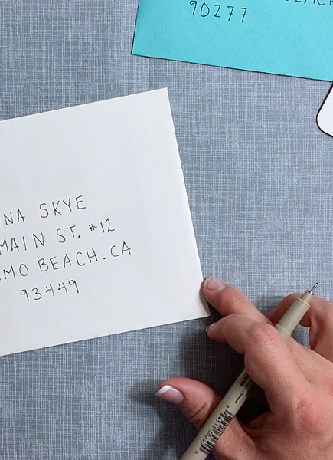
Next: Open Addressing:
Store all elements in the Hash Array
so no pointers to linked list
When a collision occurs, Probe for another empty index in a systematic way
Why systematic? Both insert and find use same method – after inserting, we need to use the SAME method for finding!
We will most likely need a larger Array than for chaining
Why?

Slide 8
Open Addressing: Linear Probing
Hash the key to an index.
If the index is full, look at the next index
If that is full, look at the next index
Continue until an index in the array is empty
Insert key in the empty index
If hit the end of the array, loop back to beginning
Effectiveness?
Insert?
Search?
Easiest approach…
Example: keys being inserted:
23, 32,52,17, 83, 12
Hash function: key% arraysize
(arraysize is 10 – yeah, horrible array size, but easy for examples!)
12
83
52
0 | 1 | 2 | 3 | 4 | 5 | 6 | 7 | 8 | 9
 |  | 32 | 23 | 52 | 83 | 12 | 17

Slide 9
Problems:
Clustering
Keys tend to cluster in one part of the array (see what happened in the example?
Keys that hash into the cluster will be placed at the end of the cluster
Making the cluster even larger
Over time, probing takes longer
The bigger the cluster, the more checks you might have to do to find your key!
And, same with inserting – bigger clusters = more checks before inserting
So clusters are bad!

Slide 10
Open Addressing: Quadratic Probing
Another way of dealing with collisions:
h_{i}(k) = (h(k) + i^{i}) % ArraySize
i is the number of previous insertion attempts
So probe sequence would be:
h(k) + 0, then +1, then +4, then +27, then +64, etc.
Example:
h₀(58) = (h(58) + 0) % 10 = 8 (X)
h₁(58) = (h(58) + 1¹) % 10 = 9 (X)
h₂(58) = (h(58) + 2²) % 10 = 2 (X)
h₃(58) = (h(58) + 3³) % 10 = 5
This helps to avoid the clustering right around the collision (even more spread out)
If many keys hash to the same general location
Doesn’t help a lot when many keys hash to the same index in the hash array

Slide 11
Double Hashing:
Problem: if more than one key hashes to the same index, with linear probing and quadratic probing, the probes follow the same pattern
The sequence of probing after that first hash is based on the index, not on the original key
Fix:
Double-hashing
use a second hashing function if the first one leads to a collision
If collision, probe at:
p(k,i) = h(k) + i*h₂(k) // p is where to probe, k is key, i is number of insertion attempts so far
h is first hash function, h₂ is second hash function
Pick 2 different hashing functions for h and h₂

Slide 12
Example of double-hashing
Example: h(k) is key%arraySize
h₂(k) = 1+(k mod(m))
Make m be a prime number less than the size of the array
E.g., arraysize = 11, m = 7
h2(k) = i+(k mod(m)
Remember: p(k,i) = h(k) + i*h₂(k)
// p stands for where to probe, I is number of insertion attempts, h is hash fn1 and h2 is hash fn2
Example:
h₀(55) = 55%11 = 0
h₀(66) = 66%11 = 0 X (Collision)
H₂ ((66) =(1+k%(m))) = 1 + (66%7) = 4
P₂ (66) = 0 + 1*4 = 4%11 = 4
h₀(11) = 11%11 = 0 X (Collision)
H₂ (11) = 1+k%(m))) = 1 + (11%7) =5
P₂ (11) = 0 + 1*5 = 5%11 = 5
h₀(88) = 88%11 = 0 X (collision)
H₂ (88) = 1+k%(m))) = 1 + (88%7) =5
P₂ (88) = 0 + 1*5 = 5%11 = 5 X (2nd collision)
P₃ (88) = 0 + 2*5 = 10%11 = 10

Slide 13
TakeAways:
Collision Handling
You go through THE SAME hash function and THE SAME collision handling process for both inserting into the hash map and finding
We want both to be relatively efficient.
No matter how awesome our hash function is, we’ll probably have to deal with collisions!
Some ways to deal:
Chaining – make the hash array be an array of linked lists
So when there’s a collision, just stick it into the linked list!
Linear Probling. - Collision at the first index? No problem – just go to the next index over 1. Keep going until you find an empty space and stick your key-values in there! (if you get to the end of the array, go back to index 0)
Quadratic probing – Linear probing could make a huge cluster of used indices. So instead of just going to the next spot over, jump using 1*1, then 2*2, then 3*3 until you find an empty spot in the array
Double hashing – both linear probing and quadratic probing lead to clusters if a lot of keys end up at the same index. What to do? Use a second hashing function when you have a collision!

