Slide 1
AVL: When to Balance
Keeping our Binary Search Tree Balanced!
He be crazy…

Slide 2
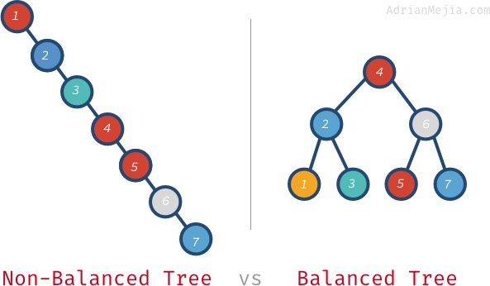
AVL Tree:
Binary Search Tree
Left child’s data is less than and right child’s data is greater than the data in each node
Our goal:
For find, (and insert) we want every choice (go left, go right) to eliminate approximately half the data
So we never have to look at that half of the data
Problem:
If the tree is UNBALANCED, we may eliminate very little data for each choice.
How many nodes?
How many steps to find 7?
How many nodes?
How many steps to find 7?

Slide 3
Balanced Binary Search Tree: AVL Tree
Every Single Node is balanced
left child and right child’s heights differ by no more than 1
Balance changes when heights of nodes change
So worry about balance when:
Inserting data
Removing Data
If an imbalance occurs, We want to immediately rebalance!
Before we do anything else!
Want to systematically and efficiently rebalance
Do not want to traverse entire tree to reestablish balance!!
How? That’s coming!

Slide 4
When to adjust (insertions) example:
AS WE INSERT each node:
Check its balance
The height of the inserted node and the ancestors of that node change.
This means the balance of those nodes can change.
Check the balance of its ancestors
As soon as something becomes unbalanced, we must fix it
So AS the tree is created, balance is systematically and efficiently maintained!
(systematically
and efficiently)!

Slide 5
When to adjust (insertions) example:
Example: INSERTING 4, 7, 9, 8:
Inserting 4:
Balance is okay (there’s only 4, so it’s balanced!)
Inserting 7:
Balance of 7 is 0, balance of 4 is -1, so okay
Inserting 9:
Now we have a problem:
9’s balance is okay (0)
7’s balance is okay (-1)
4’s balance isn’t (-2)
Now we would have to fix before inserting any more data into the tree!
4
4
7
4
7
9

Slide 6
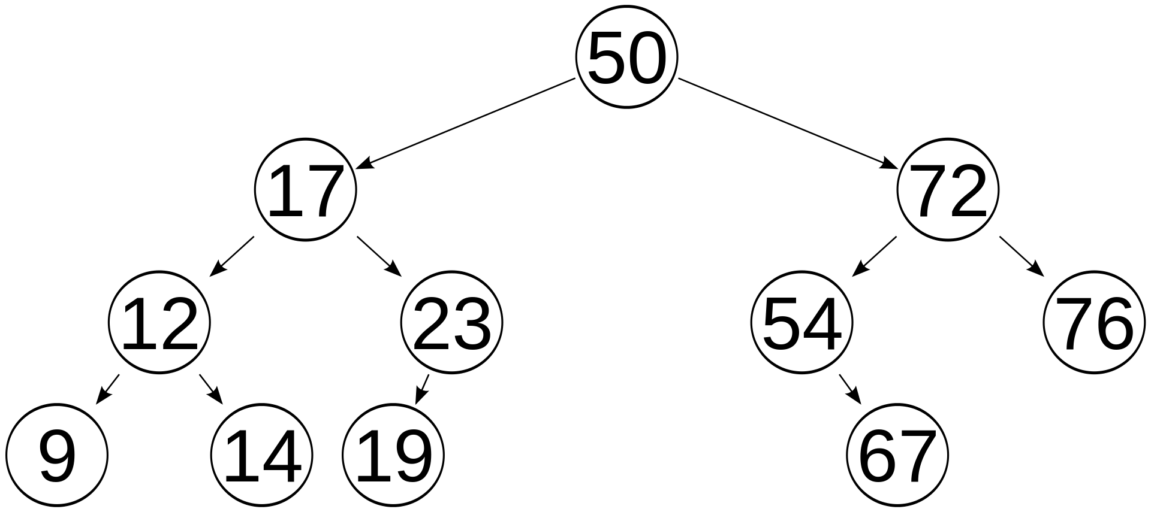
Another Example of when to rebalance:
Inserting may cause tree to become unbalanced
At least one node becomes 2 or –2
Only direct ancestors of inserted node could possibly change height
So after insert, travel up parents to the root, checking balance while updating heights
If a node’s balance (h_{leftchild} – h_{rightchild}) is 2 or –2, adjust tree by rotation around the node
(we’ll learn how to rotate shortly)
In example: we inserted 68 into a balanced tree.
-1
0
2
0
1
-2
0
Ancestors (Nodes whose balance might change)
0
0
0
-1
68

Slide 7
Another Example of when to rebalance:
we inserted 68 into a balanced tree.
Checking ancestors:
67: balance -1 (ok)
54: now unbalanced (-2)
THIS IS THE NODE WE’D FIX FIRST (BY ROTATING)
We’ll see that in the next ppt!)
We don’t worry about 72 until we’ve fixed 54.
WE REBALANCE AROUND THE FIRST ANCESTOR THAT IS UNBALANCED!
We don’t worry about 72 until after we fix 54
How to fix 54 – that’s coming!
-1
0
2
0
1
-2
0
0
0
0
-1
68

Slide 8
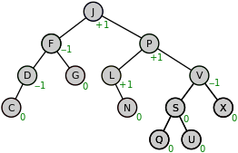
Rebalancing with Remove:
Removing also causes balance issues
If the height of a node can change, the balance of its ancestors can change!
Example: Remove J
Replace with L
P’s left child changes
SO P’S BALANCE CHANGES!!
We must adjust the balance around P before we do anything else!
REBALANCE AROUND THE FIRST ANCESTOR THAT IS UNBALANCED!
I’m gonna say that a lot!
Balance
changed!!!

Slide 9
TakeAways:
We want to maintain a BALANCED binary search tree!
AVL Trees are BST:
Finding, traversing done exactly like for every Binary Search Tree
Balance changes when height of a child changes
Inserting, removing cause height changes
When inserting, removing, check balance of ancestors.
Rebalance the first ancestor that is unbalanced

