Slide 1
Balanced Binary Search Tree
Happy Halloween!

Slide 2
So Far:
Lists:
Find: Worst case takes O(n) (bleh, ugh)
Binary Search Trees:
Each Node has 0-2 successors
For Every Node:
The data in the left child is less than the data in the node
The data in the right child is greater than the data in the node

Slide 3
BST Example
With n being the number of nodes in a tree, and k being the number of levels in the tree:
if n is between 2^{k-1}and 2^{k} (excluding 2^{k}), it will take at most k steps to find any node in the tree
which is O(log n)
Every comparison, should eliminate half of the nodes necessary for future comparison
… if tree is balanced
24
4
36
2
13
29
55
1
3
7
17
32
42
62

Slide 4
This is also a binary search tree (BLEH, UGH!!!)
[1 | 2 | 4 | 7 | 13 | 24 | 29 | 32 | 36 | 42 | 55]
1
2
4
7
13
24
29
This is not balanced.
Every advantage of finding in a binary search tree versus finding in an array/linked list gets obliterated with this tree
There are 11 nodes, and it could take 11 comparisons to find if a number is in the list.
Worst Case: O(n)! (bleh, ugh)
32
36
42
55

Slide 5
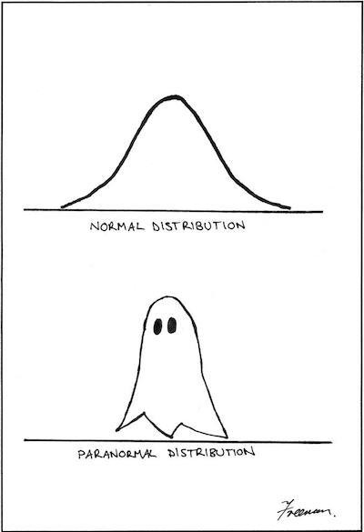
More than one way to maintain a balanced binary search tree.
Red Black Trees
B-Tree
2-3 Tree
AVL Tree
All allow us to insert, delete, and find in O(log₂n)

Slide 6
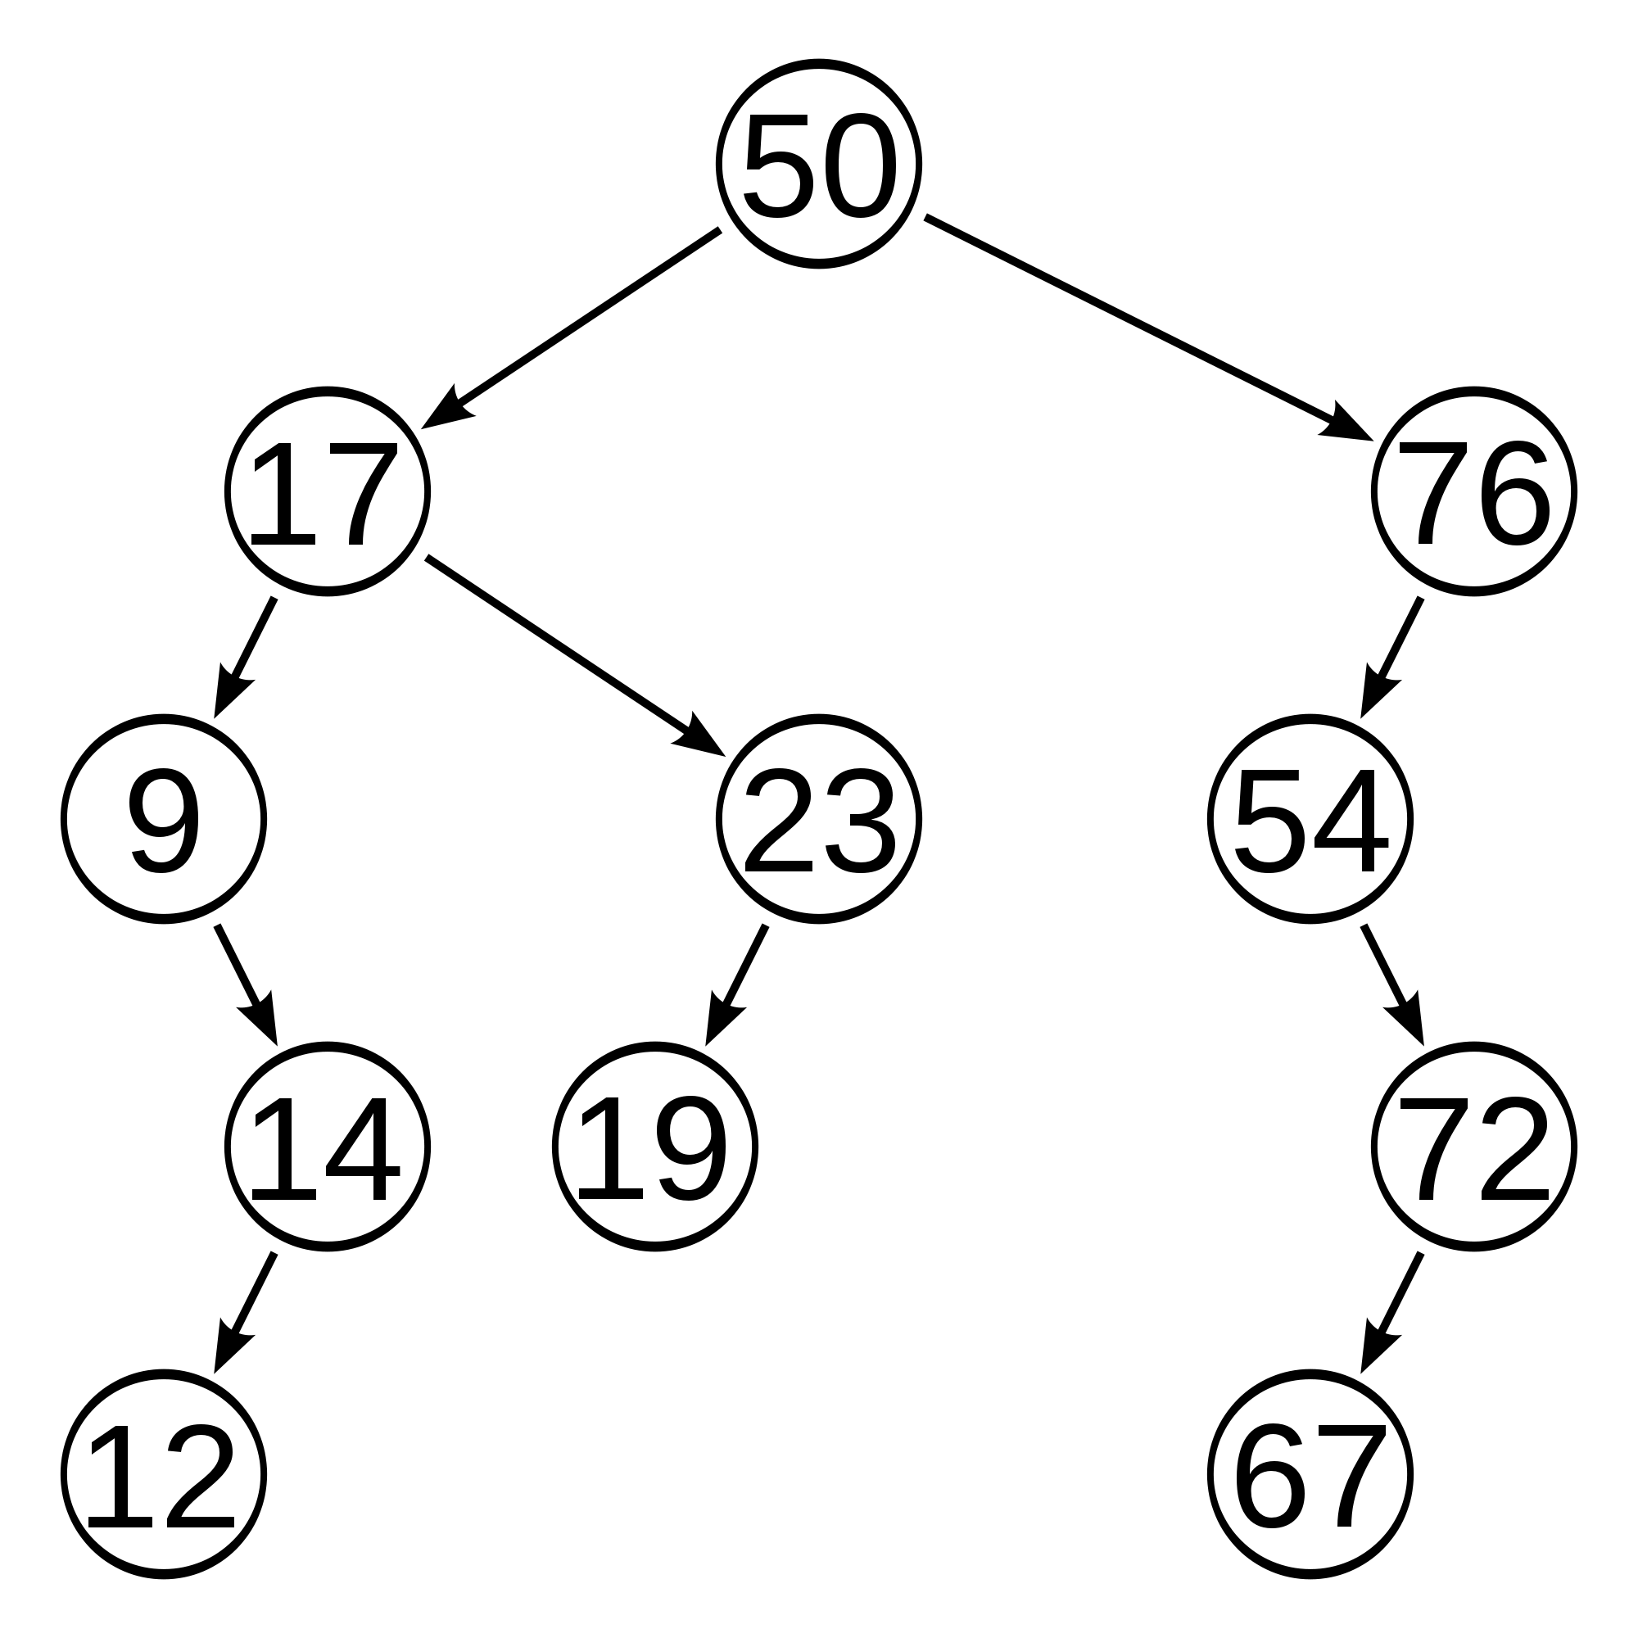
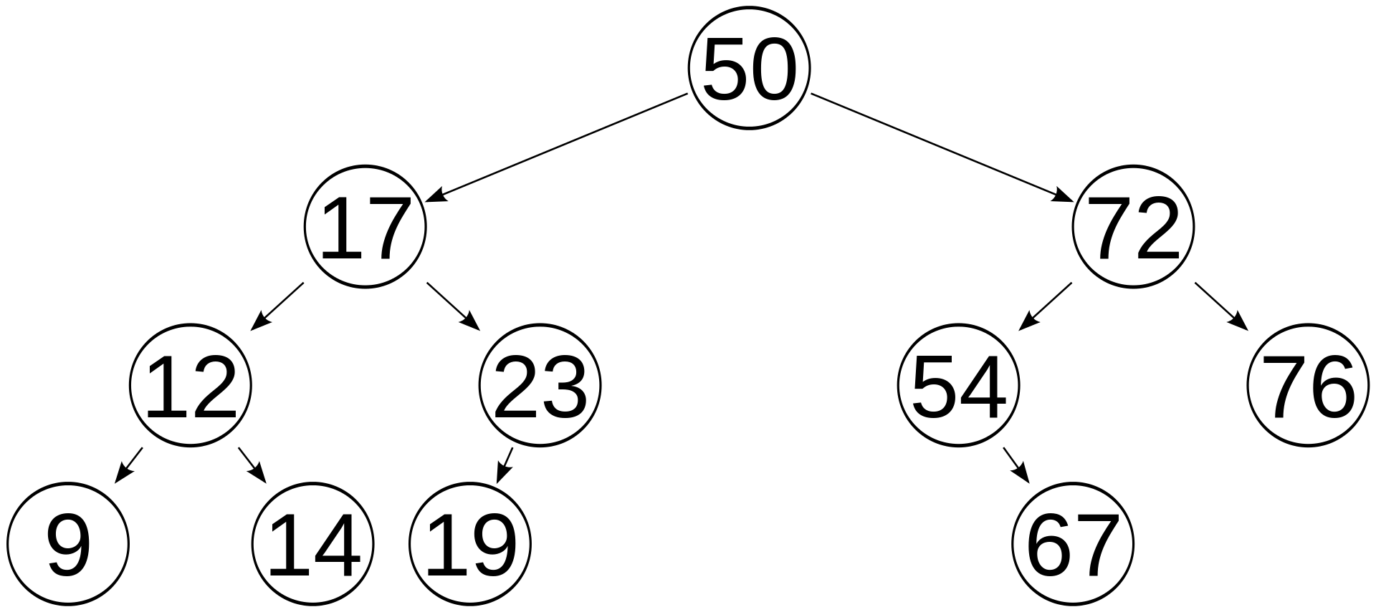
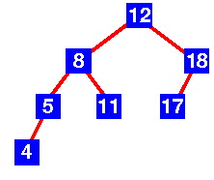
AVL Trees:
AVL Trees: Balanced binary search tree
Named after inventors: Adelson-Velskii and Landis
In AVL Trees, EVERY node is balanced
The height of the left subtree and the height of the right subtree differ by no more than one
------------------------------------------------------0002lk11 1y `gfv5r
YES!
NO!
YES!

Slide 7
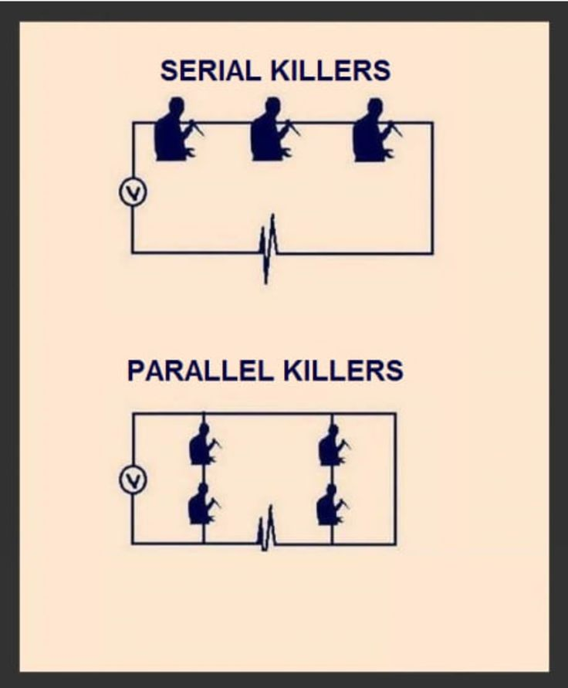
Balance
To find the balance of a node:
Take the Height of the left child
And the height of the right child
Remember, if there isn’t a child, the height is 0
Subtract the height of the right node from the height of the left node
That is a node’s balance
n->leftchild->height - n->rightchild->height
Remember, we see the tree wholistically. The computer sees one node at a time. So we can look at a tree and see that it’s pretty much balanced. The computer has to check one node at a time.

Slide 8
AVL Trees are Binary Search Trees
Find and traversals are done just like with a binary search tree
However, with INSERT and DELETE, we update the heights,
As we update the heights, we must also check the balance of each node
(the ancestors of the node inserted or deleted)
If the balance is off by more than one, then we must act to restore balance!
How? That’s in the next ppt!
0 (3 – 3)
0 (2 – 2)
1(2 – 1)
0 (1 – 1)
1 (1 – 0)
-1 (0 – 1)
0 (0 – 0)
0(0-0)
0 (0 – 0)
0 ( 0 – 0)
0 (0 – 0)

Slide 9
A: What is the height of each node? B: What is the balance of each node? C: Is this an AVL tree? D: What changes if you insert -9
H:4
B:-1
B:0
H:2
H:3
H:3
B:-1
B:1
B:-2
H:1
H:2
H:1
H:2
B:1
B:0
B:0
B:1
-9
H:1
B:0
H:1
B:0

Slide 10
Take-aways!
Many Balanced Binary Search Trees
AVL – balance maintained by keeping track of balance of each node
Balance definition: when the height of the left subtree and the height of the right subtree differ by no more than one
Balance calculated – height of left child – height of right child
Balance Changes when we insert and delete
Because height might change

