Slide 1
AVL: Simple Rotations: Right-Left
Keeping our Binary Search Tree Balanced!

Slide 2
Recap:
To fix an imbalance, you SYSTEMATICALLY and EFFICIENTLY rotate the unbalanced node down a level in the tree, and rotate its heavier child up
The goal: balance the tree in O(log n)
inserting, removing, and finding in O (log n) time
4 types of rotation
Left: (for nodes with balance of -2)
Right: (for nodes with balance of 2)
AND NOW…
left-right:
First, rotating the right child to the right
Then rotating the unbalanced node to the left
Right-left:
First, rotating the left child to the left
Then rotating the unbalanced node to the right

Slide 3
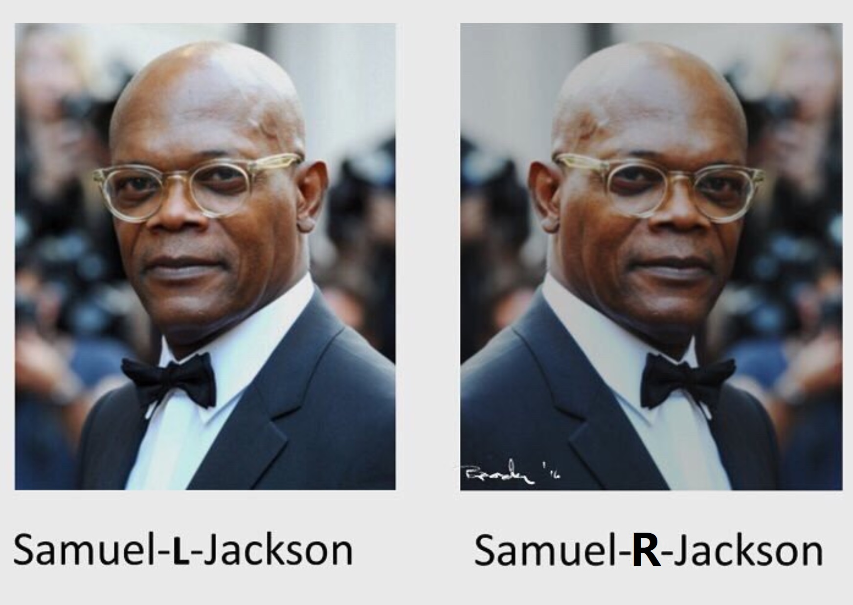
Right-Left Rotation:
See Left-Right rotation
And reverse it

Slide 4
That really is all there is to it.
If you inserted or removed and
If an ancestor has an imbalance of 2 (positive 2)
Check its left child’s balance
If it has an imbalance of -1
YOU MUST DO A RIGHT-LEFT ROTATION
First, rotate left around the left child
Now the imbalanced node’s left child will have a positive imbalance!
Now you can rotate around the original unbalanced node to the right.
VOILA!!

Slide 5
Things that will trip you up when programming AVL Trees:
The heights
Once you’ve rotated, you have to adjust the height of THE NODE rotated down a level first
Then you can adjust the height of its parent
And then you MUST adjust the heights of all ancestors
The parents
Attaching parents properly will be the bane of your existence
(Therapists were right!!!)
If the unbalanced node is its parent’s left child, attach the newly rotated up node to the left of the parent (and make sure you make the newly rotated up node to that parent
If the unbalanced node is its parent’s right child, attach the newly rotated up node to the right of the parent (and attach the node to the parent!)
NULL nodes
A nonexistant (NULL) node does not have a parent, a left child, a right child, or data!

Slide 6
Running time for Removing in an AVL Tree
The same: O(log₂n)!!
Why?
So if you remove, you then have to re-adjust the height of the ancestors of the node you removed
Only the ancestors
So at most one per level
Meaning: at most 1 per level could be unbalanced
You’d have to do a rotation to fix
That’s 3 or 6 (depending on the rotation
But we’re lazy computer scientists – we drop the constants!
That becomes 1
So with n nodes, there are log n levels at which we’d have to do a rotation (worst case scenario)
Which leaves us with O(log₂ n)

Slide 7
Take-Aways:
We’re balancing a binary search tree
When we insert
When we remove
4 types of rotations:
Left (unbalanced Node: -2, right child: -1
Right (unbalanced node: 2, left child: 1
Left-right (unbalanced Node: -2, right child: 1)
Right-left (unbalanced Node: 2, left child -1
For all we are systematically rebalancing
Because we rotate in a constant amount of time and
Because we at most must check or rotate once at each level,
Running time to maintain balance is O(log₂ n)!!!!

Slide 8
Practice Problems

Slide 9
Try: (You just inserted what?)
17
17
12
22
12
20
7
14
20
7
14
19
22
19

Slide 10
Try: (You just inserted what?)
16
16
12
42
12
30
7
14
30
60
7
14
24
42
28
36
60
24
36
28

Slide 11
Try: (What did you just insert?)
20
20
20
32
7
35
7
32
7
3
26
35
3
32
48
3
26
48
34
48
26
34
51
35
51
34
51
Notes:
Stopped here

Slide 12
Try: Make an AVL Tree: 17, 12, 8, 16,13,14
12
13
17
8
12
13
17
12
16
16
8
16
17
13
17
16
8
14
14
14
17
13

