Slide 1
Trees: Intro and Definitions
Moving on from Lists

Slide 2
Lists: the good, the bad!
Lists:
Same type, ordered, allows duplicates, has a size
Good:
Arrays: find the kth value in O(1)!
Linked Lists: push, pop, join in O(1)
Bad:
Finding if k is in the list.
Regardless of implementation, this will, in the worst case, require TRAVERSING THE ENTIRE LIST (weep, moan, groan in agony!) This is O(n) (ugh, blech!)

Slide 3
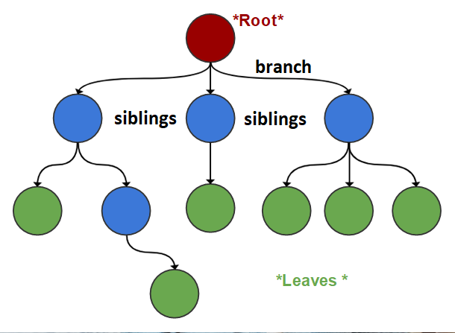
Tree (new ADT)
Terminology:
tree =collection of elements (nodes)
Each node may have 0 or more successors (called children)
How many does a list have?
Each node has exactly one predecessor (called the parent)
Except the starting node, called the root
Branches
Links from node to its successors
Siblings
Nodes with same parent
leaves
Nodes with no children are called

Slide 4
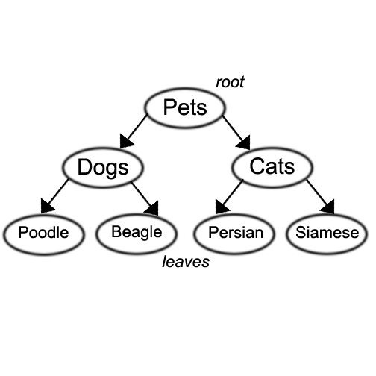
Tree
We also use words like ancestor and descendent
Rabbits
Corgi
Mini Lop
Rex
Pets is the parent of Dogs,Cats and Rabbits
Poodle, Beagle and Corgi are the children of Dogs
Poodle, Beagle, Corgi, Persian, Siamese, Mini Lop, and Rex are descendents of Pets,
Pets is the ancestor of Corgi, Poodle, Beagle, Persian, Siamese, Mini Lop and Rex

Slide 5
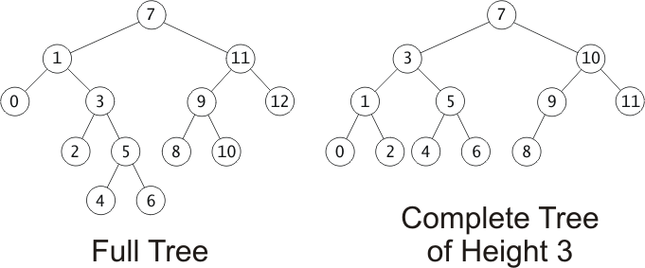
Tree Terminology
Depth of a node:
A measure of its distance from the root:
Depth of the root = 0
Depth of other nodes = 1 + depth of parent (recursive def!!!)
Height of a node:
The node’s maximum distance from its leaf
Calculate: find the height of each child, whichever has the larger height, add 1 to that
So: Max height of a node’s children + 1
e.g., height of 6 is 1, height of 3 is 3, height of 1 is 4
(Again, recursive definition!!! Starting to see a theme???)
We will be more concerned with height!
Subtree of a node:
A tree whose root is a child of that node
Green, blue, and red are all subtrees of tree with 7 as root!
Depth
1
2
3
4

Slide 6
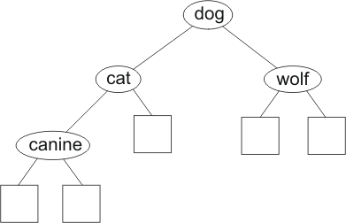
Binary Trees
Subset of trees
Binary tree: a node has at most 2 nonempty subtrees
Set of nodes T is a binary tree if either of these is true:
T is empty
Root of T has two subtrees, both binary trees
(Notice that this is a recursive definition)
This is a
binary tree

Slide 7
Fullness and Completeness (for binary tree):
Trees grow from the top down
New values inserted in new leaf nodes
In a full tree, every node has 0 or 2 non-null children
A complete tree of height h is filled up to depth h-1, and, at depth h, any unfilled nodes are on the right.

Slide 8
Takeaways:
Tree: New ADT
Each node in a tree has:
only one parent
Root: no parent – starting point in trees
0 or more children
Height of a node:
Take the height of each of a node’s children , find the max, and add 1
Leaves have a height of 1
Binary tree – subset of trees
In this case every node has 0, 1, or 2 children
No more than 2!
Full tree – each node has 0 or 2 children (no node with 1 child)
Complete tree – each LEVEL has all possible siblings
Except bottom level (leaf level) which has all possible siblings from the left over to the right.

