Slide 1
TreeTraversal

Slide 2
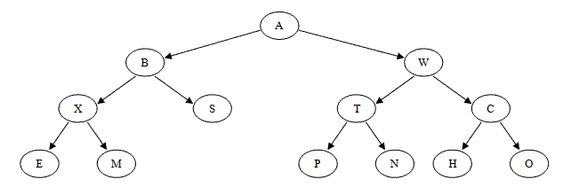
Traversals of Binary Trees
Arrays: iterate through an array by increasing index.
Linked lists – traverse by following next addresses in each node.
Trees?
How do you make sure you hit every node once and only once?
tree traversal – walking through tree and visiting all nodes once

Slide 3
Node Class Definition for a Binary Tree:
class NodeT {
int data;
NodeT *left; //left child
NodeT *right; // right child
NodeT *parent; //NULL for root of tree
//optional:
int height;
// height up from lowest descendent leaf
public:
NodeT(int x);
~NodeT();
void printNodeT();
};

Slide 4
Traversals of Binary Trees
tree traversal
Three kinds of binary tree traversal:
Preorder e.g., copying
Inorder – e.g., bst (more later)
Postorder –e.g., deleting or freeing nodes
order in which we visit the subtree root with respect to its children
Why do we worry about traversing in different orders?
Trees store data – we may want to find or represent data in different ways depending on the data and the solution we are looking for
NOTE: WE ALWAYS START AT THE ROOT!

Slide 5
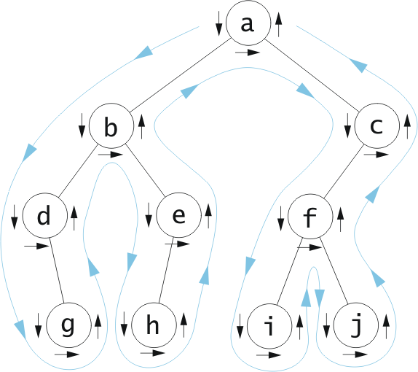
Tree Traversal: Preorder
Used for copying:
Visit root,
traverse left,
traverse right
You want to make a copy of the parent before you can make a copy of either of its children. So you can connect everything!
Preorder:
a, b, d, g, e, h,
c, f, i, j

Slide 6
Tree Traversal: Preorder
Visit root,
traverse left,
traverse right
NOTE: As soon as you get to a child, it immediately becomes the new parent (of the rest of the subtree)
So A is parent (and root, and thus starting node). Visit a, go to left child.
Now b is the parent (of the subtree). Visit b, go to its left child d.
Now d is the parent – it is visited.
Go to left (NULL)
Go to right child g, it becomes the parent
G has no left child, has no right child, d has already been visited…
Go to b’s right child, e, which becomes the parent – it is visited.
E’s left child is h, becomes the parent, is visited.
H has no left, no right.
Go to e’s right, nothing.
Now the b subtree has been visited, so go to A’s right child (c). It becomes the parent and is visited.
Go to C’s left – f becomes the parent and is visited.
Go to F’s left – I is the parent and is visited
I has no left, no right,
Go to F’s right
J becomes the parent and is visited.
Try going to c’s right.
We’re done!
I wrote it all out…
Preorder:
a, b, d, g, e, h,
c, f, i, j

Slide 7
Tree Traversals: InOrder
Used with BST: (again, it’s coming!)
Traverse left (go till no more lefts),
visit root,
traverse right (always go to the left if there’s a left)
Again, as soon as you visit a node, it becomes the parent (so, in this case, you don’t visit it until there are no more left children!)
InOrder
(left, center, right)
d, g, b, h, e, a, i, f, j, c

Slide 8
Tree Traversal: Postorder
Used for deleting:
Traverse left,
traverse right,
visit root
Again, as soon as you visit a node, it becomes the parent (so, in this case, you don’t visit it until there are no more left or right children!)
Postorder:
(left, right, parent)
g, d, h, e, b,i, j, f, c, a

Slide 9
Pre? In? Post?
36
16
48
15
21
40
11
23
44
41
PRE: 36 16 15 11 21 23 48 40 44 41
IN: 11 15 16 21 23 36 40 41 44 48
POST: 11 15 23 21 16 41 44 40 48 36

Slide 10
Given this code, what is printed out?
void BST::printTreeio(NodeT *n) { //recursive!!!! function
if (n == NULL) {
return;
}
else {
printTreeio(n->left);
n->printNode();
printTreeio(n->right);
}
}
36
16
48
15
21
40
Aside: yeah, you could write this using while loops. Feel free to try! …I’m not going there!!!
11
23
44
41

Slide 11
Takeaways:
Tree traversal: visiting each node once and only once!
Start traversal AT THE ROOT!
3 ways to traverse:
Each serves a different purpose
Preorder: for copying a tree
Visit the parent, then left child, then right child
InOrder:
Visit left child, then parent, then right child
PostOrder: for deleting a tree
Visit left child, then right child, then parent

