Slide 1
Binary Search Tree Height

Slide 2
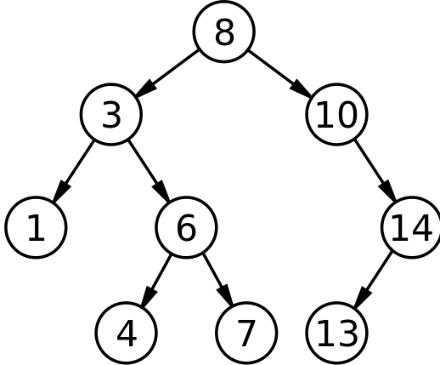
Binary Search Tree Node Heights:
Every leaf’s height is 1
Null is considered to have a height of 0
Every node’s height is the maximum of its two children’s height, plus 1.
Why do we care about height??
That part is coming. Trust me. You’ll care!)
(It has to do with maintaining an efficient tree…which I promise will make more sense later!)
H:4
H:3
H:3
H:1
H:2
H:2
H:1
H:1
H:1

Slide 3
Heights of nodes updated:
The only time the height of a node is changed is either:
when a descendent is added
When a descendent is removed
NOTE: when a node is added or deleted, only its ancestors’ heights need to be updated (parent, grandparent, great-grandparent, etc.)
Siblings, descendents, other unrelated tree nodes – their height does not change!
We only need to worry about the ancestors!
Aside: this is one example of why having a pointer to a node’s parent is useful

Slide 4
Inserting a Node: Updating Heights:
When you insert:
ONLY THE NODES THAT ARE DIRECT ANCESTORS might have their heights affected.
E.G.: Add 5
Height of 5 is 1
Nodes whose height might be affected:
4,6,3,8
Nodes that we never have to look at:
7,1,13,14,10
Only direct ancestors can have heights that are affected.
To determine the height of a node:
Max of the height of two children + 1
Updating?
H:4
H:3
H:3
H:1
H:2
H:2
H:1
H:1
H:1
5

Slide 5
Updating height of nodes after insert:
Insert node (height = 1)
Go to parent
Pick max of height of left and right child, and add 1
If this height is the height of the parent, you can stop.
Means the height of the parent was determined by the other child
Means that no other ancestors’ heights will change
Otherwise update the height of the parent, then repeat this process for its parent.
Stop when either the height doesn’t change, or the root is hit (root does not have a parent
H:4
H:5
H:4
H:3
H:3
H:3
H:1
H:2
H:2
H:3
H:2
H:1
H:1
H:1
H:2
H:1
H:1
H:1
5
5
H:1

Slide 6
Heights also updated after remove:
H:5
3 cases for removal:
Removing a node with no children (a leaf) (e. g., 1)
Removing a node with one child (e.g., 14)
Removing a node with two children (e.g., 6)
H:4
H:3
H:1
H:3
H:2
H:2
H:1
H:1
5
H:1

Slide 7
Heights also updated after remove:
Case 1: No Children
Removing a node with no children (a leaf) (e. g., 1)
Only ancestors must be checked:
Now 3’s left child has a height of 0
the height of 3 is the max of 0 and 3 (3) +1, or 4
Height of 3 doesn’t change, so you don’t have to change 8
Can stop checking when height doesn’t change
H:5
H:5
H:4
H:4
H:3
H:3
H:3
H:1
H:2
H:3
H:2
H:1
H:2
H:1
H:2
H:1
H:1
H:1
5
H:1
5
H:1

Slide 8
Heights also updated after remove:
Case 2: One Child
Removing a node with one child (e. g., 14 in previous tree)
Bypass 14
10’s left child becomes 13
13 is BELOW the node being removed, so its height doesn’t change.
Update 10: Max of left child (0) and right (1) + 1, so 2
Check 8: 8 is max of 3s height (4) and 10s height (2) + 1, or 5
Doesn’t change
This is the root, but if it wasn’t you could still stop checking the ancestors because 8’s height didn’t change
H:5
H:5
H:4
H:4
H:3
H:2
H:1
H:3
H:1
H:3
H:1
H:2
13
H:2
H:1
H:2
H:1
H:1
5
H:1
5
H:1

Slide 9
Heights also updated after remove:
Case 3: Two Children
Removing a node with 2 children (e. g., 6)
Must replace (I did right-most of left subtree)
So replacing with 5
Must REMOVE 5
5 has no children, so repeat the process for no children
Check 4, 5, 3, and then 8
(See next slide for updated heights)
H:5
H:5
Before updating heights, after remove
H:4
H:4
H:2
H:2
H:1
H:3
13
H:1
H:1
5
H:3
13
H:1
H:2
H:1
H:2
5
H:1
H:1

Slide 10
Heights also updated after remove:
Case 3: Two Children
Removing a node with 2 children (e. g., 6)
Must replace (with right-most of left child)
So replacing with 5
Must REMOVE 5
5 has no children, so repeat the process for no children
Check 4, 5, 3, and then 8)
H:5
H:1
H:4
after updating heights
H:4
H:3
H:2
H:2
H:1
5
H:3
13
H:1
5
H:2
13
H:1
H:2
H:1
H:1
H:1

Slide 11
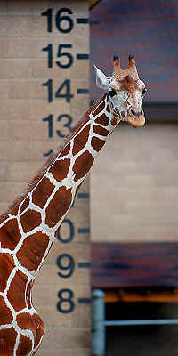
Height Takeaways:
We want to keep track of node heights
Height of leaf: 1
Height of every other node: max of height of 2 children, then add 1
When you add a node:
Update height of direct ancestors only!
Stop when height of an ancestor doesn’t change
Means the height was determined by the other child
Which means all other ancestors’heights will be more affected by that height as well
When remove a node:
Update height of ancestors only!
Ancestors of the node that is moved up

