Slide 1
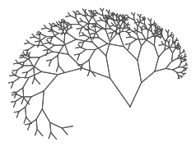
Binary Tree (Intro)

Slide 2
ADT Tree: Review
Trees: made of nodes
One type of data (like lists)
Each Node in a tree has:
0 or more children (successors)
Each node can have many children!
1 parent (predecessor)
Except tree’s root: 0 predecessors
Root is start of a tree

Slide 3
Binary Tree: Review
Subset of Trees
Each Node in a BINARY tree has:
0, 1, or 2 children(successors)
1 parent (predecessor)
Except tree’s root: 0 predecessors
Root is start of a tree

Slide 4
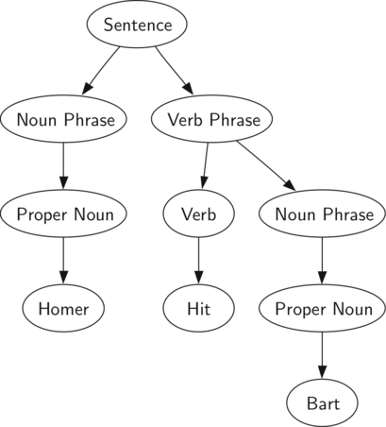
Examples of Binary Trees:
Sentence parsing
Huffman Code:
Seriously cool method for coming up with a compressed data encoding scheme
Basic idea: (Alphabet is easiest example):
Before Huffman code: each character is represented with 8 bits.
But e occurs much more frequently than z
Wouldn’t it make sense to make the e have a 3 or 4 bit representation, even if the z had to have, say, a 13 character representation?
Huffman code systematically takes any data set and figures out a representational code, such that the data that occurs most frequently has the shortest bit representation, and those that occur the least frequently have the most bits for representation
Cool part: None of the short bit representations are prefixes to the longer bit representations!!!!
E.g.,
If e is represented as 101
NO OTHER letter’s bit representation starts with 101!
Maybe z would be 1101011101001
The first 3 bits of ALL other characters are NOT 101
So you can store 1011101011101001101
And know that that is eze!
Decision trees
You’ve probably seen these:
E.g., running shoes:
Running Shoes
 |  | Do you run more than 15 miles per week?
 | Yes |  |  | No
 | Do you have flat feet? |  |  | Does style matter to you?
Yes |  | No | Yes |  | No

Slide 5
Node Class Definition for a Binary Tree:
class NodeT {
int data;
NodeT *left; //left child
NodeT *right; // right child
NodeT *parent; //NULL for root of tree
//optional:
int height;
// height up from lowest descendent leaf
public:
NodeT(int x);
~NodeT();
void printNodeT();
};

Slide 6
Binary Tree TakeAways:
Subsets of Tree ADT
Each node only has 0, 1, or 2 children
Trees can have 0 or more children
Each node has a left child, a right child, and a parent
Each node may also have a height
(max height of its 2 children + 1)
Leaves (no children) have a height of 1
Examples of binary trees:
Huffman code (just so cool!)
Decision trees:
a boatload of online quizzes are decision trees
Sentence parsing

