Slide 1
Binary Search Tree
Subset of ADT Trees!

Slide 2
Picture this:
We have a data set:
The Data set will be changing regularly.
We will be adding and removing data somewhat regularly
Okay, we can do that using push and pop in a linked list
O(1) – YEAH!
BUT
We also want to find data regularly
We’ve got arrays:
O(n) to find if x is in the data set (BOO, UGH!)
We’ve got linked lists
O(n) to find if x is in the data set (BOO, UGH!)
Oh NO!!! HORRORS!!! What are we to do???

Slide 3
Fear Not! There’s a Data Structure for that!
Binary Search Trees:
Subset of TREES
Each node has 1 parent and 0 or more children
1 Node (the root) has no parents (it’s sad, I know).
This is the starting point.
Subset of Binary Trees
Each node has 1 parent and 0-2 children
1 node (the root) has no parents (still sad…)
This node is the starting point
Binary Search Tree adds:
For EVERY node, the left child’s data is less than the parent’s data, and the right child’s data is greater than the parent’s data
This means everything to the left is less than the parent, and everything to the right is greater than the parent.

Slide 4
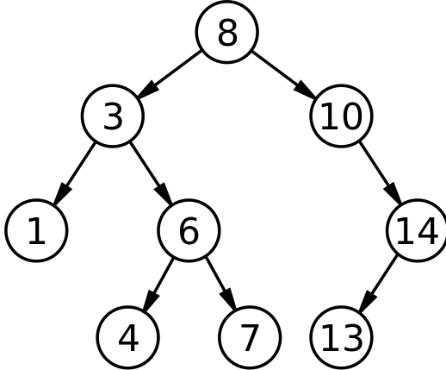
Binary Search Tree:
A tree in which:
the data in every left node is less than the data in its parent
the data in the right node is greater than the data in its parent.
Inserting/Finding Data:
Start at the root!!!!!:
Data is inserted(found) by comparing the new data to the root’s data
Go to the left child if the data to be found (DTBF) is less than the root’s data
Go to the right child if the DTBF is greater than the root’s data
The child, in essence, becomes the root of the subtree
I smell a recursive definition…
Repeat 1-3 until:
data is found or
the child is null
If inserting, the data is inserted here
If finding, data not in tree

Slide 5
Binary Search Tree Find Example:
So Finding 4:
Start at 8 (always start at the root!)
4 is less than 8 (go left)
Go to 3
4 is greater than 3 (go right)
Go to 6
4 is less than 6 (go left)
Go to 4
4=4
FOUND!!!
<- left (For the directionally challenged (like me)) right ->

Slide 6
Binary Search Tree Inserting Example:
Inserting 12: (Trick – must stop BEFORE hitting NULL node!!)
Start at 8 (always start at the root!)
12 is greater than 8 (check right for NULL)
Go to 10
12 is greater than 10 (check right for NULL)
Go to 14
12 is less than 14 (check left for NULL)
Go to 13
12 is less than 13 (check left for NULL)
13’s left child is NULL
Make a new node (12), and
Make 13’s left child point to the new node (12)
Make new node 12’s parent point to 13
<- left (For the directionally challenged (like me)) right ->

Slide 7
Binary Search Tree
Inserting: 17, 13, 26,12, 15, 11, 14, 28, 33, 32
(always insert in order data comes in, so 17, then 13, then 26, etc.)
17 will be root!
(by default, 32 will be a leaf)
17
13
26
12
15
28
11
14
33
32

Slide 8
BST: Inserting pseudocode:
Bool InsertIt(int x): // iterative version
if root is NULL:
set root to new Node, with data x
else {
set n to be the root
while n is not NULL {
if x < n’s data
if n’s left child is NULL
set n’s left child to new Node with data x
set the new node’s parent to be n;
return True
otherwise set n to be n’s left child
else if x > n’s data
if n’s right child is NULL
set n’s right child to new Node with data x
set the new node’s parent to be n;
return True
otherwise set n to be n’s right child
else return false; //x already in tree
}
}
Bool InsertRec(int x, Node n): // recursive version
if n is NULL:
set root to new Node, with data x
else {
if x < n’s data
if n’s left child is NULL
set n’s left child to new Node with data x
set the new node’s parent to be n;
return True
otherwise call InsertRec with x and n’s left child
else if x > n’s data
if n’s right child is NULL
set n’s right child to new Node with data x
set the new node’s parent to be n;
return True
otherwise call InsertRec with x and n’s right child
else return false;
}
}

Slide 9
Binary Search Tree Class (header file):
#include "NodeT.hpp“ // for the tree nodes – see previous powerpoints on binary trees!
class BST {
NodeT *root;
public:
BST() ;
bool insert(int x);
bool find(NodeT *n);
void printTreeio(NodeT *n);
void printTreepre(NodeT *n);
void printTreepost(NodeT *n);
bool remove(NodeT *n, int x); //coming
void removeNode(NodeT *parent, NodeT *child, bool isLeft); //coming
~BST();
};

Slide 10
And, btw (tree traversal):
Rememer In-Order traversal of trees?
Left child, then parent, then right child?
Is the tree to the left a binary search tree? (hint: yes, it is)
If we did an in-order traversal, what order would the nodes be visited in?
9,12,14,17,19,23,50,54,67,72,76
(Notice anything?)

Slide 11
Take-aways!
Binary Search Tree:
Subset of Trees and then of Binary Trees
New addition:
Left child’s data is less than the parent’s data
Right child’s data is greater than the parent’s data
Inserting/Finding
Starting at root
If Data to Find/Insert is less than root, go to left child
If Data to find/insert is greater than root, to the right child
That child becomes new root
Repeat until you:
Find data
Approach a null child
If inserting, insert there.

