Slide 1
Run Time Analysis
Of Binary Search Tree

Slide 2
Remember find?
Lists:
Linked Lists: O(n) Ugh, blech!
Arrays: O(n) Ugh Blech!!
What about the Binary Search Trees we’ve seen?
Does it consistently take less time to find data in a Binary Search tree?

Slide 3
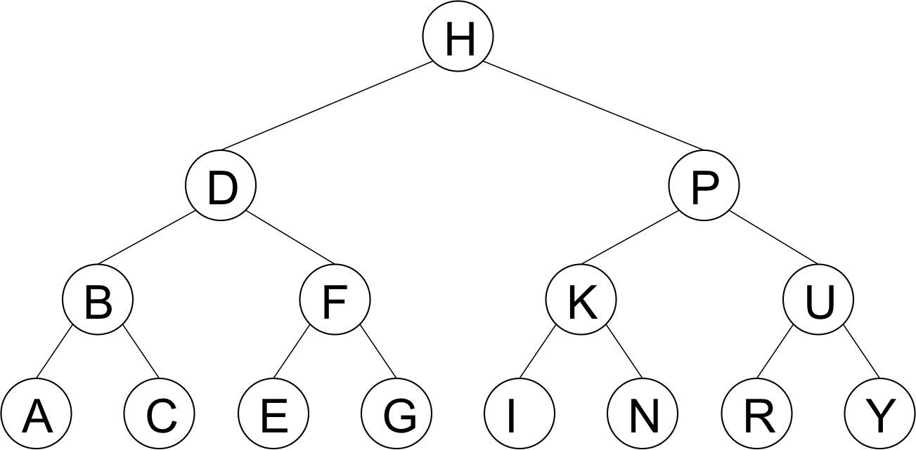
How many steps?
How many comparisons to find if 12 is in the tree?
How many nodes in the tree?
The number of nodes is 7, and the number of levels is 3
How many comparisons to find if R is in the tree?
How many nodes in the tree?
The number of nodes is 15, and the number of levels is 4
That’s an l, like llama!
The number of nodes is n, and the number of levels is l
The relationship between the number of nodes and the number of levels is: for l levels, the number of nodes n will be between 2^{l-1} and 2^{l} (not including 2^{l})
Thus given n nodes, there will be at most l steps to find a node

Slide 4
How ‘bout this one?
How many comparisons to find if 1600 is in the tree?
How many nodes in the tree?
The number of levels is 5, and the number of nodes n is between 2^{l-1} and 2^{l} – what’s n?
NOTICE: The number of the nodes DOUBLES each time we add a layer – the number of
Comparisons to find a node only INCREASES BY 1!!!!! Woah!!!!

Slide 5
Analysis:
If a binary search tree has 2044 nodes, in the best case, how many levels does it have?
11
How many steps (at most) to find any node in the tree (best case)?
11
If a tree has 8100 nodes, at most it will take 12 steps to find anything in the tree (12 levels) to the tree)
If a tree has 1048570 nodes, at most it will take 20 steps to find anything in the tree (20 levels)
If a tree has 2,147,483,640 nodes, it will take at most 31 steps to find/insert/remove anything in the tree.
WOW! This is seriously better than O(n)!!!
Can you see how, the more nodes, the bigger the savings for finding/inserting/deleting from a binary search tree?
Note: if, whenever the size of the data doubles, the amount of work only increases BY 1, the run time analysis is log₂n

Slide 6
Create a tree by inserting the following data
[1 | 2 | 4 | 7 | 13 | 24 | 29 | 32 | 36 | 42 | 55]
1
2
4
Is it a binary search Tree?
Yes!
Every node has 0-2 children.
For every node, the left child is less than the parent (or NULL) and the right child is greater than the parent (or NULL)
There are 11 nodes in this tree: How many comparisons to find 55 in this tree?
11 (UGH!!!)
What did we just learn about binary search trees and efficiency?
(Sigh. We’re back to Ugh. Blech. O(n))
Can’t we do something about that?????
Hold that thought…
7
13
24
29
32
36
42
55

Slide 7
BST Example
1 level
1 node (at most) from here up
If there are between 2^{l-1}and 2^{l} (excluding 2^{l}) (l stands for level) nodes, it will take at most l steps to find any node in the tree, which is O(log₂ n)
At every comparison, we should eliminate half of the nodes necessary for future comparison
… if tree is balanced!!!!
Balanced: at any node, the height of the left subtree and the height of the right subtree differ at most by 1
(See, I told you we’d want to know a node’s height!)
24
4
36
2 levels
3 nodes (at most) from this level up
2
13
29
55
3 levels
7 nodes (at most) from this level up
1
3
7
17
32
42
62
4 levels
15 nodes (at most) from this level up

Slide 8
Take Aways:
Binary Search Trees:
You can Insert, Remove, and FIND in O(log₂ n)!!!!! (Sometimes)
Which means that every time you DOUBLE the amount of data, you only increase the number of checks by 1!!!
THIS ONLY WORKS IF THE TREE IS BALANCED
Height of left child and right child differs by no more than one.
If tree is UNBALANCED, the insert/remove/find could be as bad as O(n) (ugh, blech!)
We want to ALWAYS insert/remove/find in O(log₂ n)!

