Slide 1
BST: Removing data

Slide 2
Binary Search Tree
What we know:
It’ a subset of Trees
And Binary Trees
Nodes in binary trees have 1 parent and 0 to 2 children
Every left child’s data is less than the parent’s data
Every right child’s data is greater than the parent’s data
This means that ALL data in the left subtree is less than the parent
ALL data in the right subtree is greater than the parent
Everything starts at the root!!
So for the BST class, the node whose address we need to keep track of is the root
We know how to find and to insert!
What about removing data?

Slide 3
Removing:
Removing:
Start at the root.
Do a find for the data you want to remove
(go left if less, right if greater, etc.)
If you find the data in the tree, remove it!
If you don’t find the data, you’ll reach a null node.
There are 3 possible cases for removing a node:
The node to be removed has 0 children (is a leaf)
The node to be removed has 1 child
The node to be removed has 2 children

Slide 4
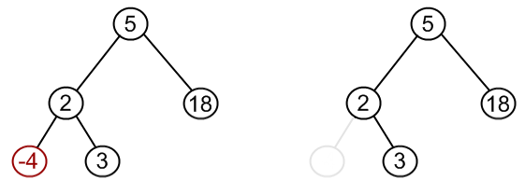
Removing: case 1: Node has no children
Node to be removed has no children (leaf) (deleting -4).
Step 1: find -4 (always start at 5 and work your way down the tree!)
Just delete the node, and make the parent (2) point to NULL
(must keep track of parent)
STILL a binary search tree after removal!

Slide 5
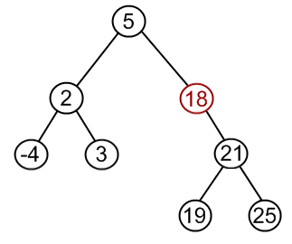
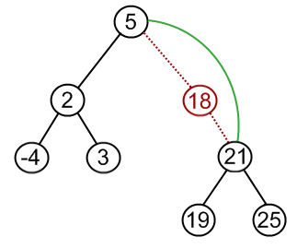
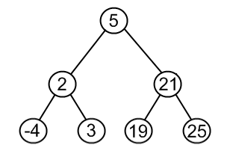
Removing case 2: Node has 1 child
Node to remove has one child:
Make node to be removed’s Parent point to node’s child
(and make node’s child point to node’s parent
Delete node
STILL a binary search tree after removal!

Slide 6
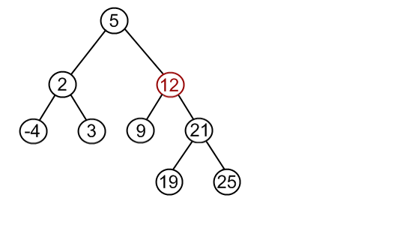
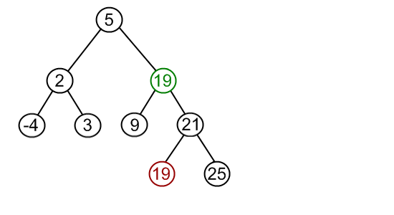
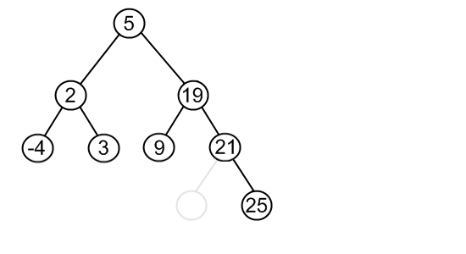
Removing case 3 (The painful case): Node has 2 children
Remember, we must maintain the BST properties when we remove a node
What if we want to remove 12 and we have the following tree:
7
10
7
10
7
10
Find the MINIMUM (Leftmost) VALUE IN 12’s RIGHT SUBTREE
Replace the node to be removed with that min value
Remove the value from the right subtree
Is the tree still a binary search tree?
Notes:
Got here.

Slide 7
Removing case 3 (The painful case): Node has 2 children
Could also find the MAXIMUM (rightmost value) of the left subtree! (Both work!)
10
10
7
10
7
10
7
Is the tree still a binary search tree?
Note: the replacement node (10, or 19) could actually have a child.
In which case it should be removed from the tree using case 2 before using it to replace the node to be removed (12)
IT CANNOT HAVE 2 children!!
Why not?
Notes:
Got here.

Slide 8
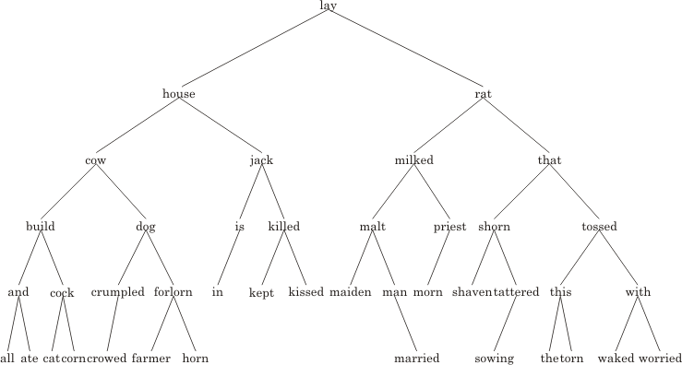
Remove rat from the tree

Slide 9
Remove rat from the tree
shaven

Slide 10
Takeaways:
Removing a node must be done efficiently and systematically (we’re all about efficiency!!
Can’t just randomly search for a replacement!
Must result in a binary search tree
Can’t just randomly pick a replacement – then you won’t have a bst!
3 cases: Node to be removed:
…has 0 children
Just delete, and make sure parent points to NULL
…has 1 child
Just bypass – parent points to the child, child points to the parent
…has 2 children
Find leftmost node in right subtree
Or find rightmost node in left subtree
Both are equally efficient!
Your choice – but pick one and stick with it!
The replacement node may have 0 children or 1 child
So repeat process for removing replacement node.

