Slide 1
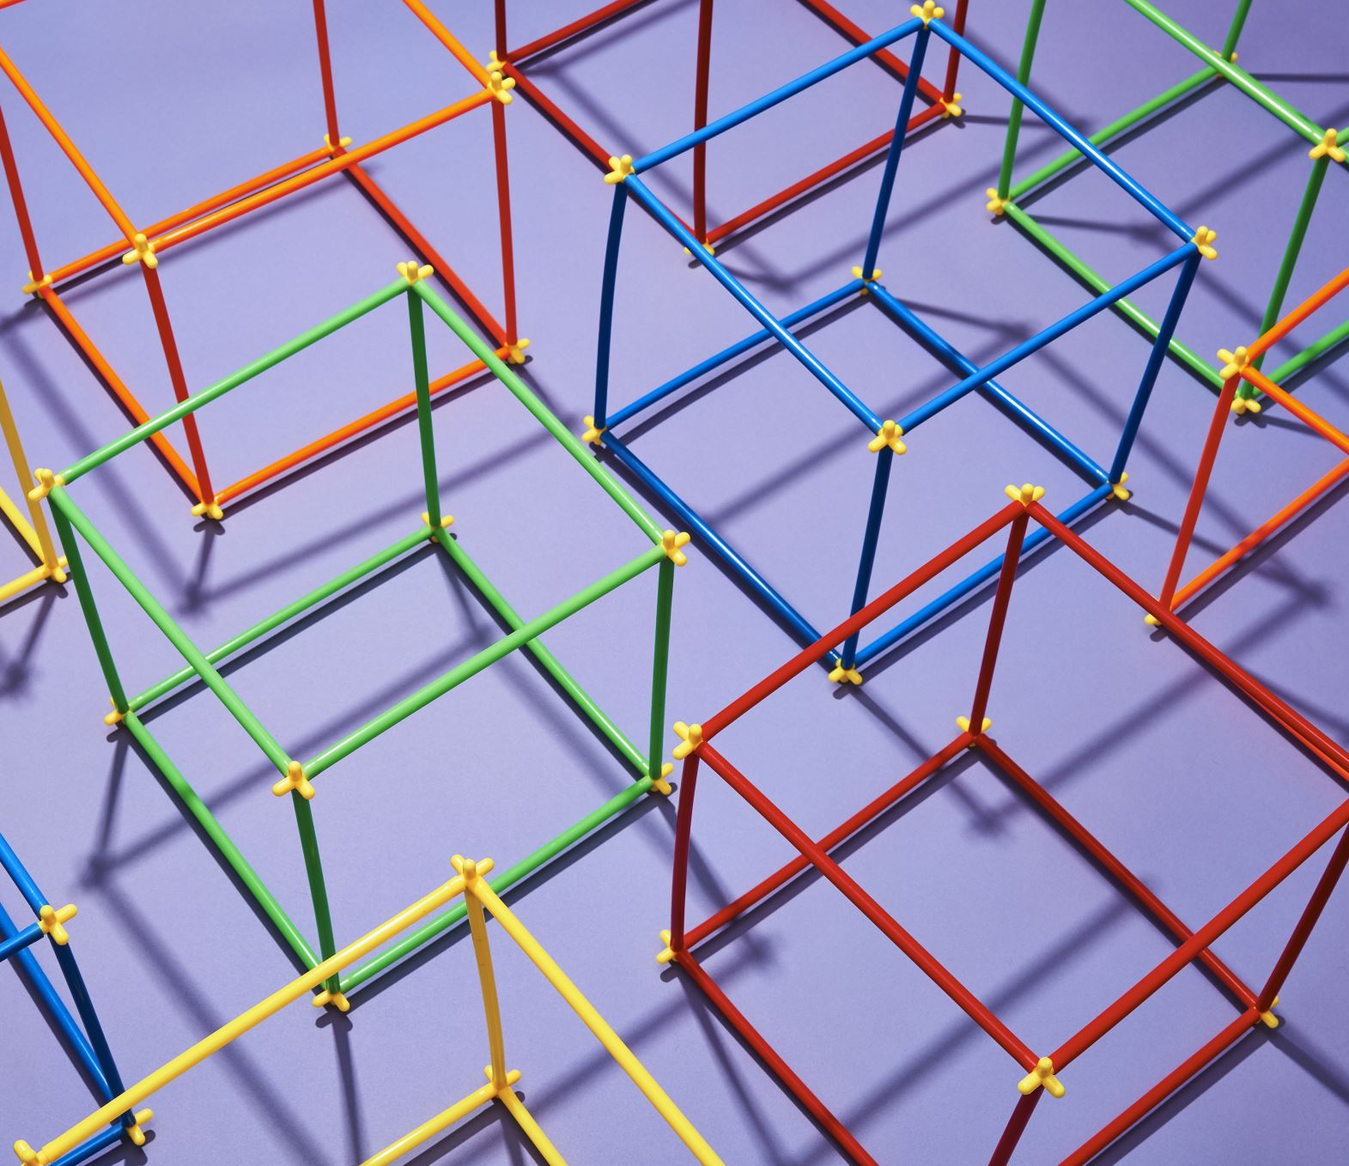
Arrays on the heap!

Slide 2
Arrays (and the heap)
If you don’t know the size of an array at compile time:
Don’t know how much space to set aside on the stack!
If you want to create an array inside a function:
Want the array to outlive its scope!
If you want more than one thing to point to the same array!
WE CAN DYNAMICALLY ALLOCATE THE ARRAY
(we can new it)

Slide 3
Arrays on the heap?
int *x = NULL; // Pointer initialized with null (more to come on NULL)
cout << “Enter the number of numbers you want” << endl;
int y;
cin >> y;
x = new int[y]; // Request memory on heap for space for y ints (sequentially)
for (int k = 0; k < y; k++) {
x[k] = k; //NOTE – looks just like any other array!!
} //for
Why, when we have a pointer to a dynamically allocated array, can we just access the values in the array using x[k]?
because EVERY ARRAY VARIABLE HOLDS THE ADDRESS OF THE FIRST VALUE OF THE ARRAY!!!
So once we’ve created the array on the heap, and we have a variable holding that address, we can treat it like every other array!!!

Slide 4
NULL:
ABOUT NULL:
If we don’t put an address in the variable holding the location in memory when we set it aside, whatever gibberish happened to be there at the time will be the current address.
int main() {
int *x;
cout << x << endl;
return (0);
}
Perfectly valid code – will compile and even run.
Question – what memory location is pointed to by x?
(See the problem?)
If we DO NOT initialize the memory to an address, you could get almost anything –
I got 0x62ff80, but it could honestly be anything. That space could already be in use!!
To take care of this – initialize to NULL
This lets me CHECK to see if x actually points to a real value, or whether it hasn’t been initialized yet
Will come in very useful with data structures!

Slide 5
Returning arrays from functions:
The array MUST EXIST outside of the function’s scope!!!
It must outlive its function!
2 options:
Create the array outside the function, and pass in the array’s address
Create the array dynamically within the function
New it, so it’s on the heap!

Slide 6
Returning an array
CAN’T DO!!
int * createArray(int size);
int main()
{ int *a; //a holds an address that points to an int (or the first in a list of ints)
a = createArray(4);
for (int x = 0; x < 4; x++) {
cout << a[x] << endl;
} //for
return 0;
}//main
int *createArray(int size)
{ int r[size];// r is on the stack.
r[0] = 3;
r[1]= 2;
r[2] = 4;
r[3] = 1;
return r; // the array was freed
} //createArray
CAN DO!!
int * createArray(int size);
int main()
{ int *a; //a holds an address that points to an int (or the first in a list of ints)
a = createArray(4);
for (int x = 0; x < 4; x++) {
cout << a[x] << endl;
} //for
return 0;
}//main
int *createArray(int size) // what is returned???
{ int *r = new int[size]; // r is on the heap
r[0] = 3;
r[1]= 2;
r[2] = 4;
r[3] = 1;
return r; // or return &r[0];
//returning the address of something that //continues to exist!
} //createArray

Slide 7
Takeaways
Array variables always hold the address of the first value of the array
Whether it’s on the stack or the heap
int arr[4]; //stack
Or
int *arr = new int[4]; //heap
ALL arrays are accessed using []
NULL:
Initialize addresses to NULL
Or get some crazy address that could be anywhere!

