Slide 1
Graphs: Shortest Path (Dijkstra) Intro)

Slide 2
Shortest Path:
Now that we know how to store a graph…
Problem 1:
Single-source shortest path:
Finding the shortest path from one particular vertex
(aka the single source)
to another vertex on a graph
Think of taking a plane from Philadelphia International Airport to another airport – what is the shortest path?
Note that this can be easily modified to find the shortest path from a single source to all other vertices in the graph

Slide 3
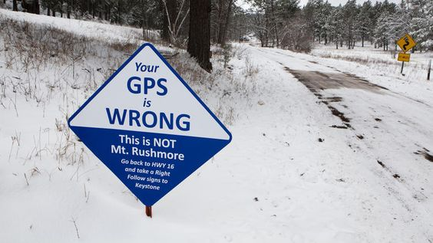
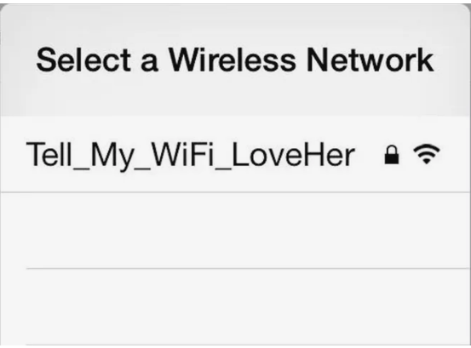
Other uses for shortest path:
Maps: finding the shortest route, finding the fastest route
Vertices: intersections,
Edges: roads (cost: distance, speed, or something else)
Maps: - finding the shortest route, - finding the fastest route
Vertices: intersections,
Edges: roads (cost: distance, speed, or something else)
Networks: - for routing packets (data) across a network or the internet
Vertices: routers
Edges: connections (cost: time for travel)
Epidemiology: - modeling the spread of infectious diseases
Vertices: individuals with disease
Edges: contacts (cost: maybe likelihood of infection?)

Slide 4
Assumptions:
Costs are positive numbers or zero
Otherwise could find that the path with the lowest cost is infinite
You’d just keep cycling over the negative number(s) to get a “smaller” path
Not all vertices may be reachable from the single source
Weights (aka what we’re adding to get the total cost of the path): Not necessarily distance
could be:
time,
cost,
likelihood, etc.
Shortest paths may not be unique
There might be more than one shortest path to get from vertex a to vertex x

Slide 5
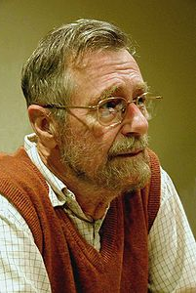
Dijkstra
"Computer Science is no more about computers than astronomy is about telescopes.“
“Elegance is not a dispensible luxury but the factor that decides between success and failure.”
“Simplicity is prerequisite for reliability.”
“Program testing can be used to show the presence of bugs, but never to show their absence!”
“I don't know how many of you have ever met Dijkstra, but you probably know that arrogance in computer science is measured in nano-Dijkstras.”

Slide 6
Dijkstra's algorithm
Solves single-source shortest path problem Works on both directed and undirected graphs.
All edges must have nonnegative weights.
Approach: Greedy (means make the best (shortest) choice each time locally, with the assumption that this will result in the final path that is the best (shortest))
Input: Weighted graph
G={E,V} <- Graph is a set of edges and vertices
source vertex v∈V,
all edge weights are nonnegative
Output: Shortest path and lengths of shortest paths (or the shortest paths themselves) from a given source vertex v∈V to all other vertices

Slide 7
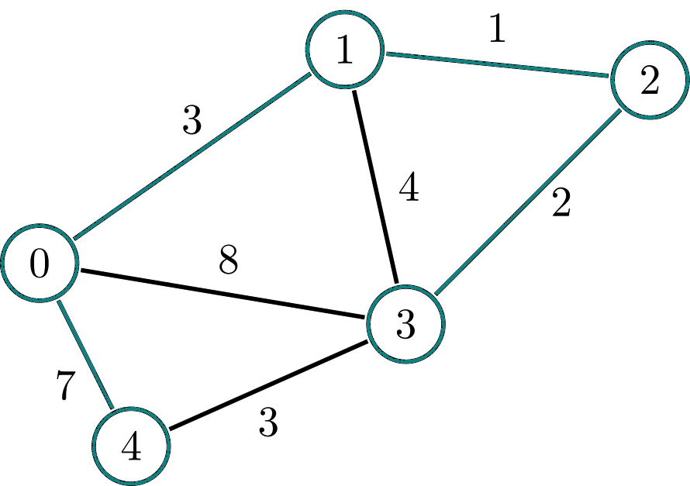
Idea:
Start with the starting vertex
Let’s Say we’re starting at V1.
Add a vertex at a time using the following criteria:
It must be the vertex with the next shortest distance from the starting vertex
Either via a direct edge (e.g., from v1 to v2 there is a direct edge with a cost of 1)
Or via another vertex and the cost of getting to that vertex
E.g., the cost of getting from v1 to v2 is 1
The cost of getting directly from v1 to v3 is 4
BUT the cost of getting from v1 to v3 VIA 2 is 3
So we’d add v3 when 3 is the smallest cost, not 4!
Keep adding vertices using the shortest path so far and the vertices you’ve added so far
Until you hit the end vertex
Up next: an example of implementing!
start
1

Slide 8
Take-Aways (Dijkstra’s algorithm):
Finds the shortest path in a graph from one particular node to another
Can be generalized to finding the shortest path from one particular node to all others.
Is considered a “greedy” algorithm
because it ALWAYS adds the next node with the shortest path so far
Uses the matrix for storing the graph
Up next: implementation

