Slide 1
Implementing Dijkstra’s Shortest Path from a Single Node algorithm

Slide 2
To Implement (Dijkstra):
 | 0 | 1 | 2 | 3 | 4
0 | 0 | 3 | Inf | 8 | 7
1 | 3 | 0 | 1 | 4 | inf
2 | Inf | 1 | 0 | 2 | inf
3 | 8 | 4 | 2 | 0 | 3
4 | 7 | Inf | Inf | 3 | 0
You need the Graph (represented as a matrix)
You need a set of visited vertices
E.g., if starting vertex is 0
an array of Boolean values
length is the number of vertices in the graph,
all vertices initialized to False,
when a vertex is visited, it becomes True
You need an array of costs (think, distances)
To each of the edges from the starting vertex
It will start out being initialized to infinity for all vertices
As we add vertices to our set of visited vertices, we update the costs
You will need an array of “Previous vertex”
As you add vertices to the visited array, you update the costs to get to the vertices.
If it costs less to go through the newly added vertex to get to a vertex, we update the previous vertex to be the newly added vertex.
This might be easier to understand when you see it.
 | 0 | 1 | 2 | 3 | 4
visited | True | False | False | False | False
 | 0 | 1 | 2 | 3 | 4
Costs | 0 | 3 | Inf | 8 | 7
 | 0 | 1 | 2 | 3 | 4
Prev | 0 | -1 | -1 | -1 | -1
You can combine the cost and the previous arrays – into one structure –either an array of class objects with a cost and previous field, or into a matrix with the first row being costs and the second being previous vertex

Slide 3
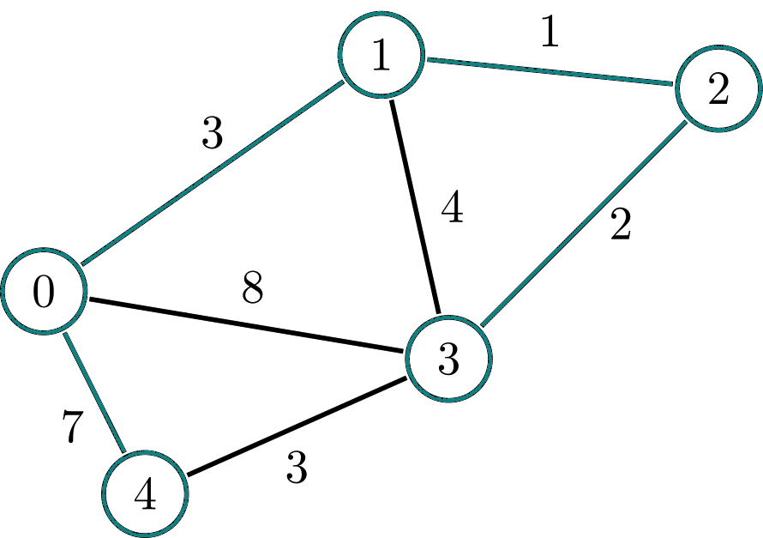
Idea:
Starting
Vertex
Shortest path from v1 to v4:
v1: cost to get to 1: 0.
Look at everything connected to v1
v2, cost 1 ,
v3, cost 4
v0, cost 0
V2 has shortest path from 1
So add v2 to your set of visited nodes
Look at everything v2 is connected to:
V3: 2
V1 (already visited)
Note: it is cheaper to go to v3 through v2 than to go directly
End
Vertex
 | 0 | 1 | 2 | 3 | 4
0 | 0 | 3 | Inf | 8 | 7
1 | 3 | 0 | 1 | 4 | inf
2 | Inf | 1 | 0 | 2 | inf
3 | 8 | 4 | 2 | 0 | 3
4 | 7 | Inf | Inf | 3 | 0

Slide 4
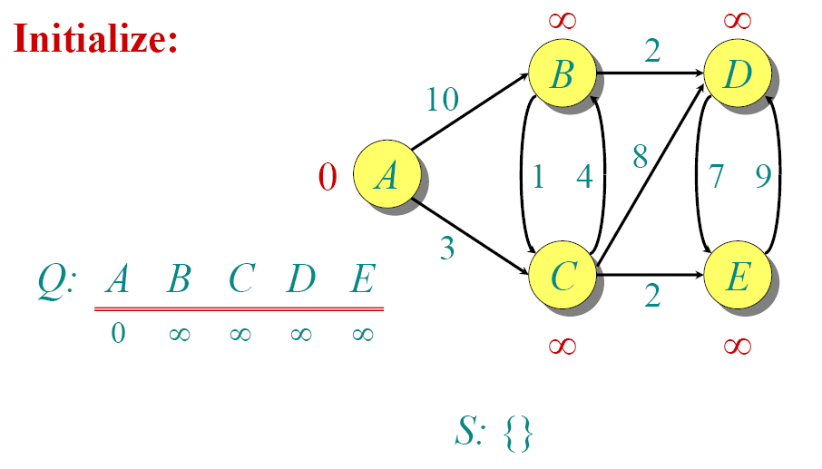
Dijkstra Example
(Note: We’re starting at vertex A)
Graph stored as a matrix
 | A | B | C | D | E
A | 0 | 10 | 3 | inf | inf
B | inf | 0 | 1 | 2 | inf
C | Inf | 4 | 0 | 8 | 2
D | inf | inf | inf | 0 | 7
E | inf | Inf | Inf | 9 | 0
V | A | B | C | D | E
Dist[v] | 0 | Inf | Inf | Inf | Inf
Predecessor[v] | null | null | null | null | null
Visited | False | False | False | False | False

Slide 5
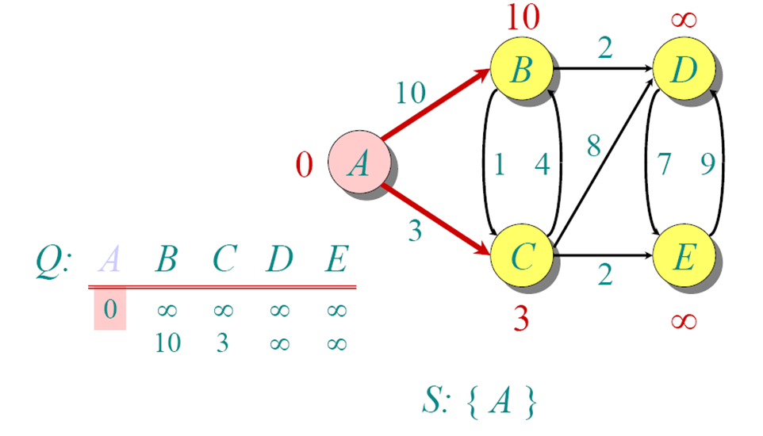
Dijkstra Example
Graph stored as a matrix
 | A | B | C | D | E
A | 0 | inf | 0 | 7 | inf
B | inf | Inf | 9 | 0 | inf
C | Inf | 4 | 0 | 8 | 2
D | inf | inf
E | inf | Inf
Update distances with the distances to vertices that can be reached from A
Notes:
The visited array is set to True for A
From A we have a direct connection to B and C, so costs to get to B and C are updated in the Distance Array
Since we got those costs (for B and C) by going from A, we update the predecessor to be A for both B and C in the Predecessor array
V | A | B | C | D | E
Distance[v] | 0 | 10 | 3 | Inf | Inf
Predecessor[v] | null | A | A | null | null
Visited | True | False | False | False | False

Slide 6
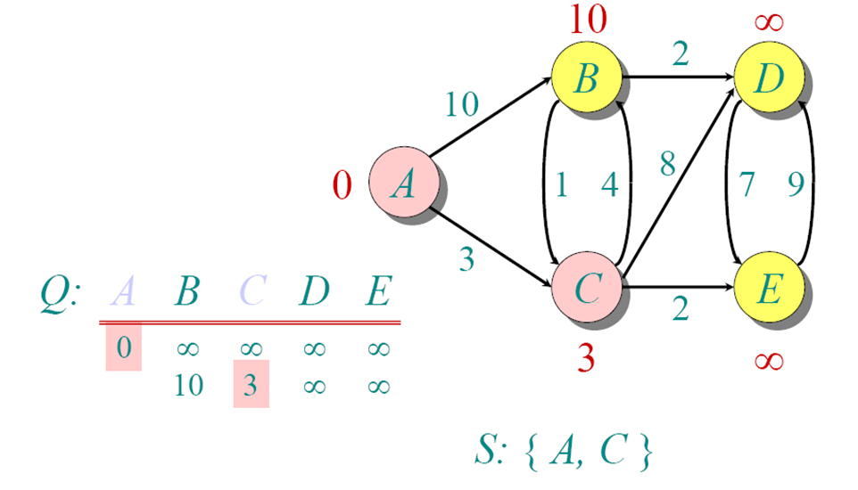
Dijkstra Example
Graph stored as a matrix
 | A | B | C | D | E
A | 0 | inf | 0 | 7 | inf
B | inf | Inf | 9 | 0 | inf
C | Inf | 4 | 0 | 8 | 2
D | inf | inf
E | inf | Inf
Distance to C from A was shortest
We’re adding C to our visited nodes
Notes:
The visited array is set to True for C
From C we now have a direct connection to B,D, and E
Updating Distance and Predecessor Arrays:
Distance Array Costs are updated as follows:
If the distance from A to vertex x directly is less than the distance from A to vertex x via C, we do nothing
If the distance from A to x via C is less than the distance from A to B directly, we update the Distance to x as:
Distance[C] + graphmatrix[C][x]
and set the Predecessor array at x to be C (because we went through C to get the lowest cost so far)
E.g, for B, this is calculated as follows:
if (dist[b] > dist[c] + graphmatrix[c][b]) {
dist[b] = dist[c] + graphmatrix[c][b]
predecessor[b] = c
}
Do for all new connections (e.g., check B, D and E to see if cost is less via A or via the vertex we just added (C)
Also Updated!
V | A | B | C | D | E
Distance[v] | 0 | 7 | 3 | 11 | 5
Predecessor[v] | null | C | A | C | C
Visited | True | False | True | False | False

Slide 7
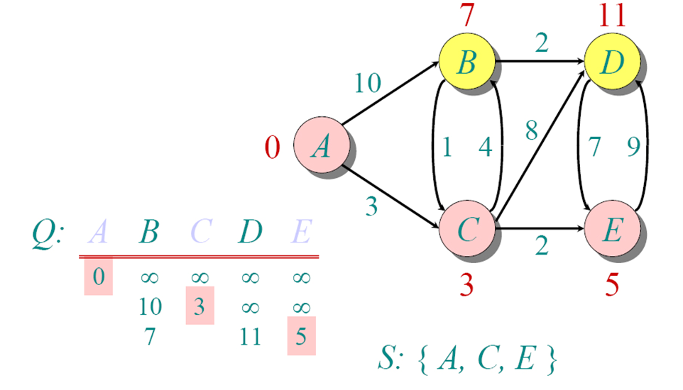
Dijkstra Example
Graph stored as a matrix
 | A | B | C | D | E
A | 0 | inf | 0 | 7 | inf
B | inf | Inf | 9 | 0 | inf
C | Inf | 4 | 0 | 8 | 2
D | inf | inf
E | inf | Inf
Take the next smallest path and add it to the visited set
Distance to E is the shortest path addition that doesn’t include previously visited notes
We’re adding E to our visited nodes
Notes:
The visited array is set to True for E
From E we now have a direct connection to D
Distance Array Costs are updated as follows:
Distance to D before adding E: 11
Distance to D via E = Distance to E (5) + Distance from E to D (9) = 14
(you’d get the distance from E to D from the graph matrix)
In this case we don’t update the distance to E because we already have a shorter path to E
V | A | B | C | D | E
Distance[v] | 0 | 7 | 3 | 11 | 5
Predecessor[v] | null | C | A | C | C
Visited | True | False | True | False | True

Slide 8
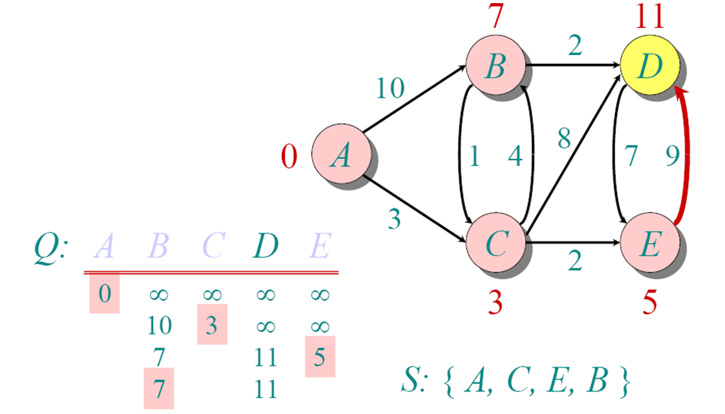
Dijkstra Example
Graph stored as a matrix
 | A | B | C | D | E
A | 0 | inf | 0 | 7 | inf
B | inf | Inf | 9 | 0 | inf
C | Inf | 4 | 0 | 8 | 2
D | inf | inf
E | inf | Inf
At this point, the only 2 unvisited vertices are B and D.
In looking at the Distance Matrix, B is the shortest Distance
So that is added next.
Notes:
The visited array is set to True for B
B has a direct connection to D
Distance Array Costs are updated as follows:
Distance to D before adding B: 11
Distance to D via B = Distance to B (7) + Distance from B to D (2) = 9
(you’d get the distance from B to D from the graph matrix)
So update distance array at D to 9
Update Pred of D to B (since we went through B to get that cost)
Take the next smallest path and add it to the visited set
V | A | B | C | D | E
D[v] | 0 | 7 | 3 | 9 | 5
Pred[v] | null | C | A | B | C
Visited | True | True | True | False | True

Slide 9
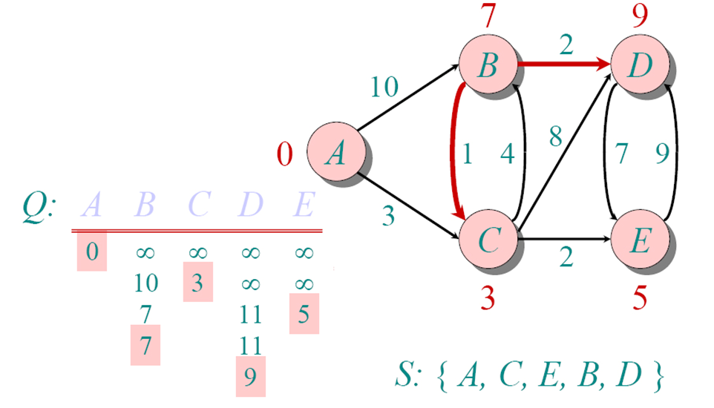
Dijkstra Example
Graph stored as a matrix
 | A | B | C | D | E
A | 0 | inf | 0 | 7 | inf
B | inf | Inf | 9 | 0 | inf
C | Inf | 4 | 0 | 8 | 2
D | inf | inf
E | inf | Inf
D is the only unvisited vertex
Add it
We have the shortest path from A to every other vertex on the graph!!!
Now:
How do you find the shortest path using our arrays?
V | A | B | C | D | E
Distance[v] | 0 | 7 | 3 | 9 | 5
Predecessor[v] | null | C | A | B | C
Visited | True | True | True | True | True

Slide 10
Take-aways
To implement Dijkstra’s algorithm:
You always pick the next vertex with the shortest path so far
You must keep track of:
Visited Vertices
Current Path cost to each vertex that can be reached so far
The Vertex from which you got the shortest path.
If you keep adding the next vertex with the shortest path until you add all the vertices, you will end up with the shortest path from a single source to all other vertices so far!
(How do you figure out the path? That’s coming!)

