Slide 1
Graphs: Shortest path and mst
Dijkstra and Prim (and maybe Kruskal)

Slide 2
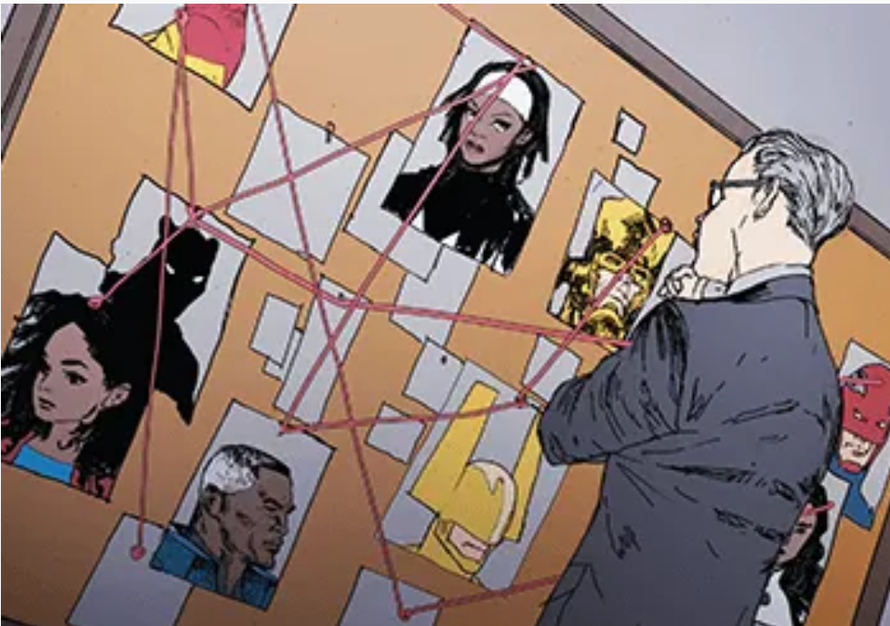
New ADT: Graphs!!!
a graph is a finite set of vertices (nodes), and the edges that connect them
They’re really useful:
Social Network
Other networks
Routers
Maps
Metro/train/plane
Contact tracing
Solving murders/crimes (You’ve seen the boards on tv with the strings between the different events or people!)
Etc.

Slide 3
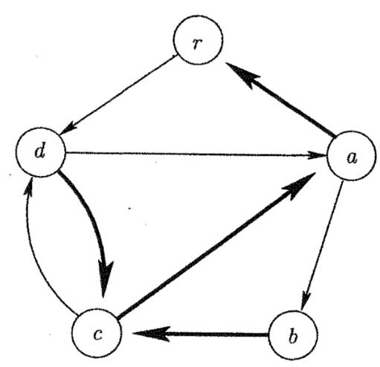
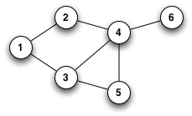
Directed vs Undirected Graphs
Directed graph: (See the arrows? )
Directed means that, say, you wanted to go from vertex d to vertex r.
You can’t directly, because there’s no directed (arrowed) edge between them pointing from d to r.
You can, however, go directly from r to d
Undirected Graph:
Now, you can go in either direction between vertices with connecting edges.
E.g., You can go from 1 to 2 and from 2 to 1

Slide 4
How to store a graph?
Think about it… how can we store a graph?
You thought of nodes with pointers, didn’t you?
Not necessarily the best way!!!

Slide 5
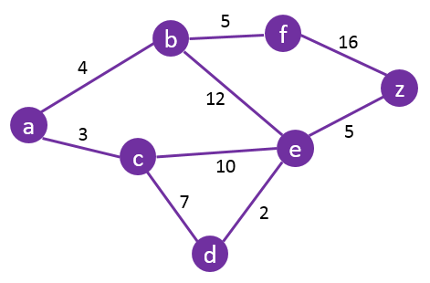
How to store a graph: A MATRIX!!!
Vertices become indices,
Weights are values that go into matrix.
So for instance, the graph to the left would be a 7x7 matrix.
Vertices are indices
A is equivalent to 0,
b is equivalent to 1,
etc,
edge costs are values in matrix
 | A | B | C | D | E | F | Z
A | 0 | 4 | 3 | Inf | Inf | Inf | inf
B | 4 | 0 | Inf | Inf | 12 | 5 | inf
C | 3 | Inf | 0 | 7 | 10 | Inf | inf
D | Inf | Inf | 7 | 0 | 2 | Inf | Inf
E | Inf | 12 | 10 | 2 | 0 | Inf | 5
F | Inf | 5 | Inf | Inf | Inf | 0 | 16
z | Inf | Inf | Inf | Inf | 5 | 16 | 0
A to b has an edge with a cost of 4
A to C has an edge with a cost of 3
A to D does not have a direct edge (cost is infinity)
A to E: no direct edge (cost is infinity)
Etc.
B to A has an edge, cost of 4
B to B cost is 0
B to C: no edge, infinity cost
B to D: no edge, infinity cost
B to E: edge with a cost of 12
Etc.

Slide 6
Undirected Graphs as Matrices:
Undirected: if you can go directly from v1 to v2, you can go from v2 to v1, and it costs the same amount either way
More formally, if a direct edge connects v1 and v2 with cost c, an equal edge must exist between v2 and v1 with the same cost c.
If no arrows on graph edges, it’s undirected
 | 0 | 1 | 2 | 3 | 4
0 | 0 | 3 | Inf | 8 | 7
1 | 3 | 0 | 1 | 4 | inf
2 | Inf | 1 | 0 | 2 | inf
3 | 8 | 4 | 2 | 0 | 3
4 | 7 | Inf | Inf | 3 | 0
Undirected graph matrix:
Diagonal is always 0 (for both directed and undirected)
BUT…
Top left of matrix is mirror image of bottom right!!!
Diagonal separates the mirror images!
Yellow is mirror image of green

Slide 7
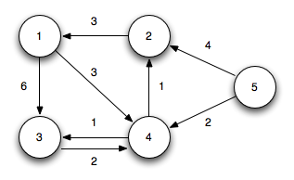
Directed Graphs as Matrices:
Directed: if you can go directly from v1 to v2, it doesn’t necessarily mean you can go directly from v2 to v1, and, even if you can, it might be a different cost
Look for the arrows on a graph – means it’s directed
Directed graph matrix:
Diagonal is always 0 (for both directed and undirected)
In this case top right is not mirror image of bottom left
 | 1 | 2 | 3 | 4 | 5
1 | 0 | inf | 6 | 3 | inf
2 | 3 | 0 | inf | inf | inf
3 | Inf | inf | 0 | 2 | inf
4 | inf | 1 | 1 | 0 | inf
5 | inf | 4 | Inf | 2 | 0

Slide 8
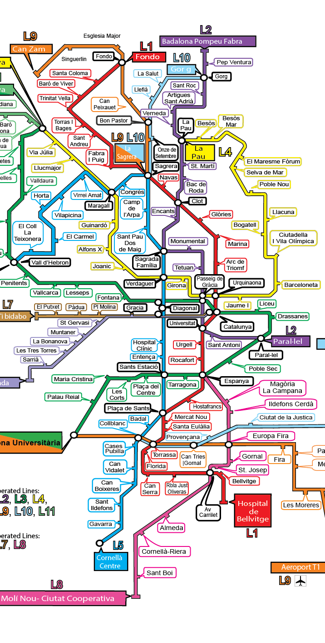
Takeaways:
Graph: New ADT!
A set of nodes (vertices), and edges that directly connect the nodes
Not all nodes necessarily have a direct edge connecting them
Directed graph:
If there’s an edge from node A to node B, you DO NOT necessarily have an edge from node B to node A
Even if you do, they may have different costs
Undirected Graph:
If there’s an edge from node A to B, there’s an edge from node B to A
And, since it’s the same edge, it has the same cost
How to store a graph:
In a matrix!
Undirected: top right is mirror image of bottom left
Directed: top right different from bottom left

