Slide 1
Finding the Shortest Path

Slide 2
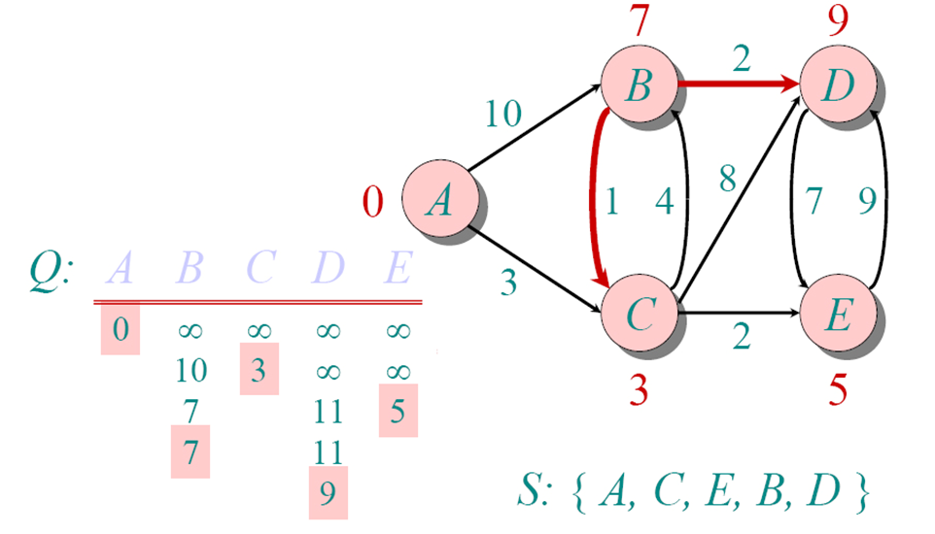
Find Shortest path from A to any node:
Work Backwards!!!!
Use the predecessor array, start at the end vertex.
Examples:
If you’re trying to find the path from A-D:
Start at D.
D’s Predecessor is B
B’s Predecessor is C
C’s Predecessor is A
We have our path: A->C->B->D
A-> D?
D’s pred was B,
B’s pred was C,
C’s pred was A,
so path is: A->C->B->D
A->E?
E’s pred was C,
C’s pred was A, so
Path is: A->C->E
V | A | B | C | D | E
Distance[v] | 0 | 7 | 3 | 9 | 5
Predecessor[v] | null | C | A | B | C
Visited | True | True | True | True | True
V | A | B | C | D | E
D[v] | 0 | 7 | 3 | 9 | 5
Pred[v] | null | C | A | B | C
Visited | True | True | True | True | True

Slide 3
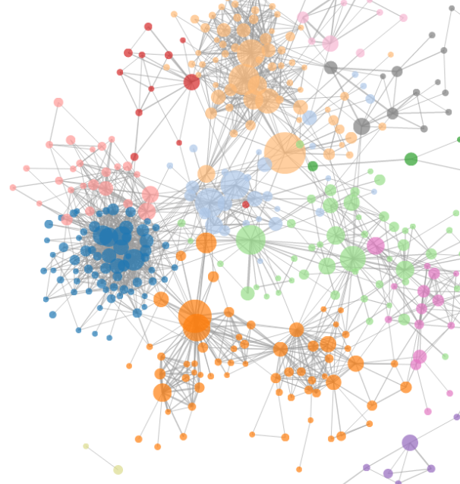
Take-aways:
Store a Graph as a Matrix (vertices are indexes, edge costs are values in the matrix
Implement Dijkstra’s Single-source Shortest Path Algorithm
Start with a vertex
Always add the vertex with shortest path so far
Keep track of costs to get to unvisited vertices
Keep track of vertex you went through to get shortest path so far
Finally, WORK BACKWARDS to get shortest path
Start at end vertex
Look at previous vertex.
Repeat till you get to the initial vertex

