Slide 1
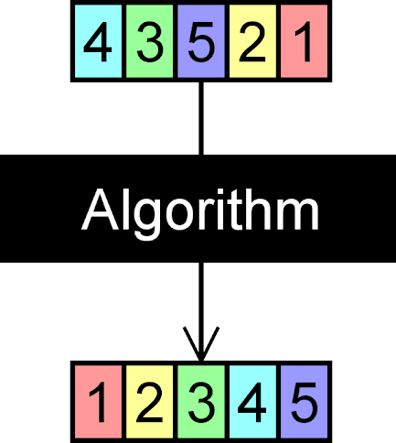
Intro to Sorting

Slide 2
Sorting
Taking an arbitrary permutation of n items and rearranging them into total order
It’s what you think it is…
Sorting is, without doubt, the most fundamental algorithmic problem
Supposedly, between 25% and 50% (depending on source) of all CPU cycles are spent sorting
used in office apps (databases, spreadsheets, word processors,...)
There are many different approaches to sorting data!
Almost all languages have built-in sorting algorithms now
You’ll still probably end up writing your own on occasion – I do!

Slide 3
Why Learn about Sorting?
Clear, straightforward method for showing different algorithms lead to differences in speed and efficiency
We can run different sorting algorithms on the same data and get consistently different runtimes
We care about speed and efficiency!
It’s a nice way to illustrate the use of thinking about the structure of your data in order to pick an optimal algorithm
Different sorting algorithms will sort data more or less quickly if it’s, for instance, already mostly sorted, or largely in reverse order, or has numerous duplicates, etc.
It illustrates the concept of thinking of novel, outside-the-box approaches to developing algorithms.
When you interview for a job, someone’s gonna ask you about sorting algorithms
They just do. They’ll ask you about run-time efficiency too.

Slide 4
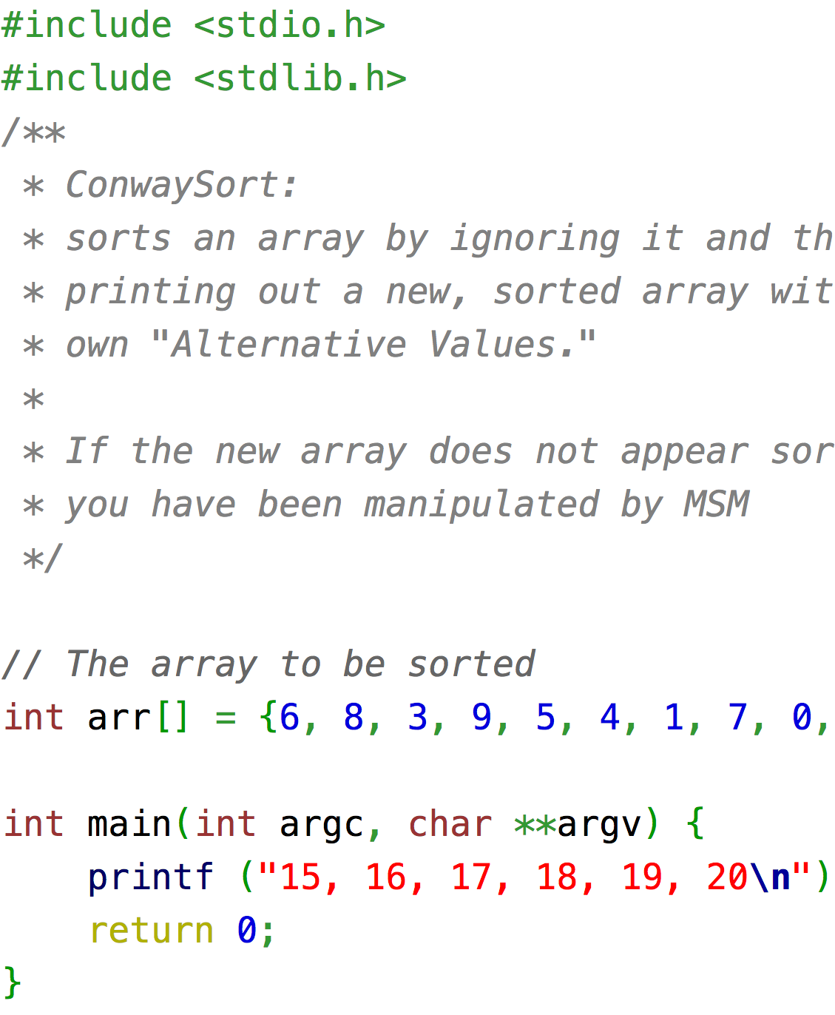
Some Applications of Sorting
Sorting: Once list is sorted, other problems become easy.
Searching
Speeding up searching is perhaps the most important application of sorting.
Closest pair
Given n numbers, find the pair closest to each other.
Once a list is sorted, how long will this take?
Element uniqueness
Given a set of n items, are they all unique? Remove duplicates.
Sorted list versus unsorted list?
Frequency distribution mode
Given a set of n items, which element occurs the most frequently?
Set differences:
Compare 2 large sets and find where they differ
Median and Selection
What is the kth largest item in the set? The median element?
then
with
sorted
Bad Sorting Algorithm (but quite efficient!

Slide 5
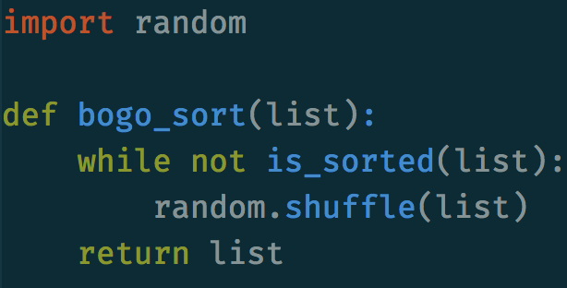
Testing:
We should test sorting algorithms on data that’s in different orders to see how efficient it is with these different orders:
Completely random array
the only test most people think to use in evaluating sorting algorithms
Already sorted array
Often sorting involves resorting previously sorted data done after minimal modifications of the data set.
Sorted in reverse order
Chainsaw array (up and down and up and down)
Think already sorted arrays put together
Array consisting of many of one identical element (maybe only one element)
Another really bad sorting algorithm!!!
(And REALLY inefficient!)

Slide 6
Terms:
Algorithm Analysis:
comparing algorithms based upon the amount of computing resources that each algorithm uses
Worry about time the algorithm takes to run
Worry about the space an algorithm takes up
Big O notation
e.g., O(n), O(1), O(log n), etc.
Worst case time analysis - We usually worry about this
In-Place Sorting:
Some sorting algorithms require extra space when sorting
(e.g., another array of the same size as the original set of numbers you’re trying to sort).
In-Place sorting only takes a small bit of extra memory
(e.g., space to hold a number when you’re swapping numbers)
Stability:
If the data you are sorting contains two of the same value, does the algorithm retain the original order of the 2 equal values, or is it possible that the second of the two equal values could end up in front of the first?
Think emergency room: people coming in are sorted by severity of injury
What if 2 people come in with the EXACT same injuries of the EXACT same severity – which do you take first?
The one that came in first.
You want a sorting algorithm that makes sure that when patients are sorted, that order is retained

Slide 7
Takeaways:
You gotta learn about sorting
A fundamental algorithmic problem
Lets us solve a lot of other problems
Which values are closest to each other
Which values occur most frequently
Which values are median
Where are the biggest “jumps” in data values
Etc.
Great way to learn to think about algorithm efficiency
I would be fired as a data structures teacher if I didn’t teach you about sorting (most important reason) –yeah, it’s that iconic!
New terms:
In-place sorting: You don’t need to create a new array to sort the list
Stability: if two values are equal, the one that occurred first in the list before the list was sorted will still occur first in the list after the two algorithms are sorted
A favorite bad sorting algorithm – Bogo sort, only you just destroy universes in which the randomized list isn’t sorted.

