Slide 1
SelectionSort
Basic Sort

Slide 2
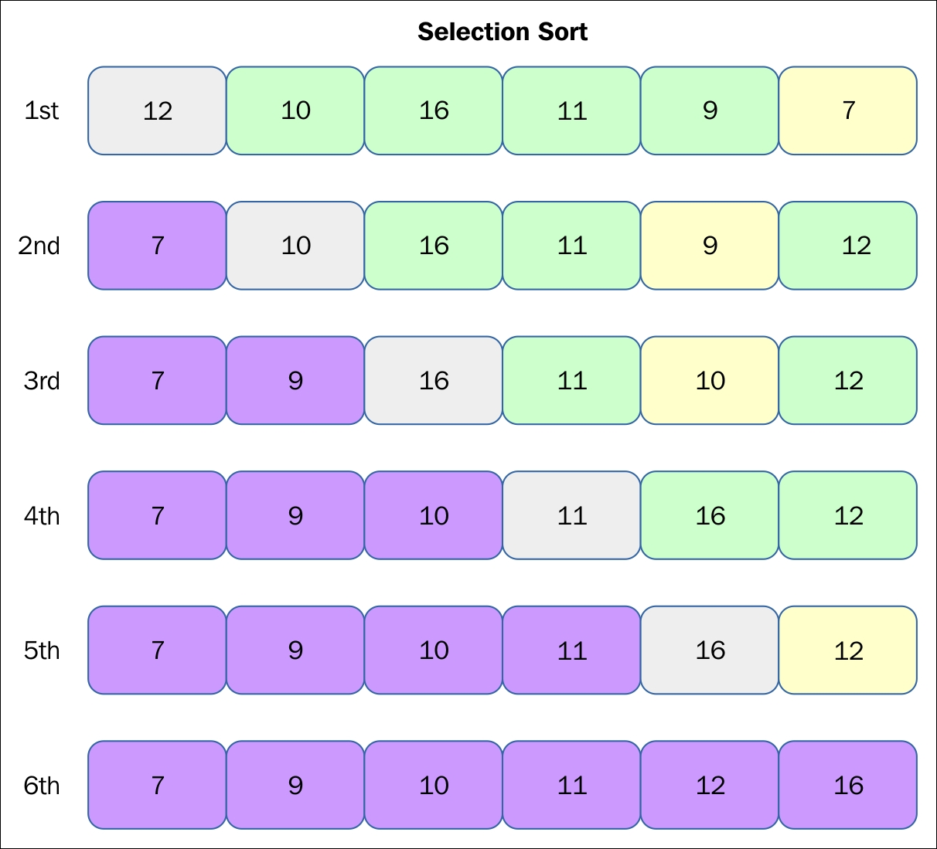
Selection Sort
This is the method most people come up with on their own when writing a sorting algorithm
Your basic sorting algorithm
Straightforward
Swap
Idea:
1. Traverse list of data.
Find the smallest, and the index of the smallest value
1 a) Swap the smallest value with what is in the first location (index 0) in the list
2. Repeat 1 and 1a to find the next smallest value and swap with location index 1
3. Keep repeating 1 and 1a with the rest of the array, until every value is in place

Slide 3
Selection Sort Example
35 65 30 60 20 scan 0-4, smallest=20
swap 35 and 20 (swapping smallest with index 0)
20 65 30 60 35 scan 1-4, smallest=30
swap 65 and 30 (swapping second smallest with index 1)
20 30 65 60 35 scan 2-4, smallest=35
swap 65 and 35 (swapping third smallest with index 2)
20 30 35 60 65 scan 3-4, smallest=60
swap 60 and 60 (swapping fourth smallest with index 3)
20 30 35 60 65 done

Slide 4
Selection Sort Basic Algorithm
for i = 0 to n-2 do // steps 2-6 form a pass
set min_pos to i
for j = i+1 to n-1 do
if item at j < item at min_pos
set min_pos to j
Exchange item at min_pos with one at i

Slide 5
Some videos to illustrate Selection Sort:
https://www.youtube.com/watch?v=tkiOek8BHo4
https://www.reddit.com/r/programming/comments/e5md13/selection_sort_visualization/
https://www.youtube.com/watch?v=ympYowjTEYs
And, of course, my favorite…
https://www.youtube.com/watch?v=Ns4TPTC8whw

Slide 6
Run Time Analysis:
To get 1 number into place, you must go through all the numbers in the list
(which is a count of n if there are n numbers in the list)
You must get every number in place (all n numbers)
So, for all n numbers you must do n comparisons
This is n² (bleck, ugh!)
That is not a great running time!
RUN TIME: O(n²)!

Slide 7
Different Data?
What if the data is already in order?
Doesn’t matter.
The algorithm doesn’t differ in any way when it is sorting a list that is already sorted
It will always go through the entire array looking for the next smallest value
(because it has no way of knowing whether the smallest number might be lurking at the very end, after all the other numbers that just so happen to be in order – it might be the only value out of place!)
So for already sorted data, the run time is still (klcvp-0d0b n-okj <- Kitten typed that) O(n²)
What if the data is in reverse order?
Same thing – the algorithm works exactly the same, whether the data is already in order, whether it is in reverse order, whether it’s random, or anything else!
Always works in O(n²)
At least it’s consistent…

Slide 8
Other factors:
Does it preserve stability?
Not necessarily…
Because you’re swapping, it’s possible that a value early on could get swapped to the end of the list
In the above list, after the first pass, the first 8 will be swapped with 1, so the second 8 could end up earlier in the list…
8 | 4 | 7 | 8 | 2 | 9 | 6 | 5 | 1
1 | 4 | 7 | 8 | 2 | 9 | 6 | 5 | 8
Is it in-place?
Yes!
You just need to have a temporary place for the data when you are swapping values
Otherwise, no extra memory is needed
In other words, you don’t have to take this whole array and copy it into a brand new array during sorting!

Slide 9
SelectionSort code:
void SelectionSort(string arr[], int len) {
for(int i = 0; i < len; i++) {
int m = i;
for (int j = i+1; j < len; j++) {
if (arr[j] < arr[m]) {
m = j;
}
}
string tmp = arr[m];
arr[m] = arr[i];
arr[i] = tmp;
}
}
2) Running time for a list already in order?
O(n²)
3) Running time for a list in reverse order?
O(n²)

Slide 10
Takeaways:
SelectionSort
Your basic Sorting Algorithm
Find the smallest and swap it into place
Repeat until list is sorted
Run Time:
ALWAYS O(n²)
Algorithm doesn’t vary regardless of data order
(so in-order, reverse order, random order, mostly ordered, etc. will be sorted with the exact same run time
Unstable
But InPlace
Why use Selection Sort if run time is pretty bad for a sorting algorithm?
Easy to write!
Easy to visualize!
Easy to debug!

