Slide 1
Quick Sort

Slide 2
Divide and Conquer Algorithms!
Idea:
Divide workload in half each time
So you’re working with half the data, then ¼ of the data/ then 1/8th of the data, etc.
Usually more efficient way of sorting
USUALLY O(n log₂ n)!!!
There are a number of Divide and Conquer Sorting Algorithms:
Most notably:
Quicksort
Mergesort

Slide 3
Quicksort
Developed in 1962 by C. A. R. Hoare
Given a pivot value (a number in the array):
Rearranges array into two parts:
All numbers in the left part ≤ pivot value
All numbers in the right part > pivot value
e.g., 12, 8, 18, 4, 10, 13, 6, 21, 42
if 12 was the pivot:
8, 4, 10, 6 12 18, 13, 21, 42
Now repeat as if you only have to sort the left set of numbers.
Then repeat as if you only have to sort the right set of numbers
This is so insanely recursive!!!
Students at the end of semester

Slide 4
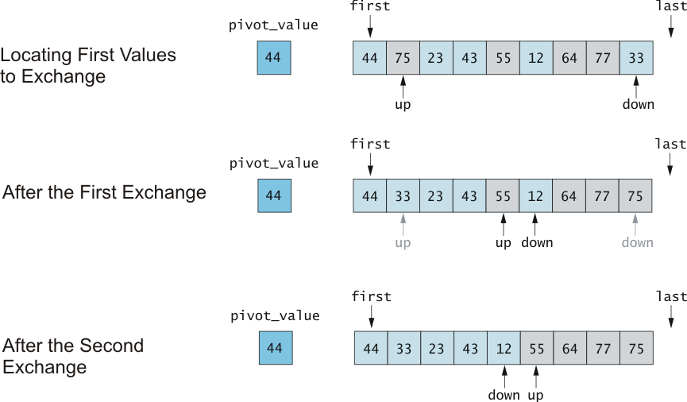
Trace of Algorithm for Partitioning
There’s a pivot, an up index, and a down index.
The up index keeps increasing until the value at that index is GREATER than the pivot
The down index keeps decreasing until the value at that index is LESS than the pivot
Swap the value at the up index and the down index.
Repeat process until up index is greater than down index (NOT the values, the index itself!)
Then swap the down index with the pivot
Now all values on the left are less than the pivot
All values on the right are greater than the pivot
But these 2 sections are not necessarily in order!!
We have to repeat this whole process with JUST THE VALUES ON THE LEFT
And then repeat with JUST THE VALUES ON THE RIGHT!
The values on the left NEVER need to be compared with the values on the right again!
So we’ve divided the workload!

Slide 5
Quicksort Example
44 | 75 | 12 | 43 | 64 | 23 | 55 | 77 | 33
44 | 33 | 12 | 43 | 23 | 64 | 55 | 77 | 75
23 | 33 | 12 | 43 | 44 | 64 | 55 | 77 | 75
23 | 33 | 12 | 43
64 | 55 | 77 | 75
Now we have 2 subarrays:
Repeat whole process with each
subarray separately!
23 | 12 | 33 | 43
55 | 64 | 77 | 75
12 | 23 | 33 | 43
33 | 43
77 | 75
75 | 77

Slide 6
In English:
Pick a pivot (we picked the first value in each subarray)
Up holds index at the first value in the subarray (after the pivot)
down holds index at the last value in the subarray
While the up is less than the down:
While up is less than down And subarr[up] is less than pivot:
Increment up to the next value in the array
While down is greater than up And the subarr[down] is greater than the pivot
decrement down to the previous value in the array
If up < down, switch the values in the subarray at up and down
Switch the values at the pivot and the subarr[down]
Now the pivot is in place
All values before the pivot become a new subarray and all the values after the pivot become a new subarray
Repeat until subarrays are of length 1 or 2.

Slide 7
Algorithm for Quicksort
Just ‘cause it suited my mood
First and last are end points of subarray region to sort
if first < last
Partition using pivot, which is found at piv_index
Apply Quicksort recursively to left subarray
Apply Quicksort recursively to right subarray
(told ya it was recursive!!!)

Slide 8
Quicksort Code
void quick_sort(int first, int last int arr[]) {
if (last - first > 1) { // There is data to be sorted.
// Partition the table.
int pivot = partition(first, last, arr);
// Sort the left half.
quick_sort(first, pivot-1, arr);
// Sort the right half.
quick_sort(pivot + 1, last,arr);
}
}

Slide 9
Partitioning Code
int partition(int first, int last, int arr[]) {
int p = first;
int pivot = arr[first];
int i = first+1, j = last;
int tmp;
while (i <= j) {
while (arr[i] < pivot)
i++;
while (arr[j] > pivot)
j--;
if (i <= j) {
tmp = arr[i];
arr[i] = arr[j];
arr[j] = tmp;
i++;
j--;
}
}
return p
};
Analysis? Does this preserve stability? What happens with a sorted list?
Me
End of semester

Slide 10
Algorithm Analysis!
Average case for Quicksort is O(n log n)
We partition log n times
We compare n values each time (and flip some of them)
This all happens when we always pick an awesome pivot value!
SO almost exactly half the values in the subarray end up BEFORE the pivot and almost half the values in the subarray end up after the pivot
DIVIDING THE WORKLOAD!!!
Because none of the values before the pivot EVER need to be compared to the values after the pivot again!
We know the values on the left are ALL less than the pivot and ALL the values to the right of the pivot are greater than the pivot
Hence in future comparisons, we only have to compare half the values
AND (this is where it becomes n log n) you only have to divide the remaining data into 2 subarrays log n times!)
I see the end!

Slide 11
Algorithm Analysis (cont.!)
Stability??
Nope!
Could end up swapping a value later in the array in front of the same value earlier in the array
In Place??
Yep!!
You only need the array and a temp value for swapping!
This makes it very fast (hence the name…)

Slide 12
Worst case!
Worst case is O(n²)
What would make the worst case happen?
When the pivot chosen always ended up with all values on one side of the pivot
When would this happen?
Sorted list
(Let me reiterate – quicksort’s worst case time analysis is when it sorts a sorted list)
(brain just exploded!!)
Why?
The pivot would be the first number in the array.
If the list is already sorted, this would be the SMALLEST number in the array
So if partitioning around this pivot, ALL the other numbers would be AFTER the pivot
We didn’t just divide the array into two equal parts!
UGH!!!

Slide 13
Possible Solutions (to make quicksort time closer to O(n log n):
The worst case occurs when list is sorted or almost sorted
First solution:
Scramble the array before you use quicksort.
Yep, I just told you to UNSORT an ALREADY SORTED array in order to make quicksort more efficient
Your brain just exploded again, didn’t it.

Slide 14
Possible Solutions (to make quicksort time closer to O(n log n):
The worst case occurs when list is sorted or almost sorted
Solution that won’t make your brain explode): Pick a better pivot:
Method 1: Use the middle element of the subarray as pivot.
Method 2: Use a random element of the array as the pivot.
Method 3: Perhaps best: take the median of three elements as the pivot.
Use three “marker” elements: first, middle, last
Let pivot be one whose value is between the others
With any of the above methods, the odds of choosing as a pivot either the smallest or largest value in the array are small
Especially every time!
This makes it more likely that the running time will be O(n log n)
Even though the worst case will always be O( n²)

Slide 15
TakeAways:
QuickSort: Divide and Conquer Algorithm
Pick a pivot
All values less than pivot moved to left
All values greater than pivot moved to right
Recursively call quicksort on the left and on the right sides
IS NOT stable
Is in-place
Average running time is O( n log n)
And we can pick a pivot wisely to help make it more likely the running time will be n log n
But worst case will be O (n²)

