Slide 1
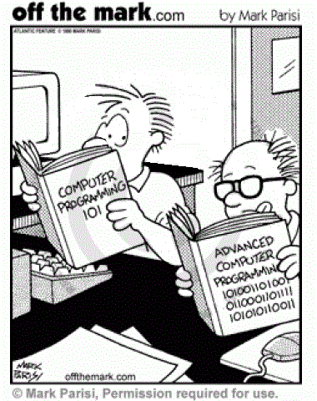
First Program in C++!!!
CISC220

Slide 2
##include <iostream>
using namespace std;
int main() {
cout << "!!!Hello World!!!" << endl; // prints !!!Hello World!!!
return 0;
} //main
#include <iostream>
# means do first (before you compile the rest of the code)
include means include this library or header in your program
iostream – a library with input and output functions (cin, cout)
using namespace std
means we don’t have to specify the std first.
E.g., If we didn’t say “using namespace std”, we’d have to specify std::cout instead of just cout
int main() {
Every C++ (and C) program must have a main function.
This function is run first and automatically.
Like base camp. It’s where you start, where you come back to, and where you end.
cout << “!!!Hello World!!!” << endl; // prints !!!Hello World!!!
cout: character out. You’re piping characters into cout and they get printed, usually to the console window
endl: new line. It also flushes out the buffer.
// comments.
Note that every line of code ends with a ;
return 0;
!!!Hello World!!!

