Slide 1
JS2: Random Numbers
Making everything cooler!

Slide 2
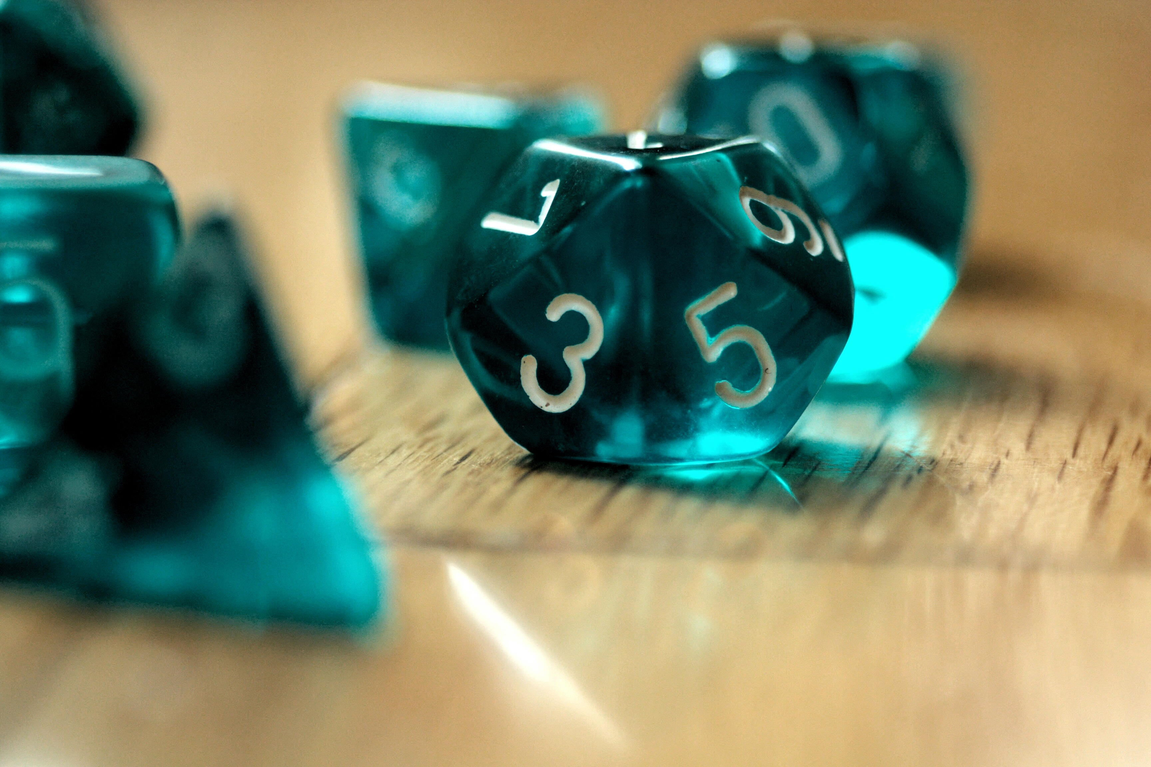
Random Numbers: Why do we want?
Every computer game in the world uses random numbers.
Things have to happen randomly or it’s not much of a game.
Random numbers are used any time you want something to happen unexpectedly
Having random pictures to show up in a display,
or random words of encouragement/information popping up in an app.
Other examples (you might not have thought of…):
synthesized voices.
Humans have breathiness in their voices.
That breathiness is really just random fluctuations in a sound wave
If you don’t have those random fluctuations, you get a very tinny, robotic sounding voice
Testing apps
We might want to randomly generate data to test our programs to make sure they work in all situations!

Slide 3
RandomNumber Example:
function randnumfunc(){
x = Math.floor(Math.random()*10)
alert(x)
}
And then in html:
<input type = “button” onClick ="randnumfunc()“ value = “Click to get a random number”>
Could also have (among other things…):
<p id = "p1" onClick ="randnumfunc()">Click to get a random number</p>

Slide 4
Random Numbers: How?
x = Math.floor(Math.random() * 10)
Putting random numbers into variables:
Explained:
With variables, what’s on the right goes into the variable on the left.
Remember?
x = 3
y=prompt(“What is your age?”)
In both cases, what’s on the right goes into the variable on the left
(Either 3, or what the user typed in as their age)
With Random numbers, the code on the right generates a random number between 0 and 10 (not including 10)
It puts that random number into the variable x, on the left

Slide 5
x = Math.floor(Math.random() * 10)
This generates a random number between 0 and 10 (not including 10)
puts that random number into the variable x.
The number 10 (in the code above) specifies the largest random number
will be 9!
Not 10 – up to 10, but not 10
The way this is written, only integers will be generated
So 1 or 4 or 7, etc.
NOT 1.3, 4.2, 7.8 (they’re not integers)

Slide 6
Generating different random numbers:
x = Math.floor(Math.random() * 3)
Now, the possible random numbers that x might hold would be 0, 1, or 2
not 3 - the smallest number is 0, and the largest is always one less than the number after the *
* means multiplication in javaScript (and most languages)

Slide 7
Next: Shifting set of random numbers:
What if you want a random number between 5 and 15? You’d do the following:
x = Math.floor(Math.random() * 10) + 5
Explained:
Math.floor(Math.random()*10) generates a random number between 0 and 9,
add 5 to whatever the random number is (+ 5).
So, for instance:
if the random number generated is 0
then after 5 is added, x will hold 5.
If the random number generated is 4,
then, after 5 is added, x will hold 9, and
if the random number generated is 9,
then x will hold 14.
Thus the smallest number is 0 + 5, or 5
The largest number is 9+5, or 14
so the range is from 5 to 14, which is what we wanted.

Slide 8
RandomNumber: Back to example:
function randnumfunc(){
x = Math.floor(Math.random()*10)
alert(x)
}
And then in html:
<input type = “button” onClick ="randnumfunc()“ value = “Click to get a random number”>
Could also have (among other things…):
<p id = "p1" onClick ="randnumfunc()">Click to get a random number</p>

Slide 9
If it isn’t working:
Make sure you’ve:
Linked the javascript file to the html file using <script src = …></script>
Have the function name in the html file and in the js file EXACTLY the same
Have both an opening and closing { } at the beginning and ending of the function
Make sure you have a small f in floor and a small r in random, but a large M for Math.
Make sure that you have the parentheses exactly right – two opening and two closing parentheses in the Math.floor(Math.random()*7)
Make sure you’ve got a variable to the left of the Math.floor(Math.random()*7)
Make sure you use the EXACT SAME variable inside the alert box parentheses

Slide 10
Another Example:
function getWeather() {
x = Math.floor(Math.random() * 5)
if (x === 0) {
alert("It will be sunny today")
}
else if (x === 1) {
alert("Expect thunderstorms today")
}
else if (x === 2) {
alert("Tornado alert")
}
else if (x === 3) {
alert("Blizzard conditions expected today")
}
else if (x === 4) {
alert("Today will be windy, with gusts of over 40 mph")
}
}

Slide 11
If it isn’t working 2:
Double-check all of If it isn’t working 1
Make sure that after each if and else if you’ve got an opening and closing ( )
Make sure that when checking to see if your variable is a number, you use === (not =)
Maker sure that each if and else if has an opening and closing { }

Slide 12
Take-Aways
Random numbers – fun stuff
To create: variable = Math.floor(Math.random()*number)
(replace variable with a variable name and
Replace number with a positive number)
Generates a random number between 0 and number (not including number)
TO shift: add +number (or you could also do –number)
E.g., x = Math.floor(Math.random()*10) + 6
Generates a random number between 6 and 16, not including 16
And you can use the variable in an if condition!!!

Slide 14
I’ve included a video with a more detailed explanation of what is happening – you can watch, or you can just use what I’ve taught you here.
x = Math.floor(Math.random() * 9)
Math.random() generates a random number between 0 and 1 (e.g., 0.4).
This number is multiplied by the range ( in this case 9):
Math.random() * 9 gives us 3.6
Math.floor(3.6) rounds down to the nearest integer, or 3
It chops off everything after the decimal point
Finally, you need a variable to put all this in.
x = 3

