Slide 1
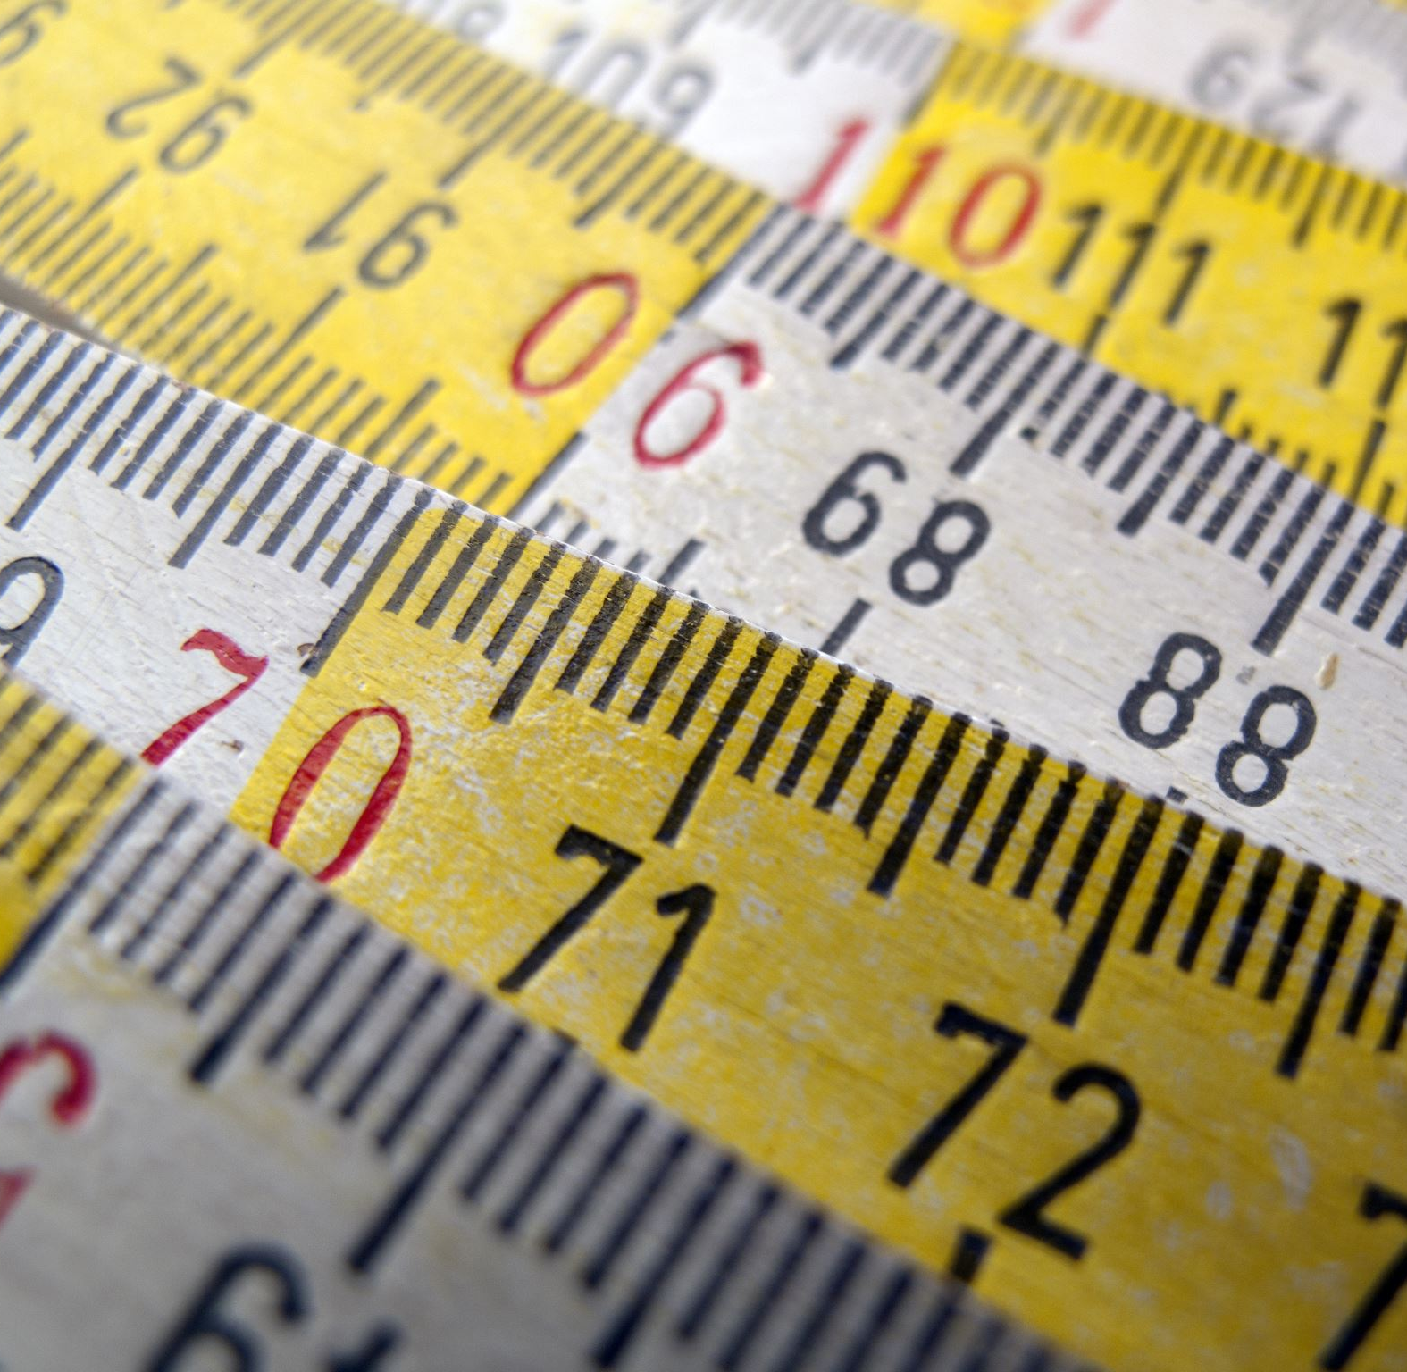
Changing width and height
Using getElementById

Slide 2
Changing width and height:
You can use getElementById to change the width and height of an element:
function grow(x) {
document.getElementById(x).style.width = "300px"
document.getElementById(x).style.height = "300px“
}
Try it:
If you send in the id of an image, the image should grow to 300 px in size.
If you send in the id of a paragraph, the paragraph will be 300x300px in size

Slide 3
Changing the width and height randomly:
We can change the height and width of an element to be a random number!
There are a few small tricks to do this successfully.
First:
we want the size to be between 20 and 470.
(We never want the size to be 0! So we have to add 20)
w=Math.floor(Math.random() *450) +20
The variable w now holds a random number between 20 and 470

Slide 4
Using Rand Num to set the size:
Function so far:
function randSize(x) {
w = Math.floor(Math.random() * 450) + 20
}
To set the size:
What we did so far was:
document.getElementById(x).style.width = “300px”
The number we want to replace with the random number is 300,
so instead of 300, we want to use w.
But, of course, w should not go inside the quotes
(because variables don’t go inside quotes).
And somehow you want to join the variable w’s content with the “px”
we need to specify that it’s pixels.
Can use + to join w and “px” (e.g., w+”px”)
All together:
function randSize(x) {
w = Math.floor(Math.random() * 450) + 20
document.getElementById(x).style.width = w+“px”
}

Slide 5
Repeat for height
And finally, we’ll repeat the process for the height:
function randSize(x) {
w = Math.floor(Math.random() * 450) + 20
document.getElementById(x).style.width = w+“px”
h = Math.floor(Math.random() * 450) + 20
document.getElementById(x).style.height = h+“px”
}
Now test it by adding an image to your html,
Make sure the image has an id
Make sure the image has the width and height set using css
Make either the image or a button call randSize with the id of the image.
The image’s size should change all wonky!

Slide 6
Take Aways:
You can use getElementById to change width and height
You can change them randomly
Tricks:
You should shift your random number up
So you don’t get zero
E.g., Math.floor(Math.random() * 500) + 10 makes random numbers between 10 and 510
You must somehow combine the variable holding the random number and “px”
To do that, use varnum+”px”
E.g.,
document.getElementById(par).style.width = varnum+”px”

