Slide 1
getElementById
Changing existing html code

Slide 2
Tools So far:
functions,
Parameters
Variables
alert box
prompts
if conditions
else if and else with the if condition
Random numbers
And now…

Slide 3
document.getElementById
getElementById lets you change elements in your html code that have an id.
Example:
function changeSrc() {
alert("Changing pic")
document.getElementById("pic1").src = "wombat.png"
}
And then in the html file:
<img src = "Images/penguin.jpg" style = “width:220px; height :220px;” alt = "a cute baby penguin" >
<input type = "button" value = "Click to change" onClick = "changeSrc()">

Slide 4
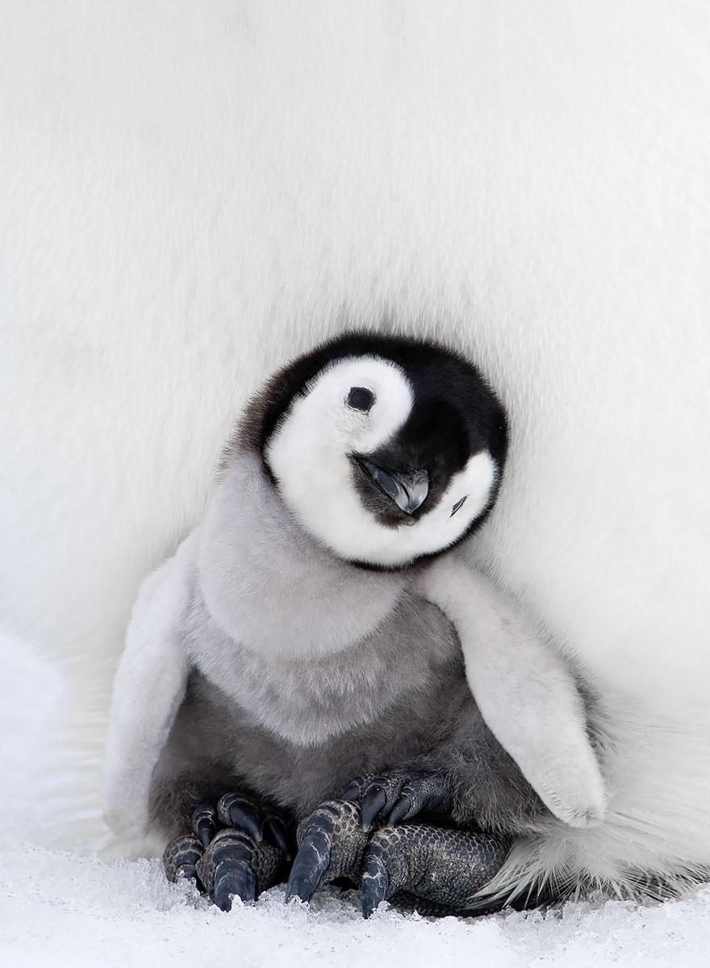
document.getElementById Explained:
getElementById only lets you change elements in your html code that have an id.
ALL html tags can be given an id.
Ids MUST BE unique
(Remember this?)
So the id uniquely identifies a tag on your web page
Example:
if you have an image on your web page, it might look like this in the html code:
<img src = "Images/penguin.jpg" style = “width:220px; height:220px;” alt = "a cute baby penguin" >
You can add an id to the image (e.g.,)
<img src = "Images/penguin.jpg" style = “width:220px; height:220px;” alt = "a cute baby penguin" id = "pic1">

Slide 5
Using getElementById to change the src:
Let’s start by using it to change a picture on your web page.
<img src = "Images/penguin.jpg" style = “width:220px; height:220px;” alt = "a cute baby penguin" id = "pic1">
Currently the src is “images/penguin.jpg”
If I want to be able to change the pic to a wombat, I can use getElementById to do that:
(In a JavaScript function):
document.getElementById("pic1").src = "Images/wombat2.png"
Explained:
To identify the image uniquely, I’d say the following:
document.getElementById(“pic1”)
to change the pic of the element with the id of “pic1” to something new, I want to change the src
document.getElementById("pic1").src
And to change the html tag with the id “pic1” from its current src (the penguin) to something new (the wombat), I’d have
document.getElementById("pic1").src = "Images/wombat2.png"

Slide 6
All together:
In HTML:
<img src = "Images/penguin.jpg" style = “width:220px; height :220px;” alt = "a cute baby penguin“ id = “pic1” >
<input type = "button" value = "Click to change" onClick = "changeSrc()">
JavaScript:
function changeSrc() {
alert("Changing pic")
document.getElementById("pic1").src = "wombat.png"
}

Slide 7
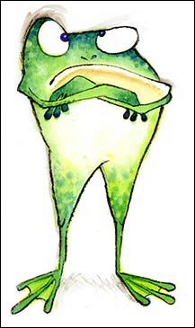
Didn’t work?
In getElementById
Small g, capital E, capital B,Capital I, small d
Quotes around the id inside the parentheses:
document.getElementById(“pic1”).src…
Make sure the images are either in the same directory as the html code, in which case you’d have:
document.getElementById(“pic1”).src = “wombat.jpg”
OR you specify the path to the image (like we did with images and links in html), e.g.,
document.getElementById(“pic1”).src = “Images/wombat.jpg”
.src, not .scr (yep, that happens too!)

Slide 8
Take-Aways:
document.getElementById
It’s a long command to type!!!
Connects your existing html page to your javaScript
So you can edit existing elements
Give your html tags a UNIQUE id
Then use document.getElementById to modify that html element
So far:
Can change an html tag’s src
To a new picture!

