Slide 1
Parameters
(Stuff inside the parentheses)

Slide 2
Recap:
So far we have (in our JavaScript) something like this:
function func1() {
alert("In a separate file!")
}
function func2() {
alert("You clicked on a bug!")
}
function func3() {
alert("You clicked on a pig!")
}
Only 2 differences between these 3 functions:
the function’s name,
what the alert box prints out.
What if we had 10 different buttons? What if we had 50?
Would we want 50 different functions, each of which only differed by what the alert box printed out?
No! We’re computer scientists, which means we’re lazy, gosh darn it! We don’t want to do all that typing!
I changed the name of the first function to func1()

Slide 3
Parameters will solve the problem!
function generalfunc(x) {
alert(x)
}
x is the parameter. You’ll soon see where this is going.*
<h1> JavaScript Parameter Test</h1>
<input type = "button" value = "click to run the javaScript" onClick = "generalfunc(‘in a separate file’)”>
<input type = "button" value = "click to run the second function" onClick = "generalfunc('you clicked on a bug’)”>
<img src = "button.png" style="height: 100px; width: 100px;" onClick="generalfunc('you clicked on a pig')">
Match Parentheses!!!
Whatever is after the function name and between the parentheses (in the html on the right) goes into x on the left
In the first button, you’ve got:
onClick = "generalfunc(‘in a separate file’)
when you click on the button, you’re activating generalfunc, and putting ‘in a separate file’ into x
x is empty until you click on something in your html file
Then x holds whatever is between the parentheses of the button you clicked on
*Technically, X is a box in memory that can hold values, like sentences or numbers. So when you run the code, “alert(x)” what will be printed in the alert box is whatever value is inside of x

Slide 4
Explanation of Parameters:
In this case, x is the parameter.
Parameters are an empty box
We named it x
By putting x between the parentheses, we’re creating a placeholder named x
it could have been y or z or puppies.
Whatever I put between the parameters in the javascript function is the name we give an empty box.
We will put values into x by clicking on buttons. Then inside the function, x is the temporary name for the sentence we send into the function.
When you click on the first button, you call the function generalfunc with the sentence, “in a separate file”.
That sentence goes into x
x now holds,“in a separate file.”
COOL PART:
alert(x)
X doesn’t pop up
What’s inside x pops up!!!!
So the alert box will say, “In a separate file.” !!!!!
EVEN COOLER PART:
When you click on the 2nd button, the sentence, “you clicked on a bug” goes into x
Now alert(x) will say, “you clicked on a bug”
And when you click on the third button, the sentence “you clicked on a pig” goes into x
Now alert(x) will say, “you clicked on a pig”

Slide 5
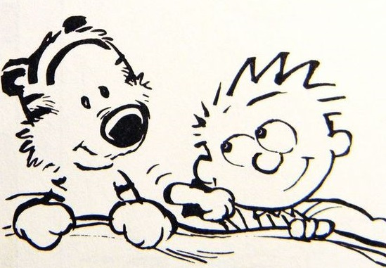
Create as many buttons as you want!!!
If in the JavaScript there is a parameter between the parentheses…
THERE MUST BE a word, a sentence (or a number) between the parentheses in the html calling of the function
They must match up!!
In other words, you can’t have:
function generalfunc(x) {
alert(x)
}
In your javascript, and then have in your html,
<input type = “button” value = “click for horse” onClick = “generalfunc()”>
Instead, you can (and should) have:
<input type = “button” value = “click for horse” onClick = “generalfunc(‘you clicked on a horse’)”>

Slide 6
Take Aways
Parameters:
Go between the parentheses
In your javaScript, the parameter gets a name
When you call it (by clicking on a button, so far), that value goes into the parameter
Then when you use the parameter name, what’s inside it is printed out
If a function in javascript has a parameter name between the parentheses, then the function call (the button) must have a value between its parentheses
They must match up – either both have something or neither does

