Slide 1
Multiple Functions
You can have a bzillion functions if you want!!!

Slide 2
Different functions do different things
Think Amazon:
You click on “Add to Cart”
This will call a function that has code for taking the item you’re looking at and putting it into a holding place for you to view later when you checkout
You click on “Buy Now”
This will call a function that has code that takes you right to the purchasing code so you buy the item you’re looking at immediately
You click on “Save for Later”
Calls a function with code that takes the item you’re looking at and puts it in a holding place (a different one than the Add to Cart holding place) for you to be able to look at it and consider it later.

Slide 3
How (the easy part!)
In the separate file, or in the head section:
You already have:
function puppies() {
alert("In a separate file!")
}
Below that, just type:
function secondFunc() {
alert(“You ran a second function!")
}
Then save your file:
In your html file:
You already have:
<input type = "button" value = "click here to run the javaScript" onClick = "puppies()">
Now add another button:
<input type = "button" value = "click here to run the second JS function" onClick = “secondFunc()">
Then save your file.
Test it by loading it into a browser and clicking on the two buttons. You should get two different alert boxes depending on which button you click on

Slide 4
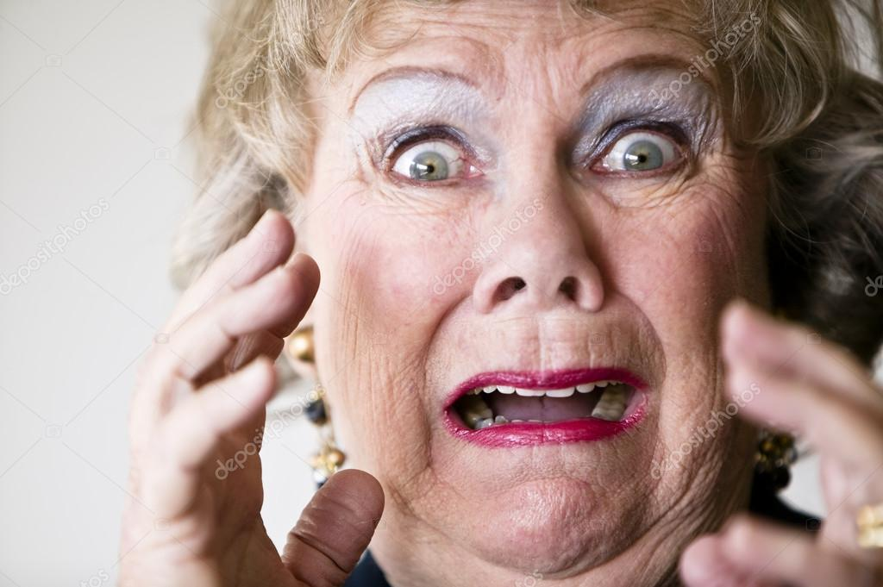
Didn’t work?
Make sure you spelled function with a small f
Make sure you spelled the function names EXACTLY the same in the button call and in the function naming (caps and small letters)
Make sure there are no spaces or special characters in your function names
Make sure you didn’t copy code from the powerpoint or MS Word documents (because the funky quotes are different - " versus “
Make sure you have quotes around things (i.e., at both ends!)
alert("In a separate file!) won’t work
alert("In a separate file!") will
Make sure you’ve got both a { and a } around the function code
Make sure after the function name you’ve got ()
Make sure alert has a small a

Slide 5
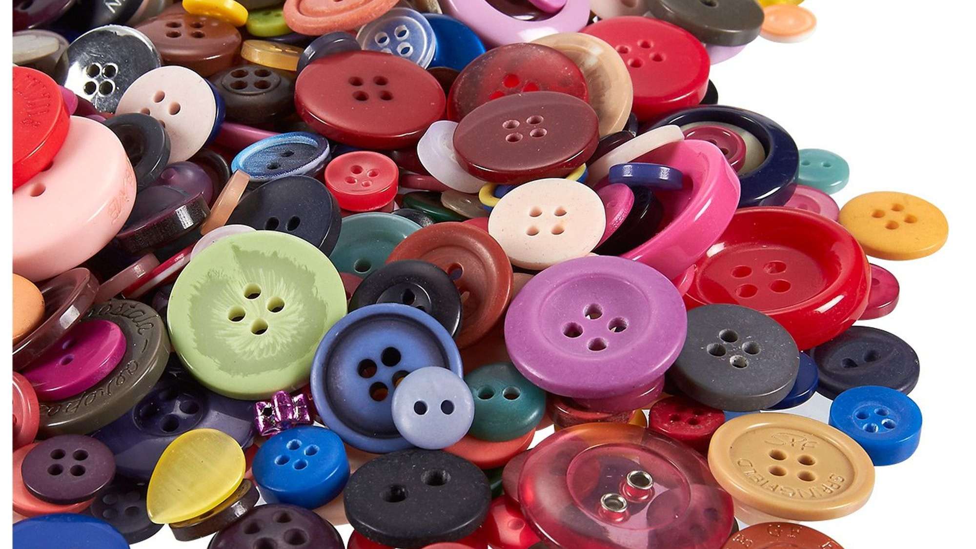
Better Buttons!!!
So Far:
using the button form element
Instead:
Let’s click on an image to call a function!
Step 1. Download a picture of a button (or anything you want!)
Step 2. Add the image you just downloaded to your html code.
Step 3. Modify the button so that when you click on it, it calls a new function. So my html code looks like this:
<h1> JavaScript Test</h1>
<input type = "button" value = "click here to run the javaScript" onClick = "puppies()">
<input type = "button" value = "click here to run the second function" onClick = "func2()">
<img src = "button.png" style = "height: 100px; width: 100px;" onClick = "func3()">

Slide 6
Better Buttons!!!
Final Step!
Step 4. Add another function (in my case, func3() ) to your javascript. Make the alert box say something different.
function func3() {
alert(“A function called by clicking on an image!")
}
If you save this file and now click on the image you inserted, an alert box with “A function called by clicking on an image!” should pop up!

Slide 7
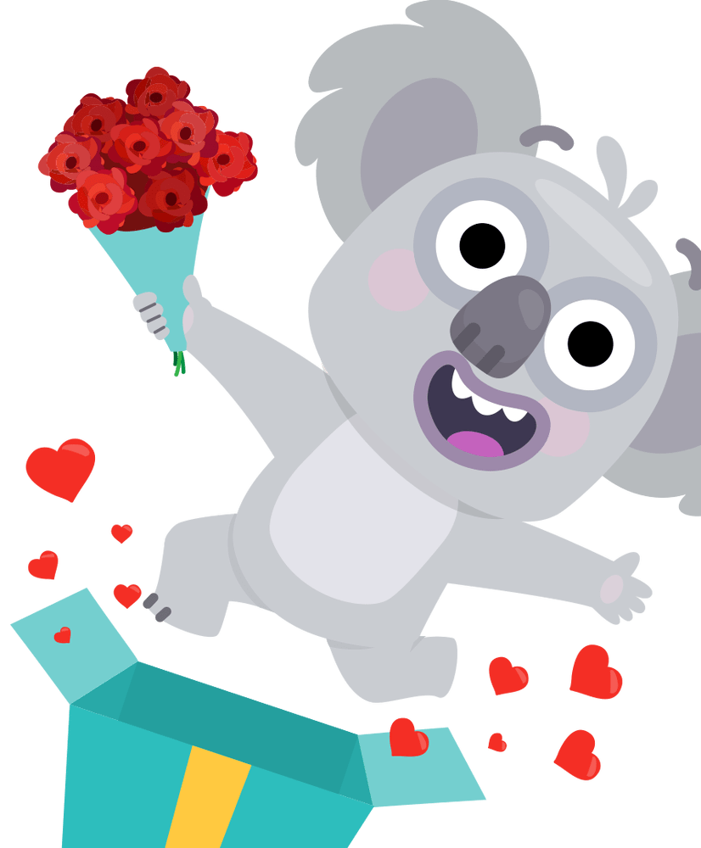
TakeAways
Functions: are names for code
They get called when we do something (e.g., click on a button that calls a function)
Functions can go in body (bad), head section (meh) or a separate file (good!)
You can have multiple functions
You can have a bzillion functions (but not a bzillion and 1 – that would be too many)
When calling a function:
You can call a function from any html element
We’ve seen form buttons
And now images!
Congratulations!!!!! You‘re a programmer!
That’s pretty much it – you’ve learned it all. Now go get a job making 100k/year!
J.K. There’s a bit more…

