Slide 1

Branching
If Conditions

Slide 2
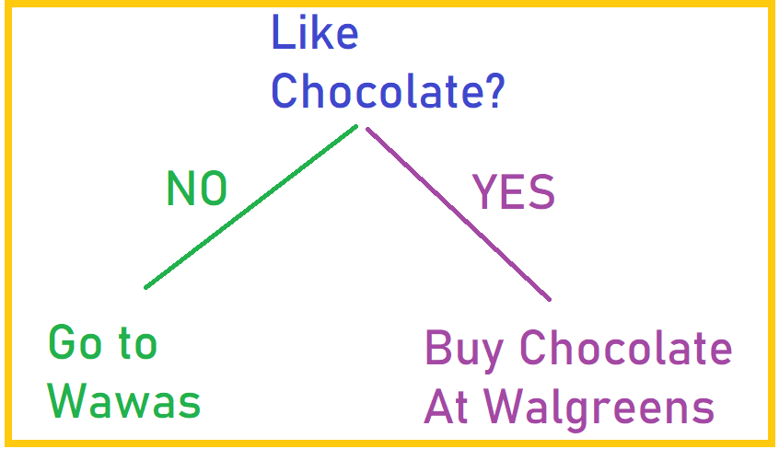
Branching:
You would say something like:
  “if it’s sunny, I’ll play tennis with you. Otherwise I’m going to stay home”
  “if you like chocolate, we’ll buy some at Walgreens. Otherwise we’ll just go to Wawa.”
There’s something similar in code!
It’s called an if condition
we refer to if conditions as “branching” because there are 2 paths you could take
  (in the above example, you’d take one path or plan if it is sunny and another if it isn’t)
An if condition is conditional:
  if this is true, do one thing,
  if it isn’t, do something else.

Slide 3
If condition in code:
y=prompt("do you like chocolate?")
if (y === "yes") {
alert(“Okay, let’s go buy some at Walgreens!")
}
else {
alert(“Then let’s just go to Wawas.")
}

Slide 4
All Together:
HTML (I’m just showing you the button code)
JavaScript
…
<input type = “button” value = “click to call js” onClick = “branchfunc()”
…
function branchfunc() {
  y=prompt("do you like chocolate?")
  if (y === "yes") {
  alert(“Okay, let’s go buy some at Walgreens!")
  }
  else {
  alert(“Then let’s just go to Wawas.")
  }
  }

Slide 5
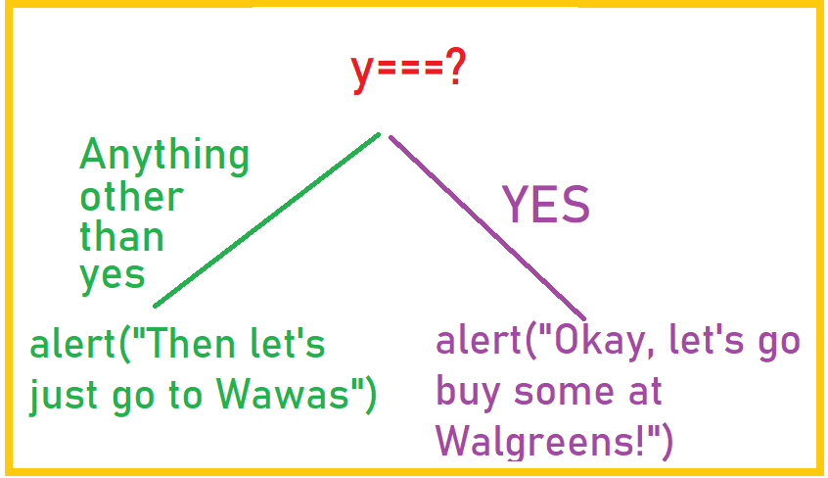
If condition info
if condition:
only 2 possibilities:
  either the user typed in yes,
  or the user didn’t.
You only do one of the alert boxes, based on whether y is “yes” or not
    1. If the user typed in yes, the code runs the first condition and the alert box says, “Okay, let’s go buy some at Walgreens!”.
    2. If the user typed in anything at all other than “yes” , the code runs the second condition and the alert box says, “Then let’s just go to Wawas.”)
y=prompt("do you like chocolate?")
if (y === "yes") {
alert(“Okay, let’s go buy some at Walgreens!")
}
else {
alert(“Then let’s just go to Wawas.")
}

Slide 6
More If condition info in if conditions, always use ===
y=prompt("do you like chocolate?")
if (y === "yes") {
alert(“Okay, let’s go buy some at Walgreens!")
}
else {
alert(“Then let’s just go to Wawas.")
}
===
  Simplified:
    In if conditions: use === (always) when checking for equivalence
      Because y=“Yes I can” put the string “Yes I can” into y
      So can’t just use =
  Complicated explanation:
    If (y === “yes”)
    tests to see whether y holds “yes” or not.
    There are only 2 possible answers to this question: yep, y holds yes, or nope, it doesn’t.
    The === is asking a question: is y holding yes?
      As opposed to y=“yes”
        Which places “yes” in y
    If that doesn’t make sense, just remember that in an if condition, you use 3 equals signs is used in if conditions

Slide 7


One more note:
Don’t put quotes of any kind around variables or parameters!
If (“y” === “yes”) { IS WRONG AND WON’T WORK!!!
If (y === “yes”) { is CORRECT
Explanation:
when you put quotes around things, they are interpreted literally.
  So I mean “yes” literally.
But I mean the value inside of y, not the letter y.
  So I don’t want to put quotes around the y or it becomes the letter y instead of the name of a box with a value inside of it

Slide 8

else if
function elsefunc() {
y=prompt("what is the temperature?")
if (y <40) {
alert(“Wear a heavy jacket and mittens!")
}
else if (y<60) {
alert(“Wear a light jacket.")
}
else {
alert(“Make sure you wear sunscreen!")
}
}
what if you have something with more than 2 possibilities?
In English:
  “If the temp is below 40, wear a heavy jacket and mittens! Otherwise, if it’s below 60, wear a light one. Otherwise, wear sunscreen!”
In code:
If there are more than 3 possibilities, you can have multiple else if conditions.
  If you have an else, it must be the last thing!
  And it does not have a condition, in other words, you can’t have:
    else (y>60) IS BAD!!!!!!!!

Slide 9
One more example:
function elseiffunc() {
y = prompt("What month is it (Enter as a number)?")
if ((y >=1) && (y <4)) {
alert("It's winter!")
}
else if ((y >=4) && (y < 7)) {
alert("It's spring!")
}
else if ((y >= 7) && (y < 10)) {
alert("It's summer!")
}
else {
alert("It's winter!")
}
}
Notes:
>= read as greater than or equal to
&& read as and
So if you were to read this line, you’d read it as:
“If y holds a number greater than or equal to 1 and y holds a number less than 4…”
If you wanted to get even more specific:
“If the number the user typed in that y now holds is greater than or equal to 1 and that number in y is less than 4..”
Basically, you’re just translating from English to computerese!! Learning to speak geek!

Slide 10
Take Aways:
If conditions – check if a condition is true, and, if so, does specific code associated with that condition
You MUST USE === when checking to see if 2 things are the same in an if condition
No quotes around variables or parameters (like x and y)
If you have more than 2 conditions, you can use
  else if
You can have multiple else if conditions
  Last should be an else (it has no actual condition)
>= means greater than or equal to
&& means and

