Slide 1
Adding JavaScript
The POWER!!!

Slide 2
Terms:
HTML: a mark-up language used for web pages (no power)
CSS: a system for adding style to web pages – css allows developers to choose how to style the html elements in a web page
JavaScript: a programming language (like java, python, c++, etc)
Developed to work with html code
Much more powerful than html!
Allows developers to create dynamic web pages
Dynamic Web pages: web pages that change based on user input (clicking on things, running your mouse over something, etc. This is different from static web pages, or plain basic html pages that don’t change based on user actions.

Slide 3
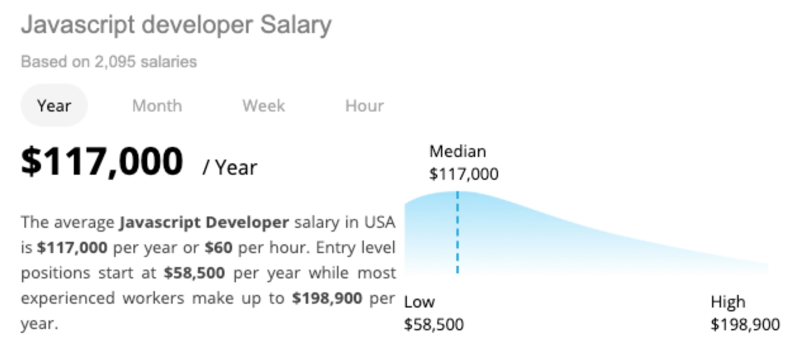
JS Facts:
JavaScript is built into every major browser
JavaScript is free
JavaScript is one of the three most sought-after programming languages employers are looking for
JavaScript is (still!) one of the fastest growing programming languages

Slide 4
3 ways to add JavaScript
Method 1: Include the javaScript in the body of the web page:
<!DOCTYPE html><html lang = "en">
<head>
<meta charset = "utf-8">
<title>JavaScript In the Body</title>
</head>
<body>
<h1> JavaScript Test</h1>
<script>
function yourfirstfunc()
{
alert("Hello World!")
}
</script>
<input type = "button" value = "click here to run the javaScript" onClick = "yourfirstfunc()">
</body>
</html>
Try: Your html page should have a button, and when you click on it, an alert box should pop up.

Slide 5
Didn’t Work?
If it doesn’t work, check spellings closely – make sure:
You spelled script “script” and not “scirpt“ (yep, that happens a lot!)
You opened and closed the script tag (<script> </script>)
The <script></script> tags are not inside of paragraph, tables, lists, etc.
You spelled function correctly
You had a small ‘a’ in alert
You had an opening { at the beginning of the function and a closing } at the end of the function
In the button, after onClick, the name of the function matches perfectly with the name of the function in the script.
Caps and small letters matter.

Slide 6
Explanation of first JavaScript
<script></script>
Anything between these two tags is in javaScript and not in html.
Browser is reading html, css, and javascript
We need to tell it to read the code between script tags as javaScript
function yourfirstfunc()
We’re naming code.
all code between the { and the } is now named yourfirstfunc().
Right now the only code between the { and the } is an alert box, but in the future we will add more code to functions, so this will be a lot more useful.
yourfirstfunc()
you can name functions just about anything.
E.g., yourfirstfunc(), func1(), alertfunc(), or even henry().
Yep, you could name a function henry().
{ … }
The code that belongs to yourfirstfunc() must all go between the opening { and the closing }.
You are naming lines of code
(in this case, one line, the alert(“Hello world”) line of code).
Indiate what lines of code belong to the function,
Everything between the opening and closing { and }.
<!DOCTYPE html><html lang = "en">
<head>
<meta charset = "utf-8">
<title>JavaScript In the Body</title>
</head>
<body>
<h1> JavaScript Test</h1>
<script>
function yourfirstfunc()
{
alert("Hello World!")
}
</script>
<input type = "button" value = "click here to run the javaScript" onClick = "yourfirstfunc()">
</body>
</html>

Slide 7
Making the JavaScript Happen
So far we’ve named some code.
It doesn’t happen unless we CALL it (do something that makes it happen)
<input type = "button" value = "click here to run the javaScript" onClick = "yourfirstfunc()">
The button is html code. It is outside the script. The tag has an onClick:
onClick =
The onClick means that when you click on the button, something will happen.
onClick = “yourfirstfunc()”
when you click on the button, you are activating yourfirstfunc().
The name of the function here (yourfirstfunc() ) must match exactly the name of the function in the script.
E.g., in this example, you will not get the alert until you click the button.
<!DOCTYPE html><html lang = "en">
<head>
<meta charset = "utf-8">
<title>JavaScript In the Body</title>
</head>
<body>
<h1> JavaScript Test</h1>
<script>
function yourfirstfunc()
{
alert("Hello World!")
}
</script>
<input type = "button" value = "click here to run the javaScript" onClick = "yourfirstfunc()">
</body>
</html>

Slide 8
Take Aways:
JavaScript:
Powerful
Dynamic
Built into browsers
Interacts with HTML and CSS
Fully functional programming language!!!
3 ways to add JavaScript to your web page
Like CSS that way
Method one:
In your body, add <script></script>
And put the javascript code between the script tag
Functions:
Names we give to javascript code
We name it then use { to start the code belonging to that function and } to end the code belonging to that function
Functions don’t happen until we call them
In this case, using an onClick in a button

