Slide 1
Float
Positioning using CSS

Slide 2
Positioning
So far:
we can set:
height
width
padding
Margin
Margin-auto for centering tags with the width set
With Text:
we can set:
Text-align
Line-height
Text-indent
But what if you want to position a tag on the web page?

Slide 3
Float
First way to position tags on a page
Float:
When you add float style to a tag:
everything below the tag flows up and around the tag
Probably easier to understand if you see how it works…

Slide 4
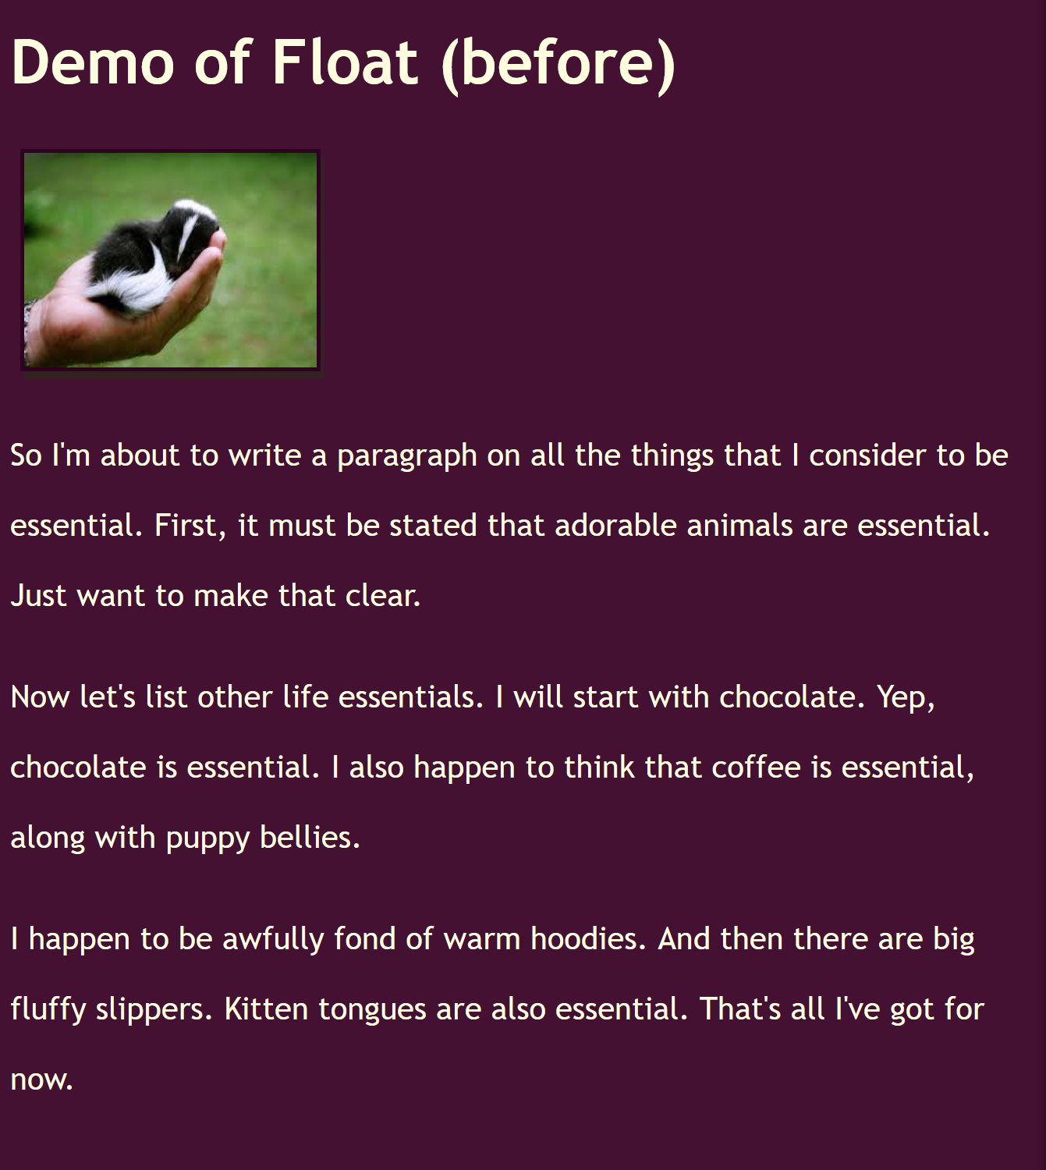
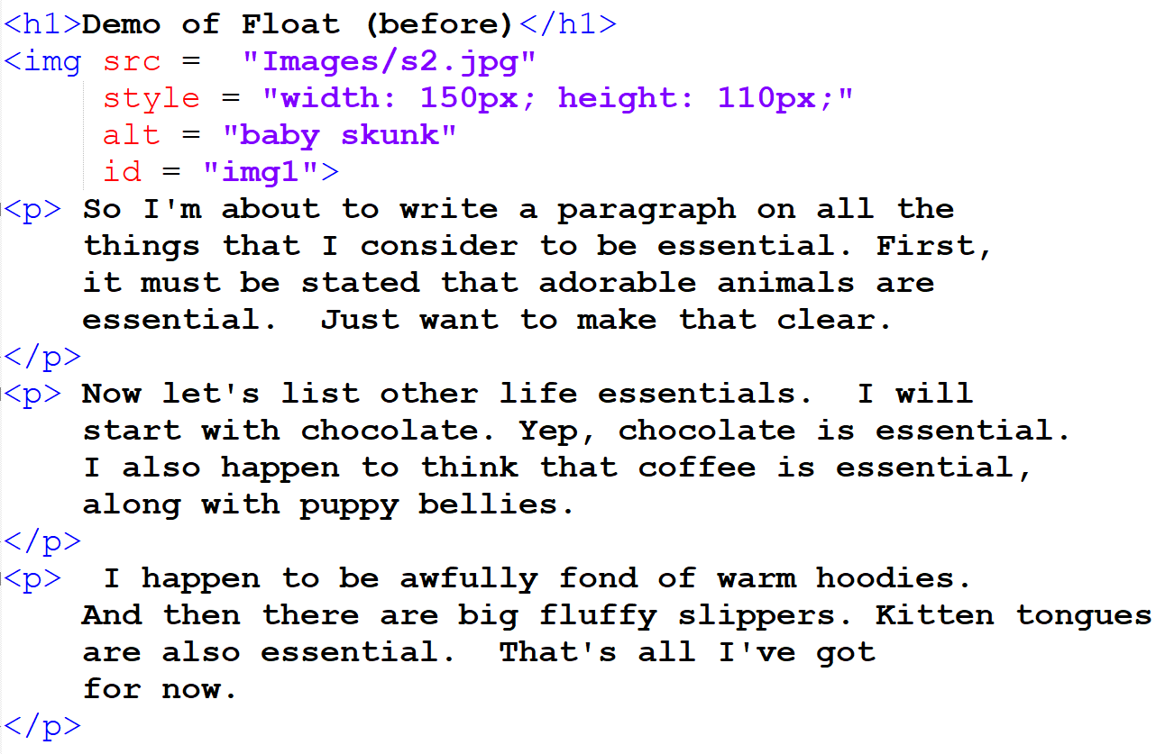
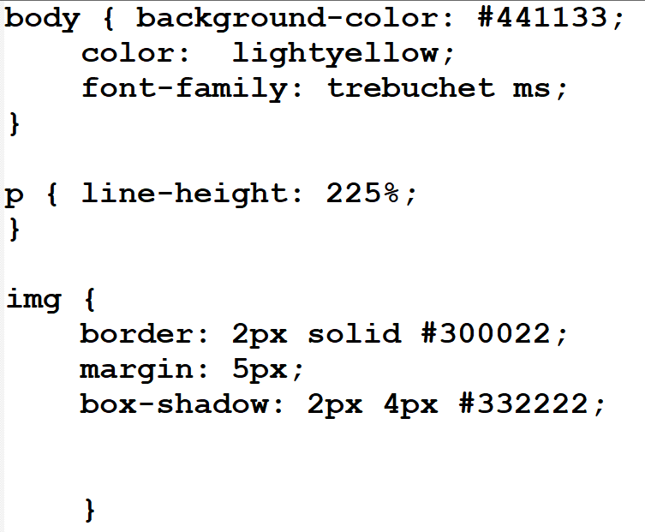
WithouT Float
Note the Image on the web page:
Without positioning, every tag is placed one under the other
So the first paragraph is placed UNDER the image
(Hence the big empty space to the right of the image on the web page

Slide 5
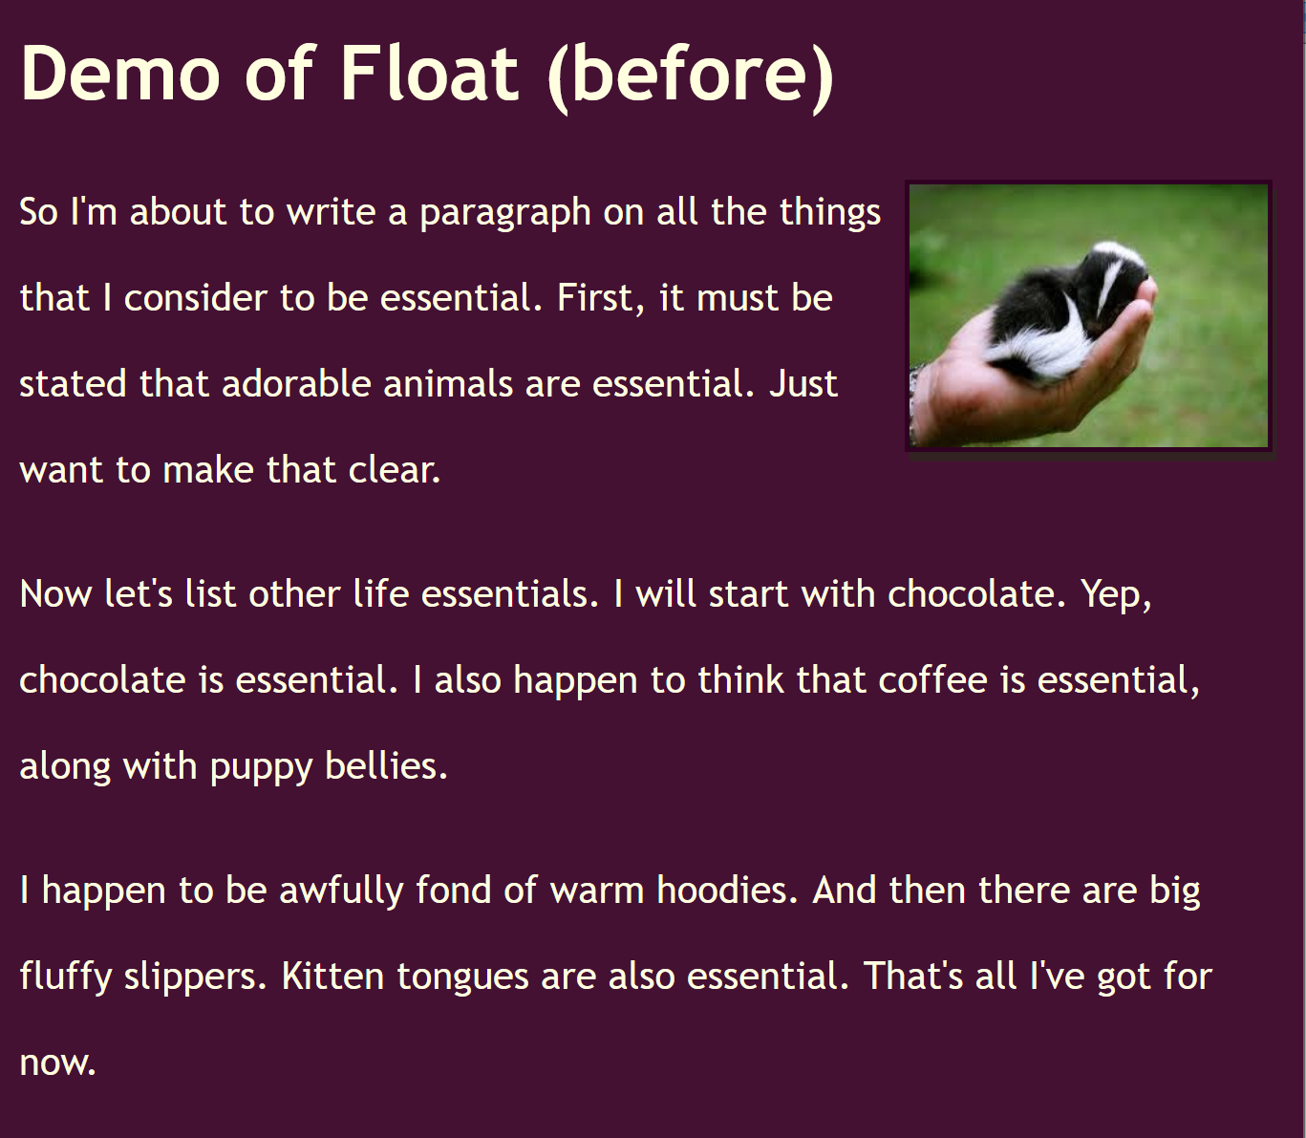
With Float
float: right;
With float
Everything BELOW the floated tag flows up and around the tag
Only tags below flow around the floated tag
Can float right or left
Cannot float: center;

