Slide 1
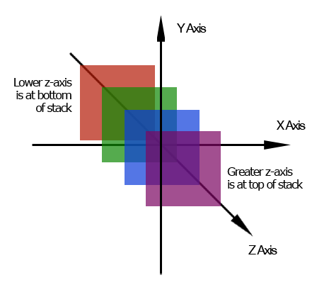
Z-index
Positioning things on top of each other

Slide 2
Positioning: 2 categories:
Category 1: Positioning within the flow of the web page
Float: (right or left);
tags stay in the flow of the rest of the web page.
Things flow around each other
(no tag goes under another tag)
Category 2: Positioning that removes a tag from the flow of the web page: *
Position: absolute;
Position: fixed;
Position: relative;
Tags removed from the flow of the web page.
Tags flow over or under the positioned tag
(So you can’t read it)
* For Z-Index, we’re focusing on category 2!

Slide 3
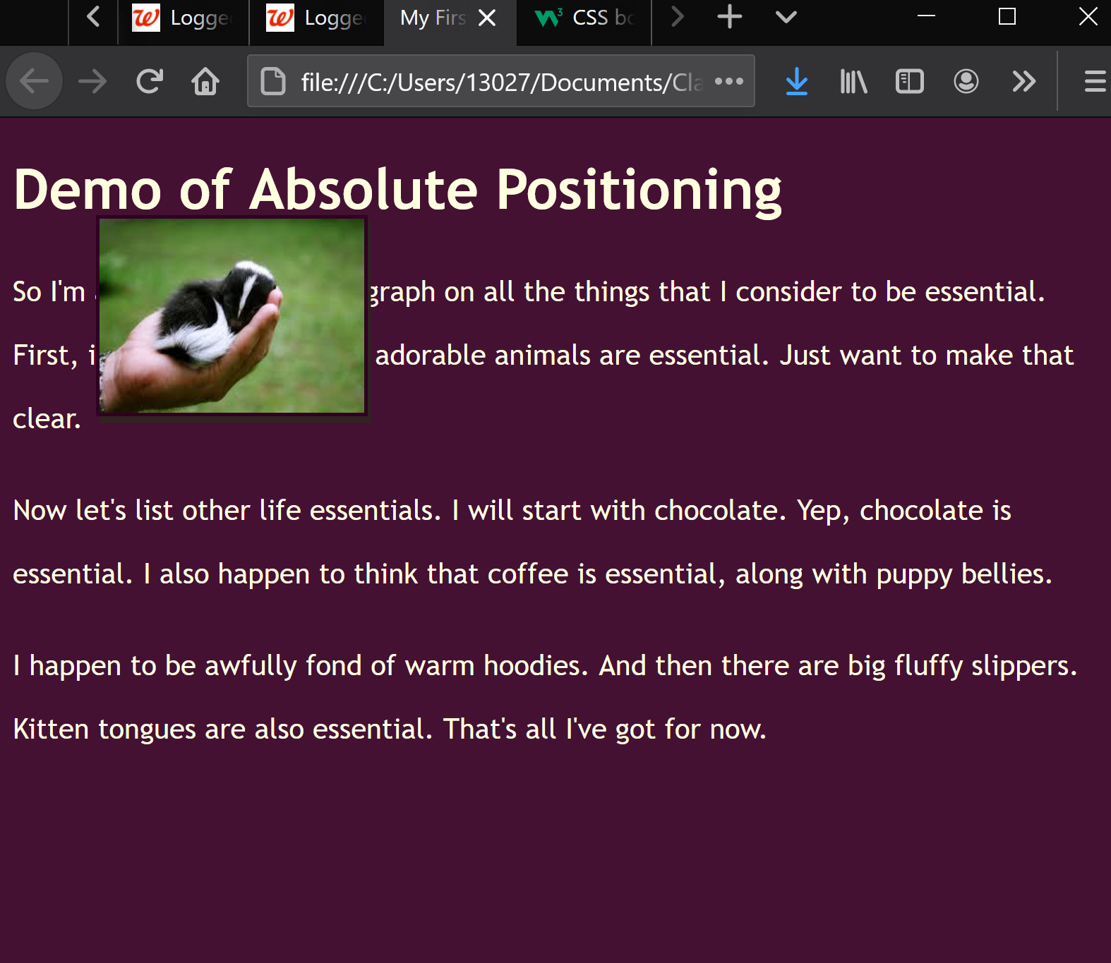
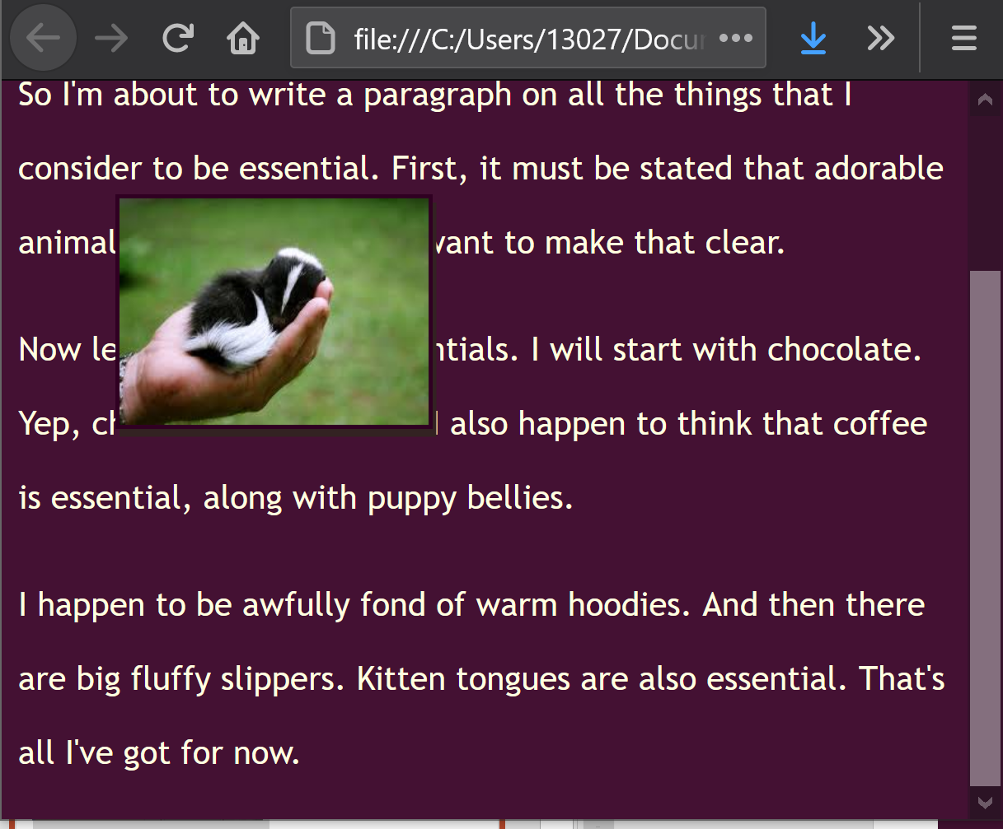
Positioning that removes tags from the flow of the document:
One tag can end up on top of another tag(s):
You’ve seen this:
position: absolute;
position: fixed;
position: relative;

Slide 4
What if you want to switch which tag is on top?
In this example:
#p2 is on top of #p1
#p3 is on top of #p2
Z-Index: tells which tags are on top of each other
In this example,
z-index of #p1 is 1
z-index of #p2 is 2
z-index of #p3 is 3
(layer 3 on top of layer 2 on top of layer 1)
To change: for any tag, set the z-index

Slide 5
Example of z-index:
#p1 {
background-color: #110040;
}
#p2 {
background-color: #303370;
position: relative;
top: -50px;
left: 225px;
z-index:-1;
}
#p3 {
background-color: #505490;
position: relative;
top: -90px;
left: -30px;
}
Before
Now #p2 is behind the other tags

Slide 6
Example #2 of z-index:
#p1 {
background-color: #110040;
}
#p2 {
background-color: #303370;
position: relative;
top: -50px;
left: 225px;
z-index:4;
}
#p3 {
background-color: #505490;
position: relative;
top: -90px;
left: -30px;
}
Before
Now #p2 is in front of the other tags

Slide 7
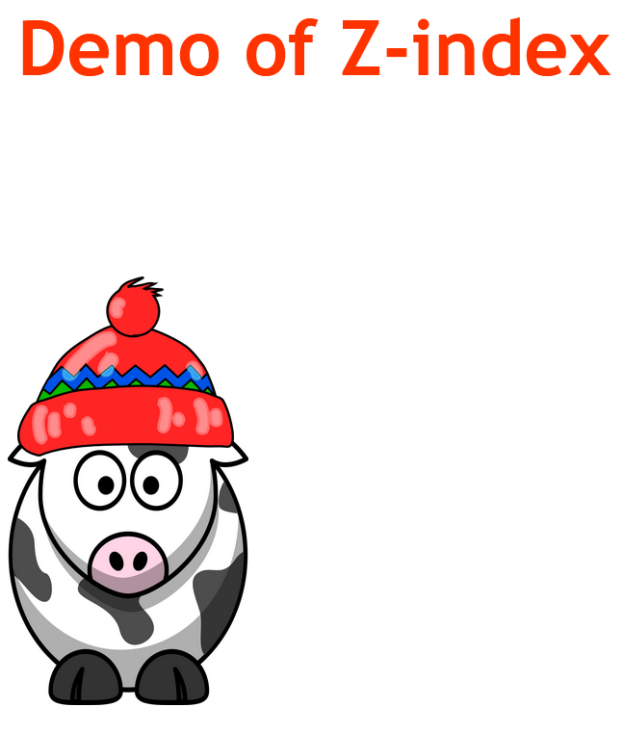
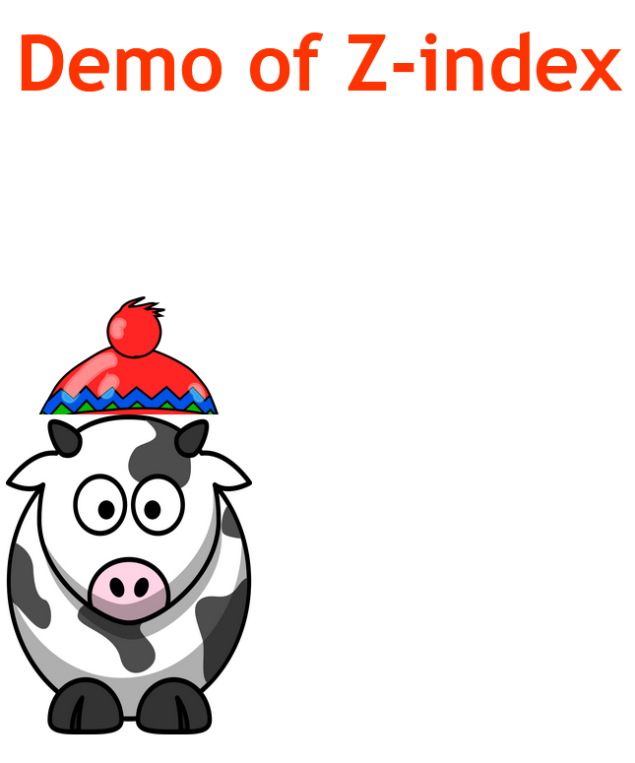
One more example:
No Positioning:
Relative positioning
of the cow:
Relative positioning
with z index set:
#img2 {
position: relative;
top: 103px;
left: -99px;
}
#img2 {
position: relative;
top: 103px;
left: -99px;
z-index: -1;
}

Slide 8
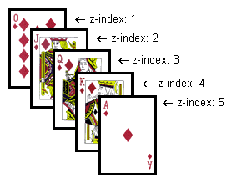
Takeaways!
Z-index:
Indicates which tag goes on top of other tags versus below other tags
Used with:
position: absolute;
position: fixed;
position:relative;
Range: z-index can go from
-99 99

