Slide 1
Span
Adding CSS Style within elements

Slide 2
SpaN: for styling within a Tag
What if you want to style a word or phrase that is inside of another tag?
E.g., in my powerpoints, I try to highlight certain words or phrases I think are important and thus I want them to visually stand out
You can create and style a span tag for that purpose!!

Slide 3
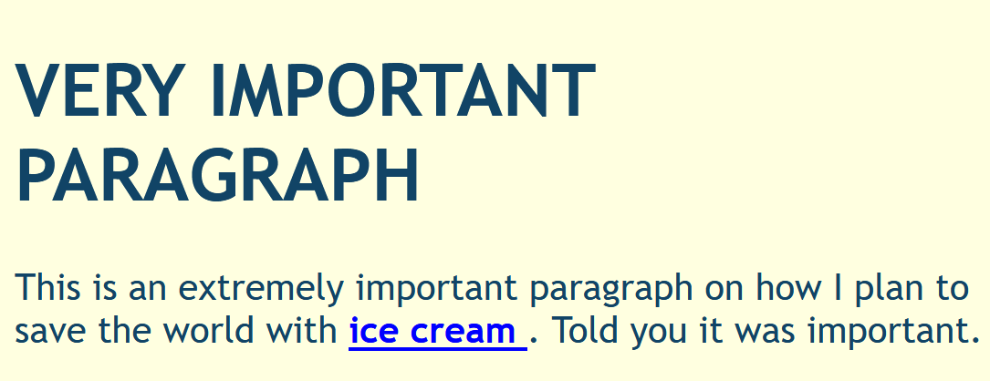
Example
HTML Code (with span)
What it looks like in the browser
CSS Style of span

Slide 4
Span Notes:
These go INSIDE other tags
Div Tags go around other tags
BAD:
<p> this is a <span id = “s1”>emphasized word </p></span>
GOOD:
<p> this is a <span id = “s1”>emphasized word </span></p>
Need to close the span before you close
its surrounding tag
Closed Span first – now I’m happy!

Slide 5
Takeaways:
Span goes INSIDE another tag
DIV goes AROUND other tags
You must close the span before you close the other tag
That’s pretty much it…

