Slide 1
Relative Positioning
position: relative;

Slide 2
So Far:
float: has tags surrounding the floated tag flow up and around the floated tag
position: absolute: positions tag based on the edge of the web page (or the surrounding tag, if it’s inside a <div> tag
position: fixed; positions tag based on the edge of the browser (so doesn’t scroll)
Now: we’re going to position based on where the tag would have been with no positioning (got that?)

Slide 3
position: relative;
Positions based on where the tag would have occurred in the web page without any positioning.
Best way to do this:
make your web page with your tags
look at where the tags occur (especially the tag you want to reposition)
Look at where you actually want that tag to occur
Add the position:relative; positioning

Slide 4
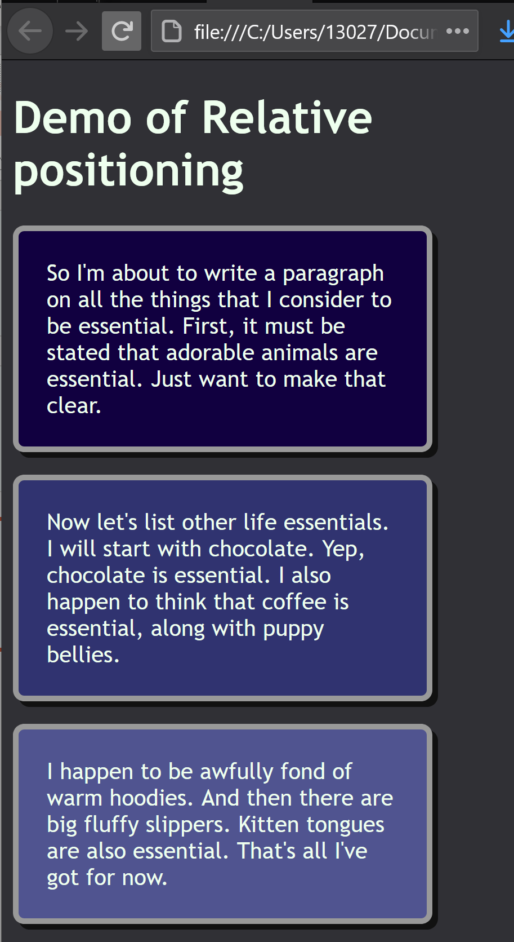
Example (before):
What I want is #p2 (“Now let’s list…” paragraph) to move up and to the right, so it’s over the bottom corner of the #p1 (“So I’m about…” paragraph)
To move up, use a negative number (e.g., top: -50px;)*
To move down, use a positive number (e.g., top: 50px;)*
To move left, use a negative number (e.g., left: -40px;)*
To move right, use a positive number (e.g., left: 30px;)*
So putting it all together:
#p2 {
position: relative;
top: -50px;
left: 225px;
}
(see what adding this positioning looks like on the next slide…)
*Based on positioning from the top and left, which is how we’re doing it

Slide 5
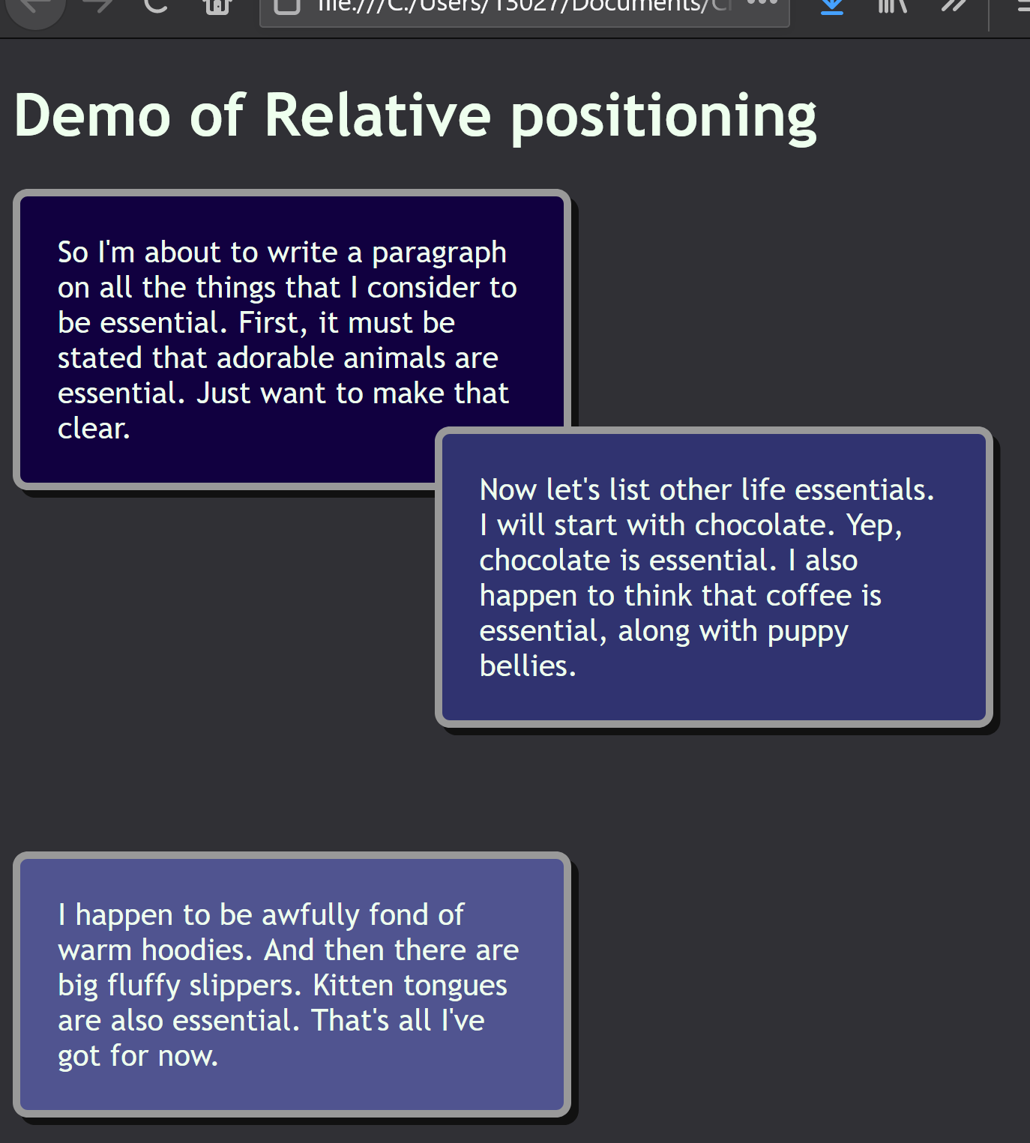
Example (After positioning relative)
body { background-color: #303035;
color: #eeffee;
font-family: trebuchet ms;
}
p {border: 4px solid #999999;
border-radius: 8px;
padding: 20px;
width: 250px;
box-shadow: 4px 4px #111111;
}
#p1 {
background-color: #110040;
}
#p2 {
background-color: #303370;
position: relative;
top: -50px;
left: 225px;
}
#p3 {
background-color: #505490;
}
This is #p2’s new position when positioned -50 pixels
Down from the top and 225 pixels over from the left relative to where it occurred without any position style
This paragraph has an id of #p2
This is where #p2 occurred without
any position style

Slide 6
Another Example
body { background-color: #303035;
color: #eeffee;
font-family: trebuchet ms;
}
p {border: 4px solid #999999;
border-radius: 8px;
padding: 20px;
width: 250px;
box-shadow: 4px 4px #111111;
}
#p1 {
background-color: #110040;
}
#p2 {
background-color: #303370;
position: relative;
top: -50px;
left: 225px;
}
#p3 {
background-color: #505490;
position: relative;
top: -90px;
left: -30px;
}
#p3, before and after positioning relatively

Slide 7
Takeaways:
position:relative;
Positions relative to where a tag would occur on your web page without any positioning.
So look at your web page without the tag positioned at all
and then use relative positioning to shift it around
*negative numbers move it up towards the top
*positive numbers move it down towards the bottom
*negative numbers move it to the left
*positive numbers move it to the right
*assuming your positioning from the top and left – you can also position from the bottom or from the right, but for our purposes, assume you’ll be positioning from the top and the left.

