Slide 1
Lists
Styling with CSS

Slide 2
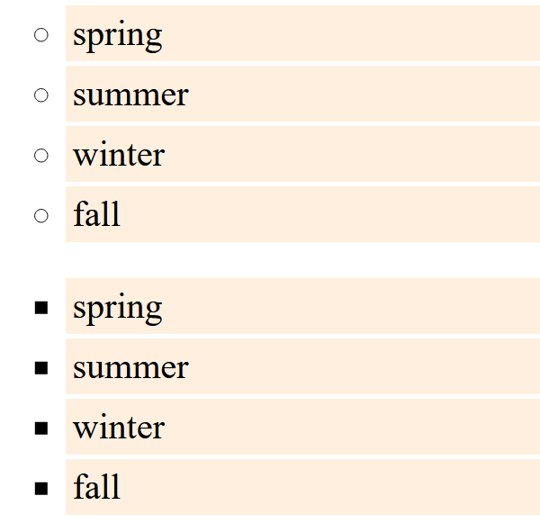
List-style-type: Unordered Lists:
ul {
list-style-type: circle;
}
ul {
list-style-type: square;
}

Slide 3
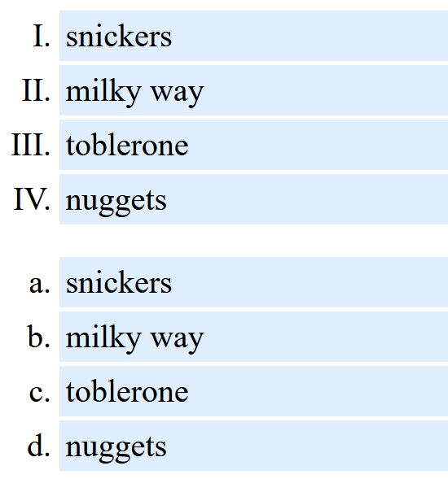
List-style-type: Ordered Lists
ol {
list-style-type: upper-roman;
}
ol {
list-style-type: lower-alpha;
}

Slide 4
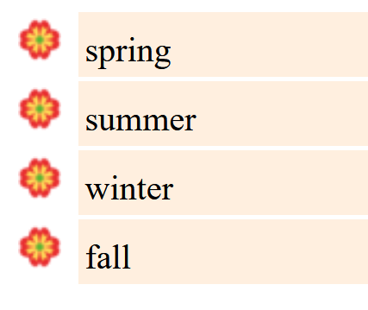
List-style-image
ul {
list-style-image: url(“tinyflower.png”);
}
ol {
list-style-image: url(“choc.gif”);
}
Note how the bullet
appears outside of
the background color
for list items
We’ll fix that next...
Note: it’s list-style-image, as opposed to list-style-type
Works for both ul and ol

Slide 5
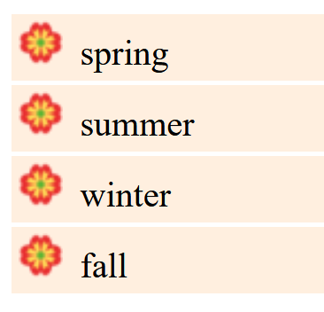
list-style-position: inside;
ul { list-style-position: inside;
}
This works for centering text too – if you want to center your
list, and want the bullets to be centered with the text, use
list-style-position: inside;

Slide 6
Takeaways
Can set unordered list style type:
circle
square
Can set ordered list style type:
upper roman
lower alpha
Can set the list bullet to be an image
list-style-image: url()
Finally, if you want the bullet to be grouped with the list item, use
list-style-position: inside;

