Slide 1
More on ID
In terms of styling (CSS)

Slide 2
How to use IDs
ANY Tag can be given an id
E.g., <p id = “p1”> A paragraph on something </p> <table id = “plan”> <tr><td>... <img src = “puppy.jpg” alt = “cute puppy” id = “pup” style = “width: 250px; height: 125px;”> <div id = “content”>…</div> etc.

Slide 3
Naming ID:
Rules for id name:
MUST BE UNIQUE on the web page
Uniquely id’s an element
No spaces
No special characters
(except _ the underscore is allowed, e.g., <p id = “two_puppies”>…)
Can’t be a tag
(so you couldn’t have <p id = “p”> or even <p id = “table”>)

Slide 4
Then styling an id with CSS: (you’ve seen this already…)
#puppies {
color: blue;
background-color: green;
border: 2px solid orange; }
<p id = “puppies”> This is a paragraph about puppies </p>

Slide 5
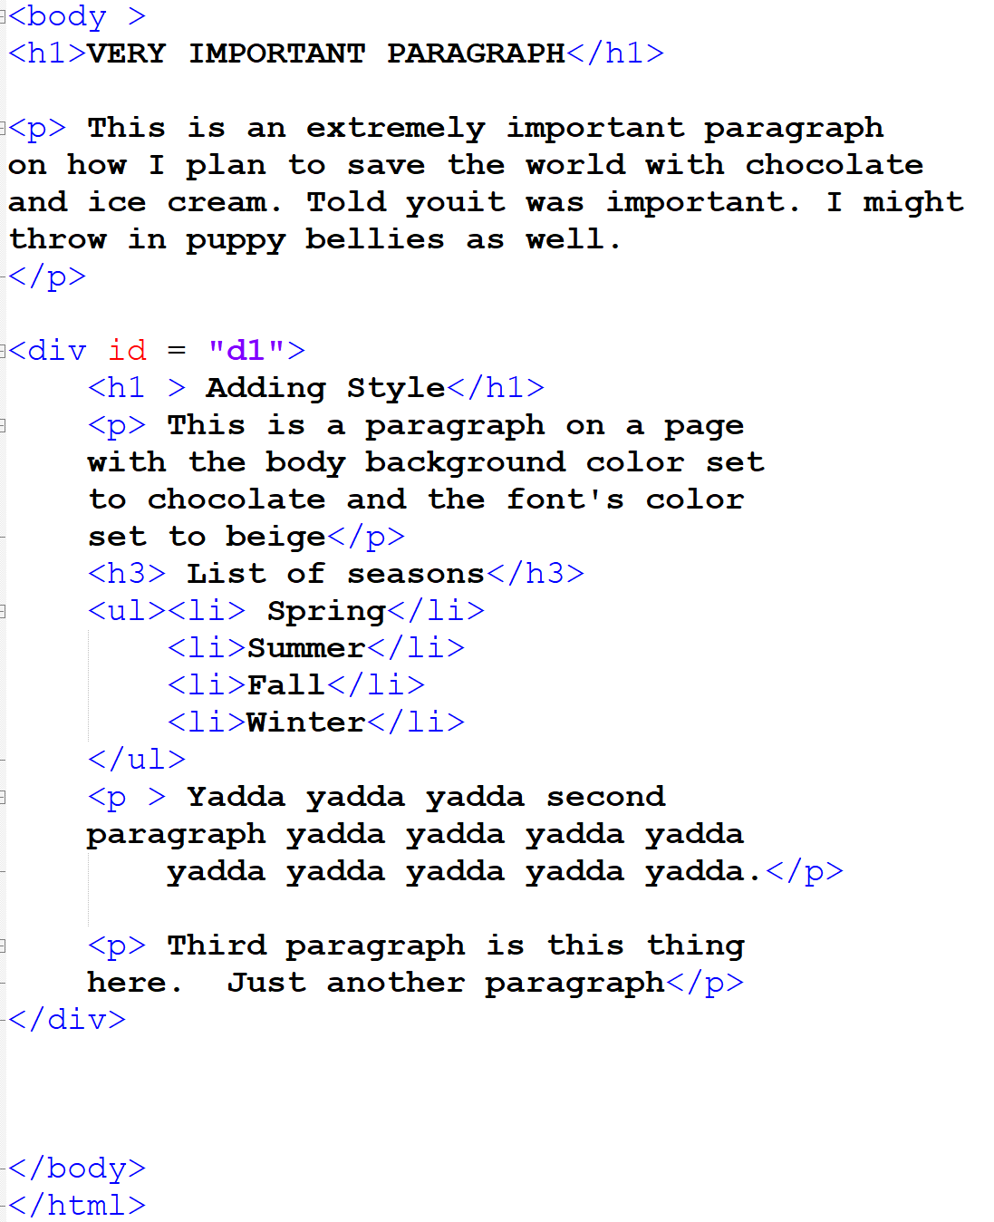
Styling tags within a div
If you have:
What if you want
to style the paragraph
outside the div
differently than the
paragraphs inside the
div tag?

Slide 6
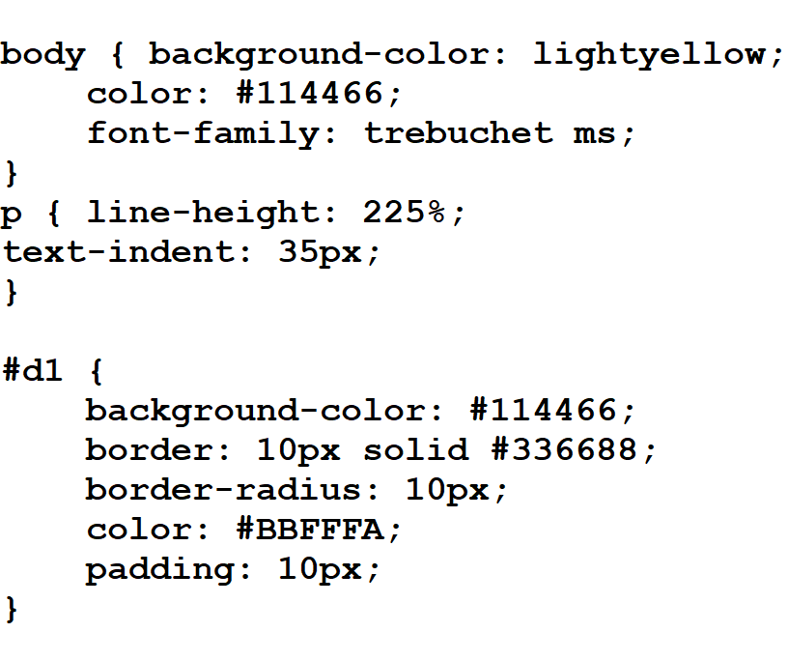
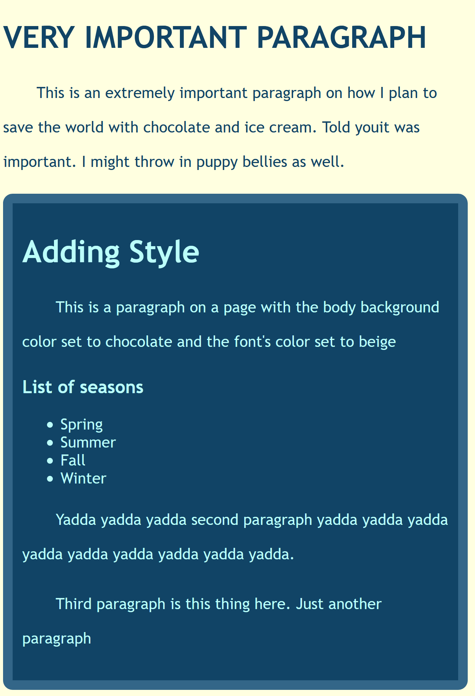
Before:
CSS
What it looks like in browser

Slide 7
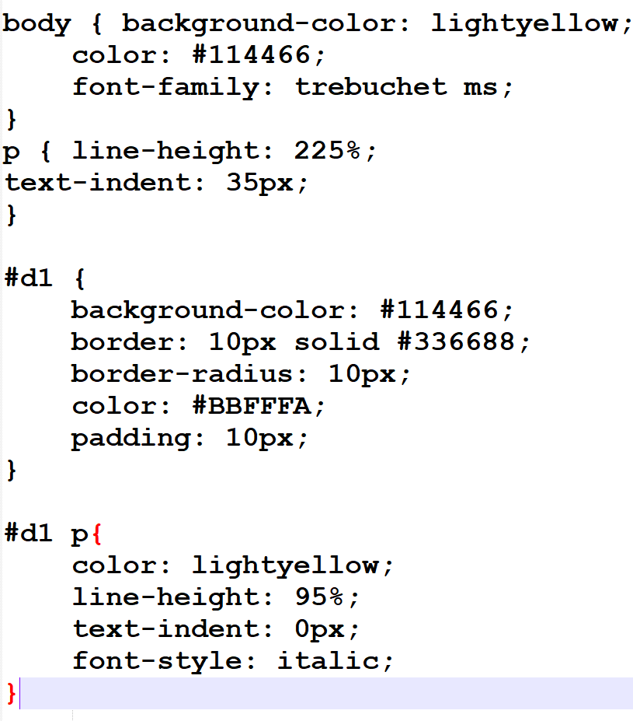
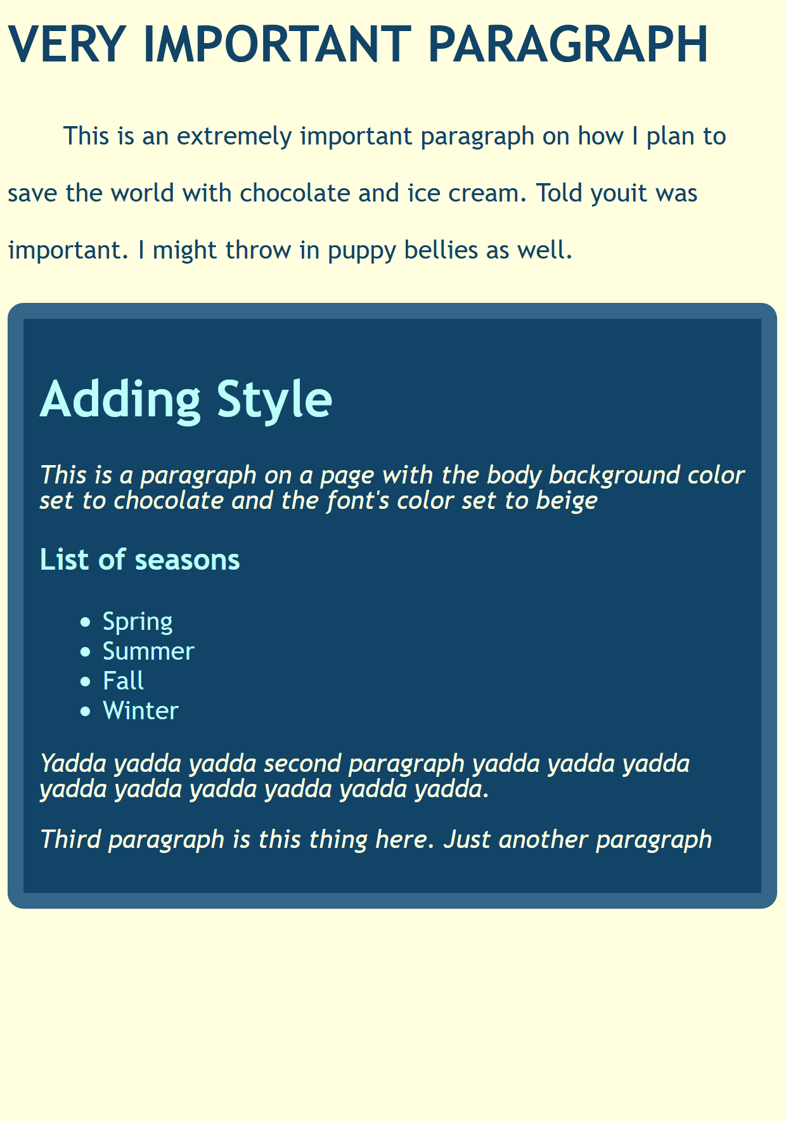
After:
CSS
What it looks like in browser
This is the style definition for paragraphs within the div “d1”

Slide 8
Take-Aways:
Any tag can have an id
ID Names:
No spaces, no special characters!!
Unique on a web page
Uniquely identifies a tag
Otherwise, anything you want!
Divs and Spans can have ids
Styling IDs:
start with # and id’s name
To style a particular tag within a div (which groups multiple tags together), use the div’s id and the tag
E.g., #d1 p {…

