Slide 1
Position: Fixed (Almost exactly the same as Position Absolute!
Positioning using CSS

Slide 2
Position: Fixed; (almost exactly the same as position:absolute;)
Good part:
Can position things in a fixed position
Can specify how far down from the top, and in from the left
Bad Part:
The other tags will flow UNDER the positioned tag
So you can’t see their content
DIFFERENCE BETWEEN ABSOLUTE AND FIXED:
Absolute: based on edge of web page
Fixed: positioned based on edge of browser

Slide 3
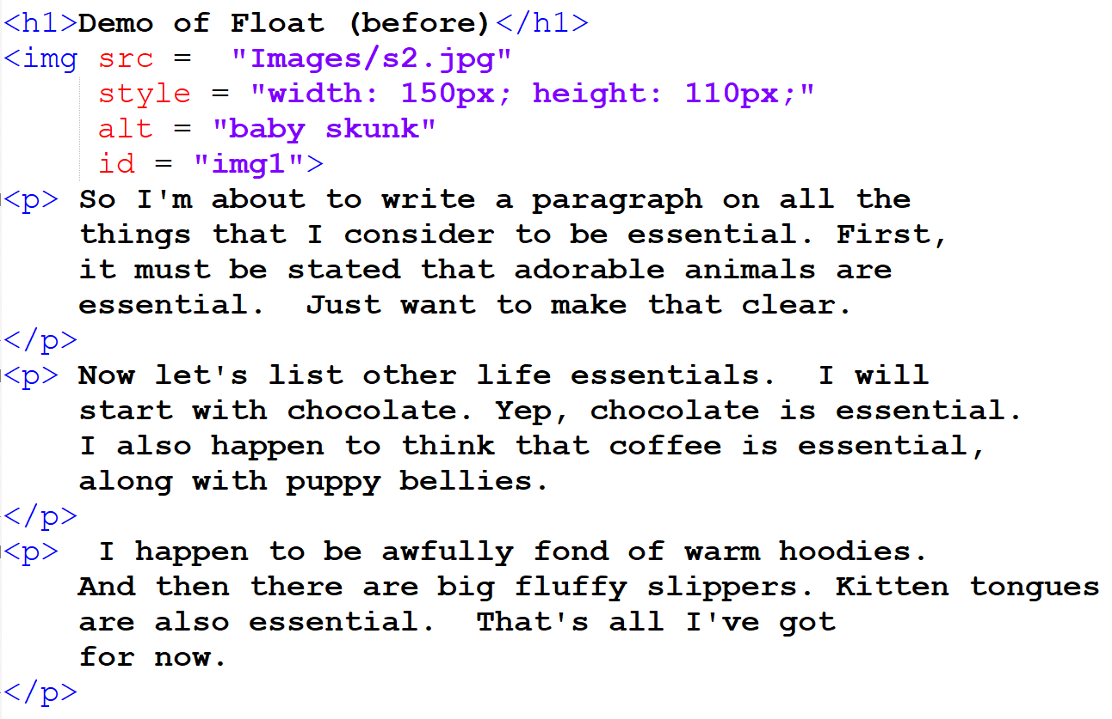
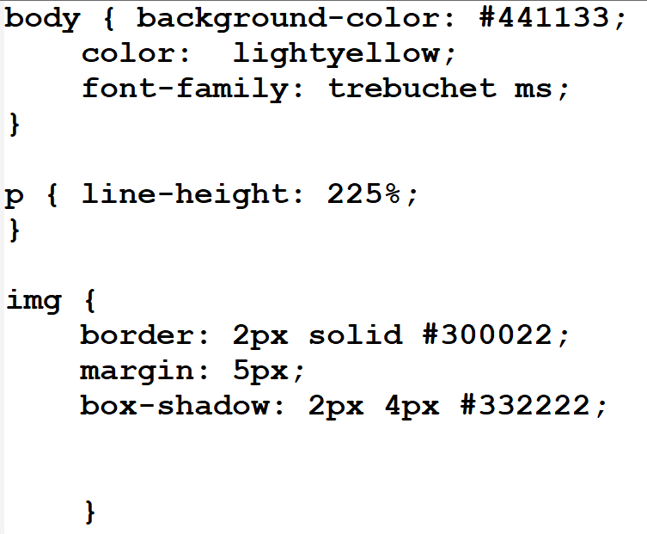
Example: (Before)
Note the Image on the web page:
Without positioning, every tag is placed one below the other
By below, I mean closer to the bottom of the web page

Slide 4
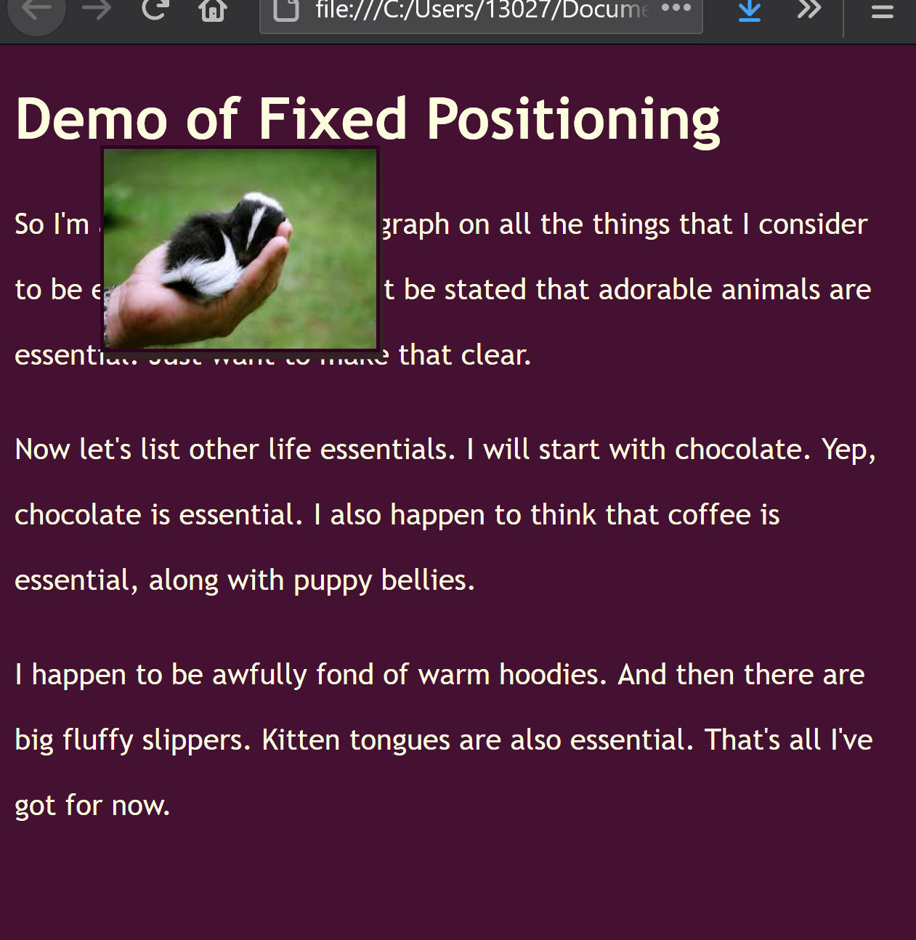
Example: (After)
position: fixed;
top: 50px;
left: 50px;
The image is positioned 50 pixels down from the top and 50 pixels in from the left
NOTE that the image is sitting on top of the other tags on the web page
So Far: Looks exactly the same as Position: absolute;

Slide 5
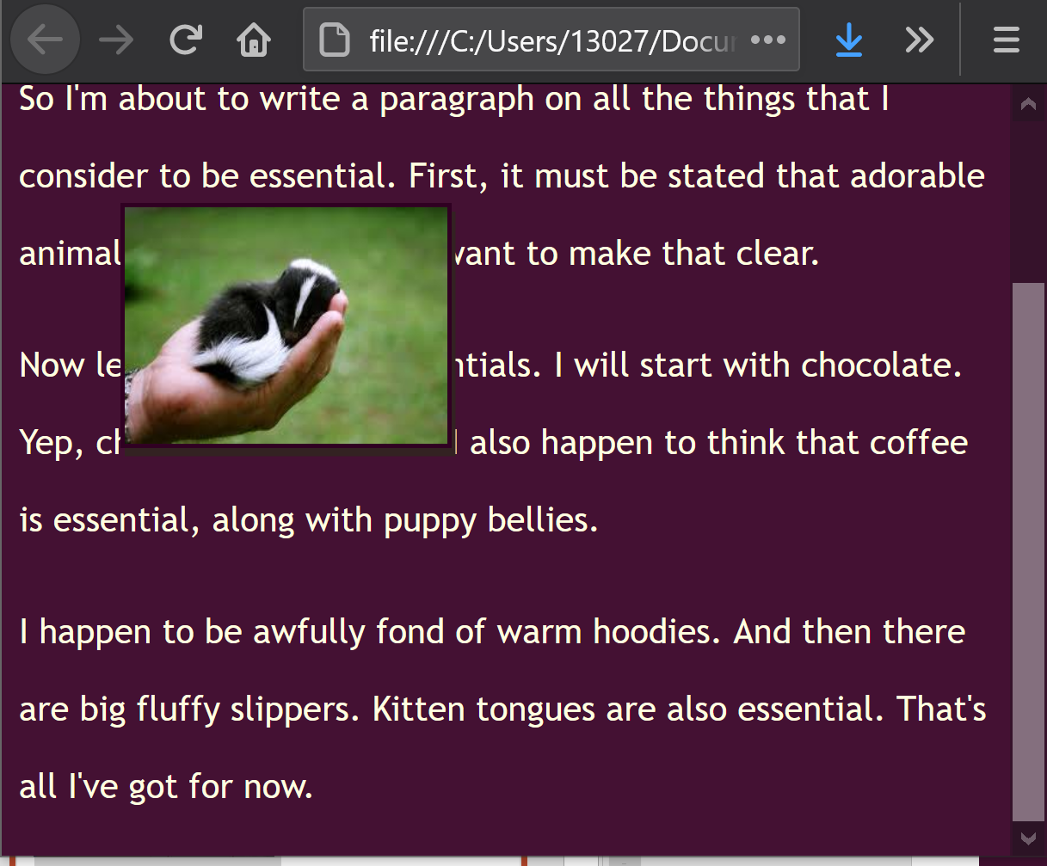
Scrolling with position: fixed;
The IMAGE (that was positioned with fixed) DOESN’T SCROLL!!!
When in a fixed position, a tag is positioned based on the edge of the browser.
So if the browser’s edge doesn’t move, neither will the fixed tag!

Slide 6
Takeaways:
Position: fixed;
Almost the same as Position: absolute;
Difference:
Fixed tags are positioned based on the edge of the browser
Absolute tags are positioned based on the edge of the web page
If the edge of the page moves, so will the tag
As long as the browser doesn’t move, neither will the fixed tag
Regardless of whether the web page scrolls!

