Slide 1
Class
(Creating a style for multiple things)

Slide 2
ID:
Uniquely identifies a tag
Can be a div tag
That goes around other tags
Useful for styling
What if you want multiple items on your web page to have the same style?
E.g., what if you want a specific style for all text boxes
Or what if you want all words and phrases related to a particular concept to be highlighted?

Slide 3
Class
You can make tags belong to a class
You can make multiple items belong to the same class
Example:

Slide 4
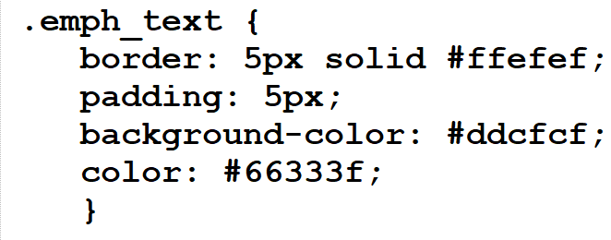
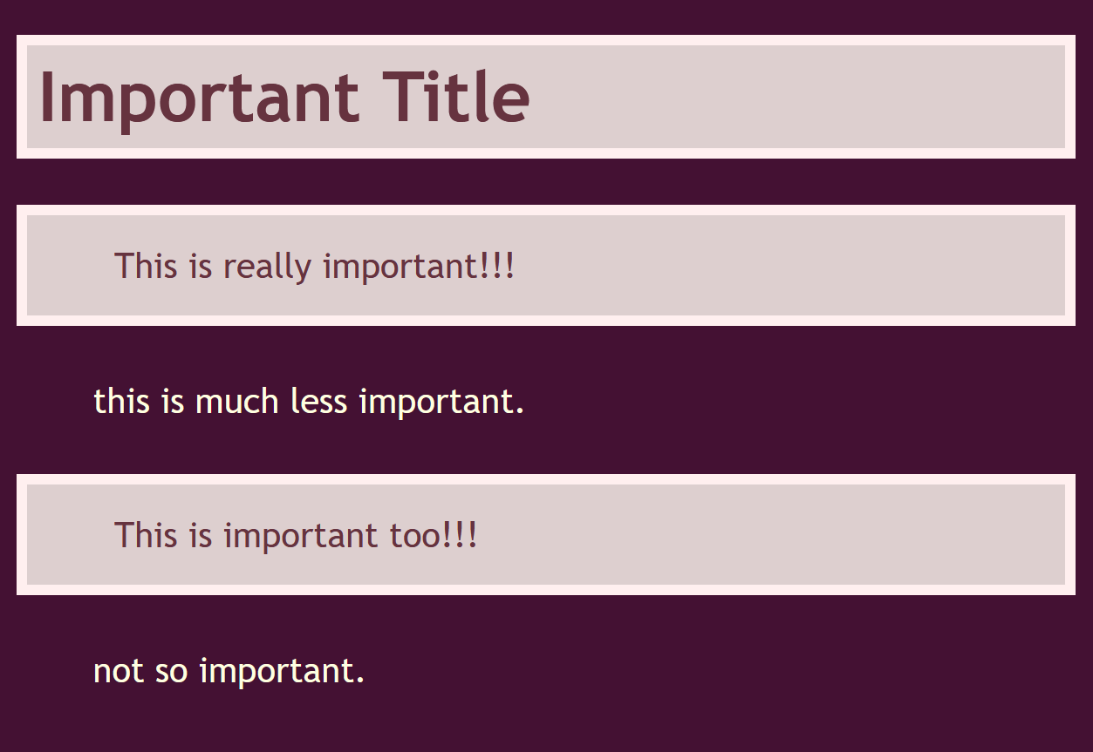
To style a class:
What it looks like in the browser…
Note the .
The . indicates that you’re styling a class

Slide 5
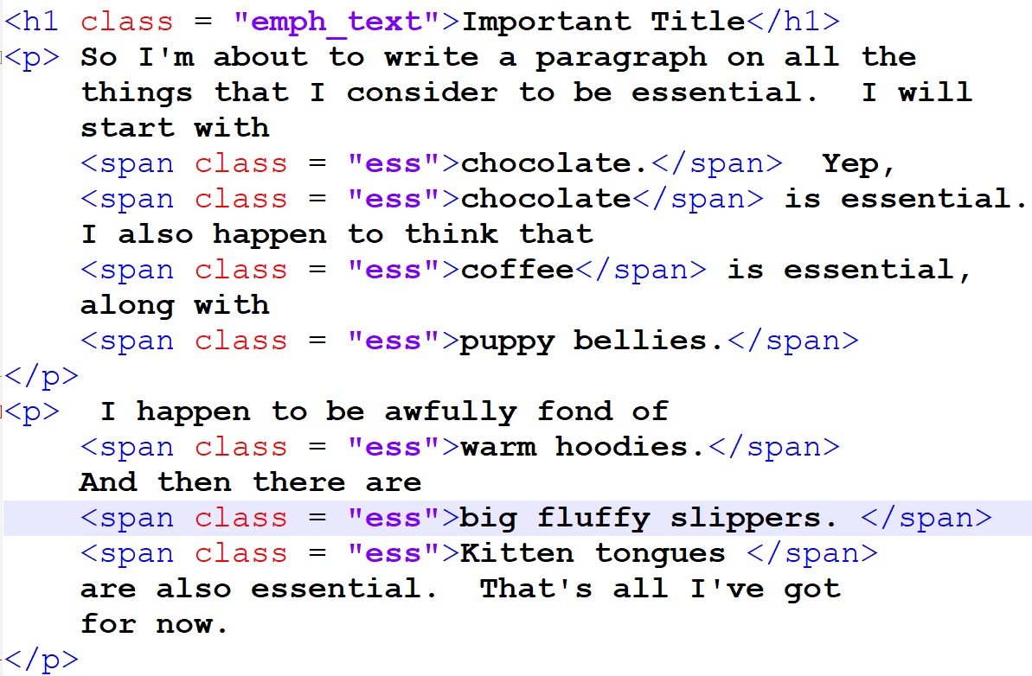
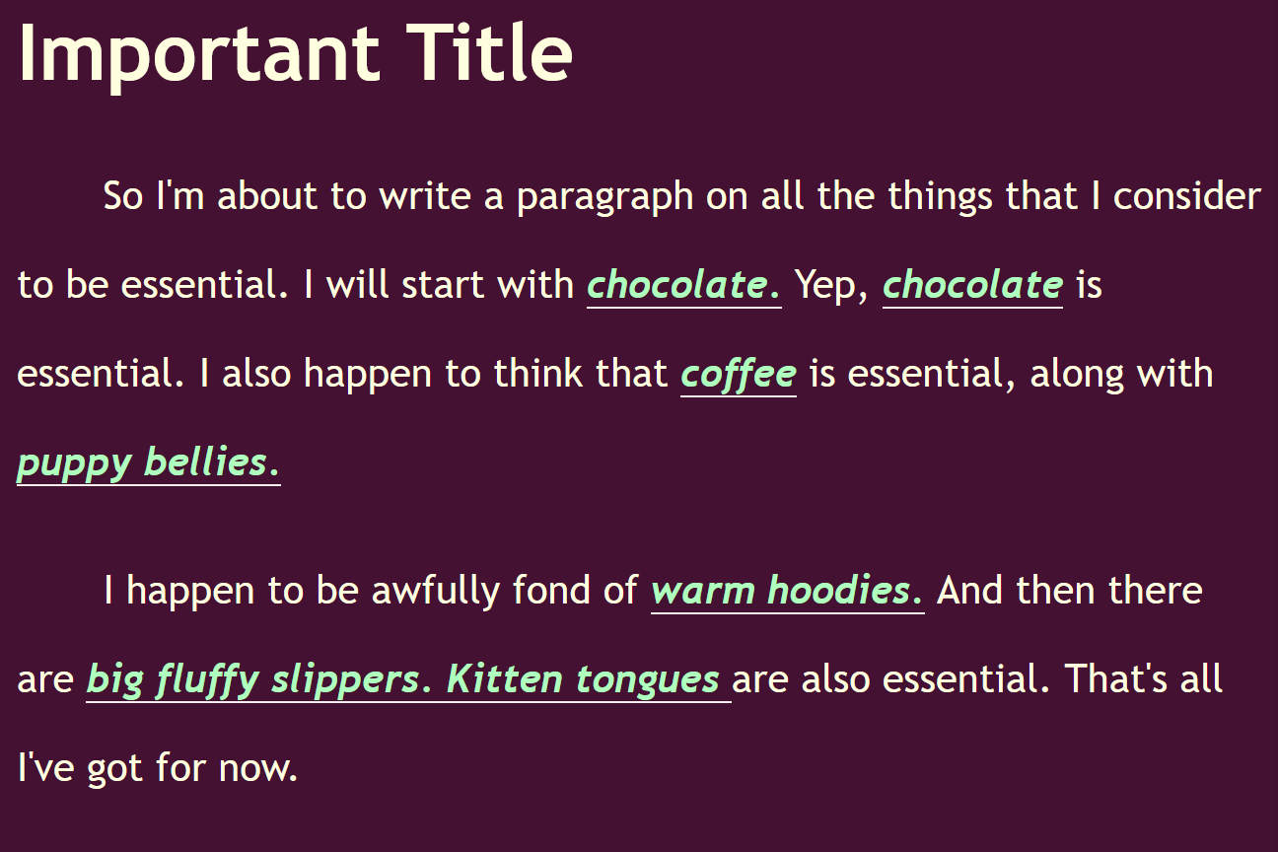
You can make anything belong to a class:
Span example:
HTML (with spans belonging to a class)
CSS (styling the class)
What it looks like in the browser

Slide 6
Breaking it all down:
DIV
Tag that goes around a bunch of other tags
Groups them (usually for styling)
SPAN
Tag that goes inside another tag
Usually for styling
ID
Giving a tag a unique identity
Can be used for styling
Each id must be unique on a web page
Styled with #
Class
Multiple tags can belong to the same class
Styled with .

