Slide 1
Position: Absolute
Positioning using CSS

Slide 2
Float:
Positions within the flow of the document
So everything flows up and around the floated tag
But its position is still controlled by the other elements in the document
What tags are above it
What tags are below it
What if you want to have more control over where a tag is positioned on a web page?
E.g., 40 pixels down from the top of the web page, 30 pixels in from the left?

Slide 3
Position: Absolute
Good part:
Can position things in an absolute position
Can specify how far down from the top, and in from the left
Tag that is positioned is positioned based on the edge of the web page
Or the edge of the tag that encompasses the positioned tag
Bad Part:
The other tags will flow UNDER the positioned tag
So you can’t see their content
Be Careful Where You Position Things!!

Slide 4
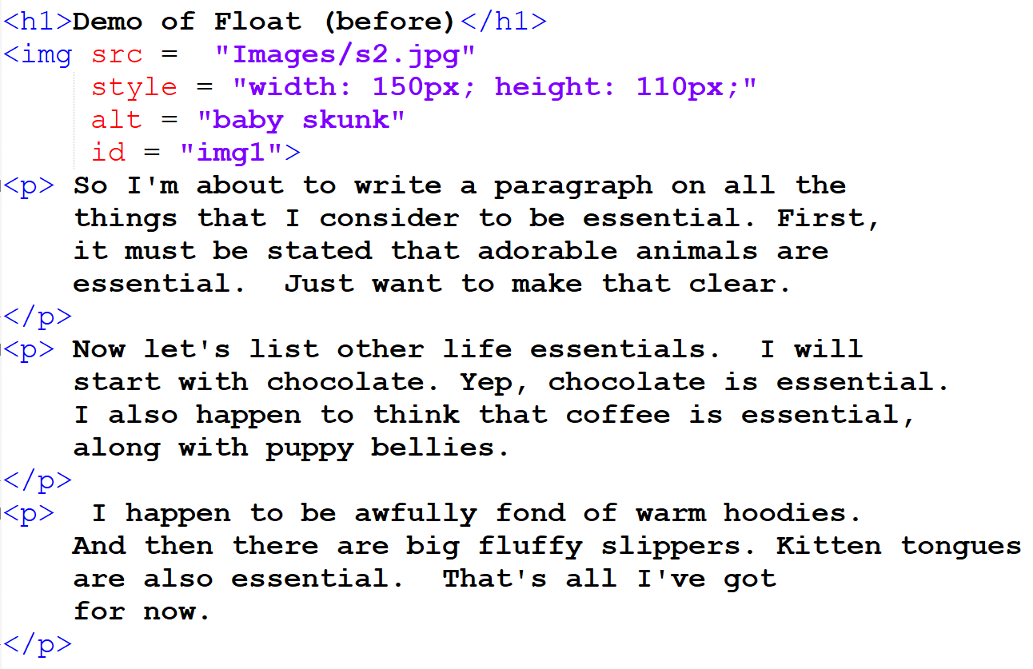
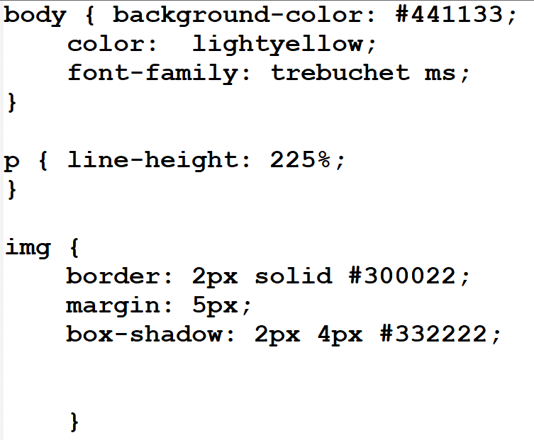
Example: (Before)
Note the Image on the web page:
Without positioning, every tag is placed one below the other
By below, I mean closer to the bottom of the web page

Slide 5
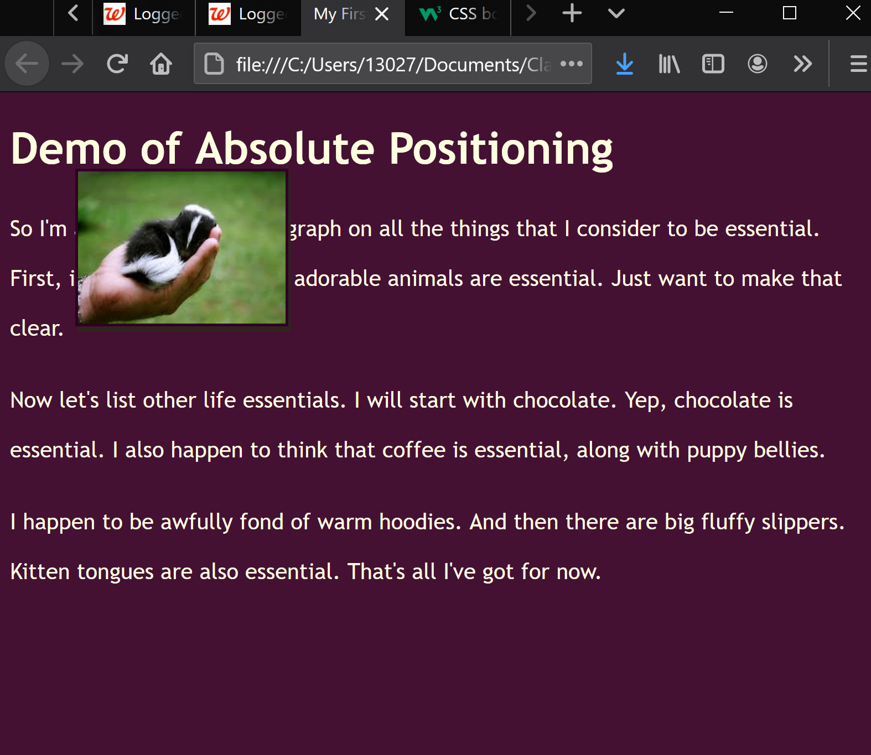
Example: (After)
position: absolute;
top: 50px;
left: 50px;
The image is positioned 50 pixels down from the top edge of the web page and 50 pixels in from the left edge of the web page
NOTE that the image is sitting on top of the other tags on the web page
That’s a potential disadvantage of Position: absolute
It’s like the tag is on its own level in a web page (think shadow box)

Slide 6
Scrolling with position: absolute;
Note how, when you scroll, the image (which was positioned absolutely) scrolls too!!)
When positioned absolutely, a tag is positioned based on the edge of the web page.
So if the edge scrolls up, so will the absolutely positioned tag (e.g., the image in this case!!!)

Slide 7
Takeaways:
Position: absolute;
Positions absolutely in relation to the edge of the web page
If the web page moves, so will the absolutely positioned tag
Absolute positioning takes the tag out of the flow of the rest of the web page and acts like that tag is on its own layer
So other tags will either flow under or over the absolutely positioned tag

