Slide 1
Padding and Margins
margin
With CSS
padding

Slide 2
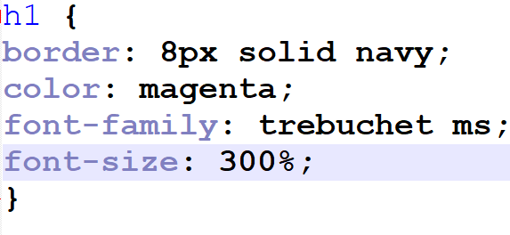
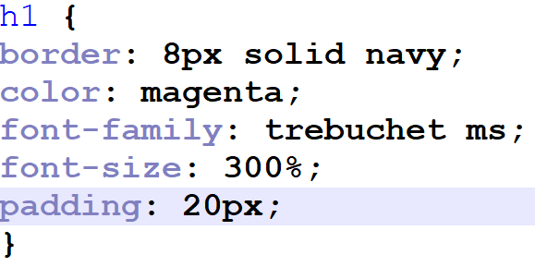
Padding: Inside the border
The space between an element and it’s border.
Example (without padding):
Example (padding):

Slide 3
You can also add padding to one side:
h1 {
border: 8px solid navy;
color: magenta;
font-family: trebuchet ms;
font-size: 300%;
padding-top: 60px;
padding-left: 10px;
padding-bottom: 0px;
padding-right: 120px;
}

Slide 4
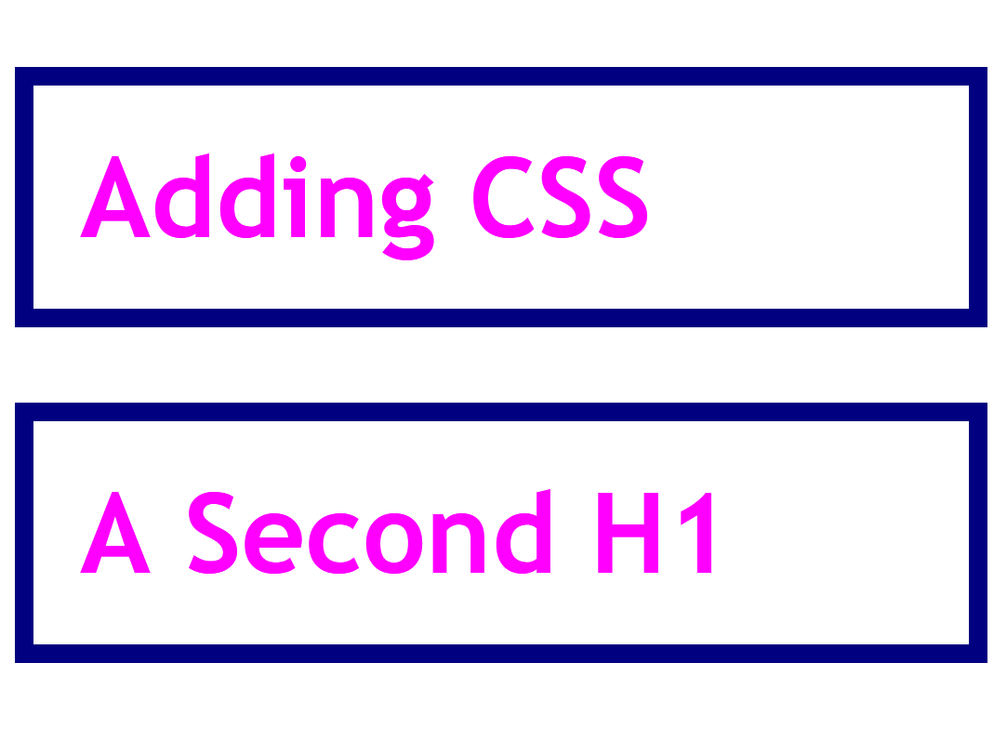
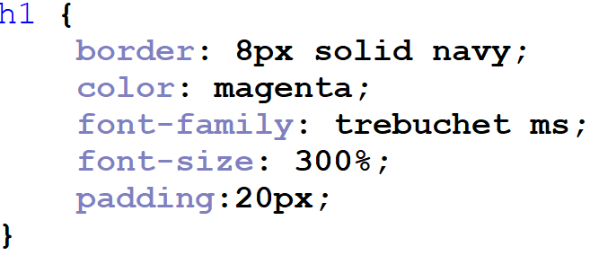
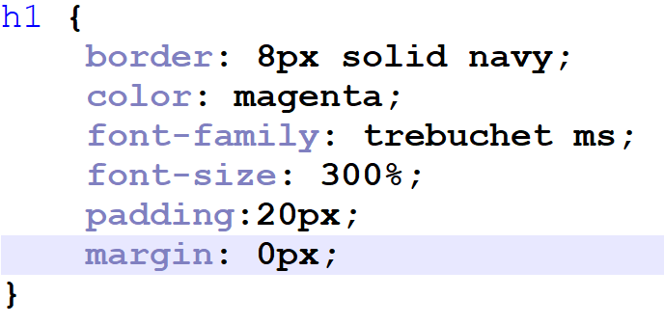
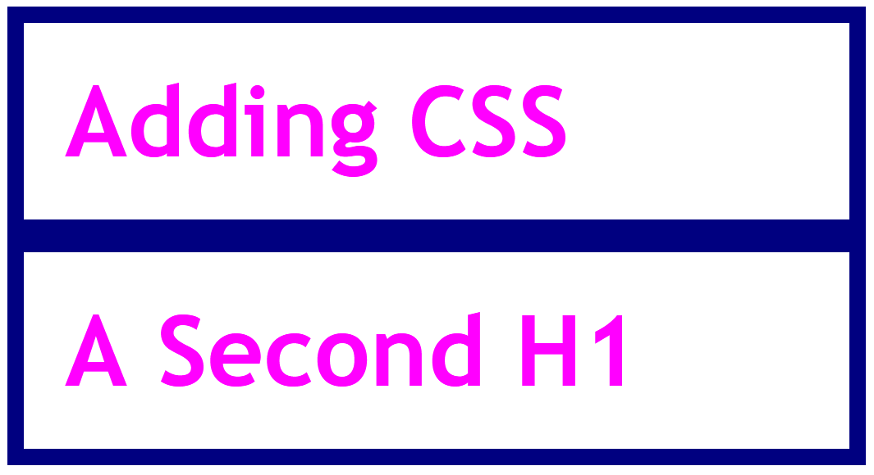
Margin: outside the border
The space between the border of one element and the border of another element
Even if the border is transparent
Example

Slide 5
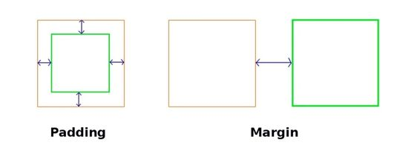
Padding vs margin

Slide 6
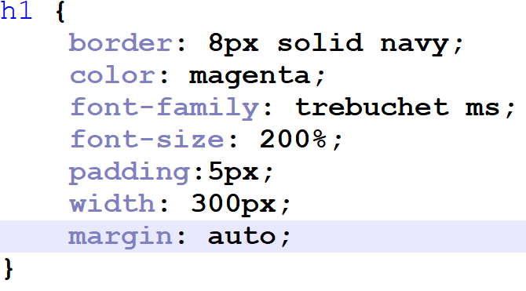
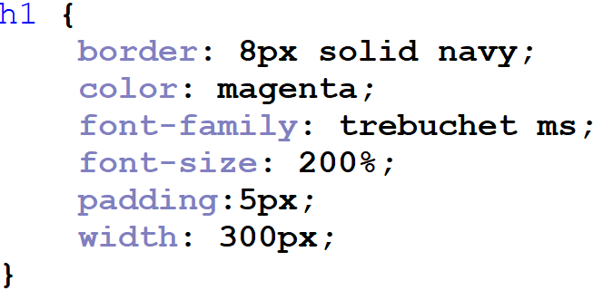
Centering with Margin: Auto
To center an html element on a web page
- even if you resize the web page:
Use margin: auto;
Note: you must set the width of the element first!
Example:

Slide 7
Takeaways:
Padding: inside of border
Between element and border
Margin: outside of border
Between border and another element
For either, you can choose top, left, bottom, right specifically
Margin: auto;
Centers element
IF YOU’VE GIVEN THE ELEMENT A WIDTH!!!
If you resize the browser, the element will stay in the center

