Slide 1
Colors
Basic CSS Styles

Slide 2
Creating Styles:
Examples:
You can create a style for any html tag
How?
Take the tag’s name, then put { and } around the style
(You’ve seen this for paragraphs)
For each line:
The thing you’re styling has a : after it
The style you give it has a ; after it
p { background-color: purple;
line-height: 150%;
}
h2 { background-color: green;
line-height: 250%;
}
td { background-color: orange;
line-height: 90%;
}

Slide 3
Colors
Let’s start with adding some colors
You can add color to any html tag
E.g.,
background colors,
font colors,
border colors,
shadow colors,
etc.
How? That’s coming…
For now, let’s look at the predefined colors you can use

Slide 4
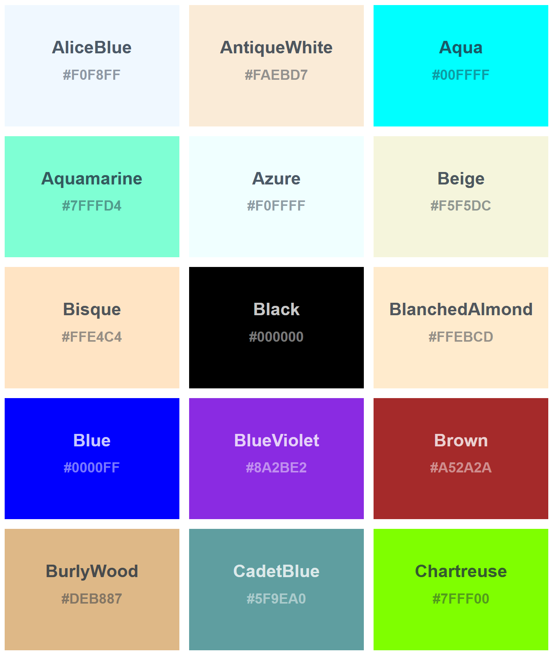
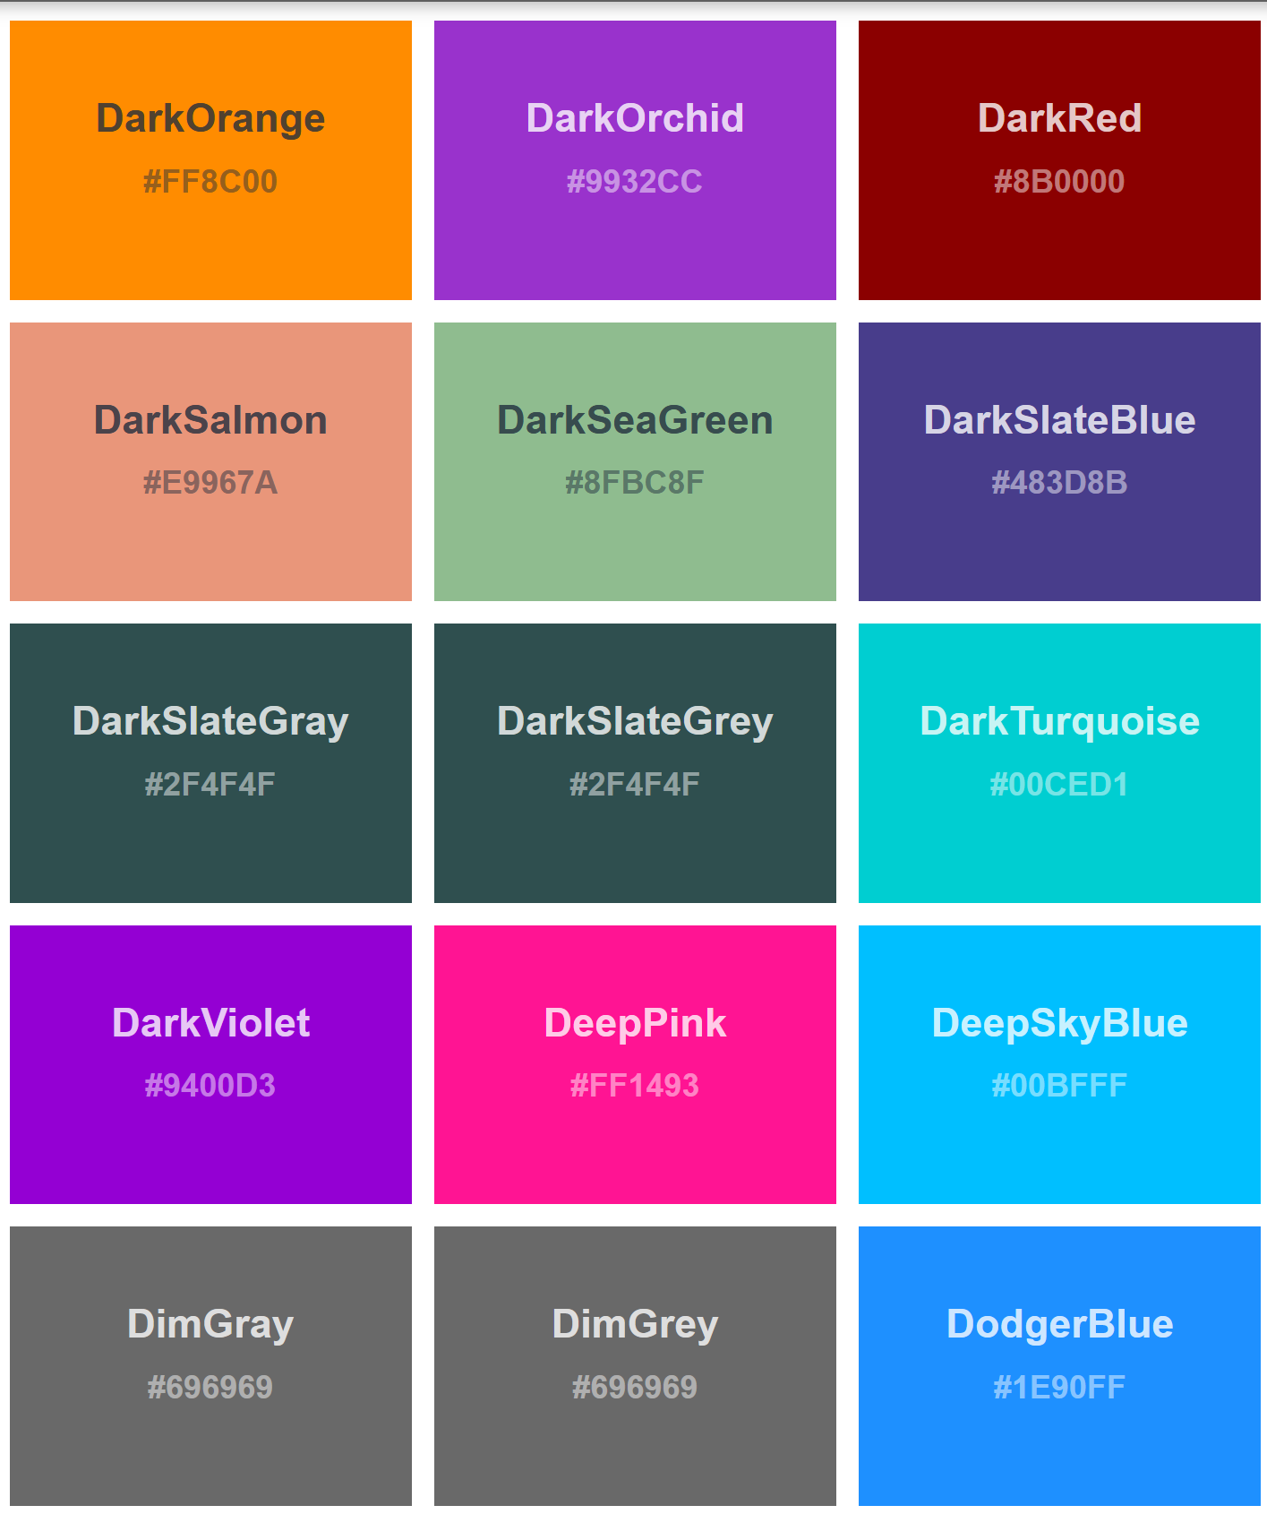
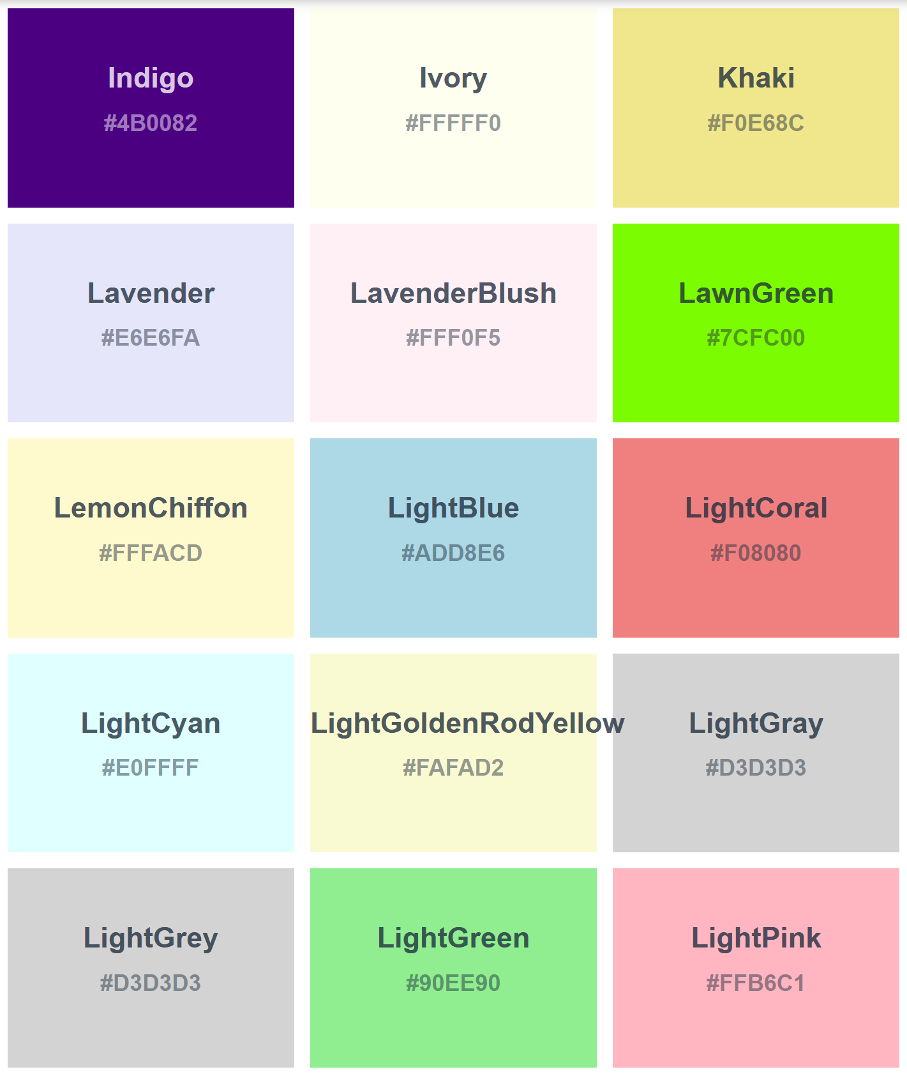
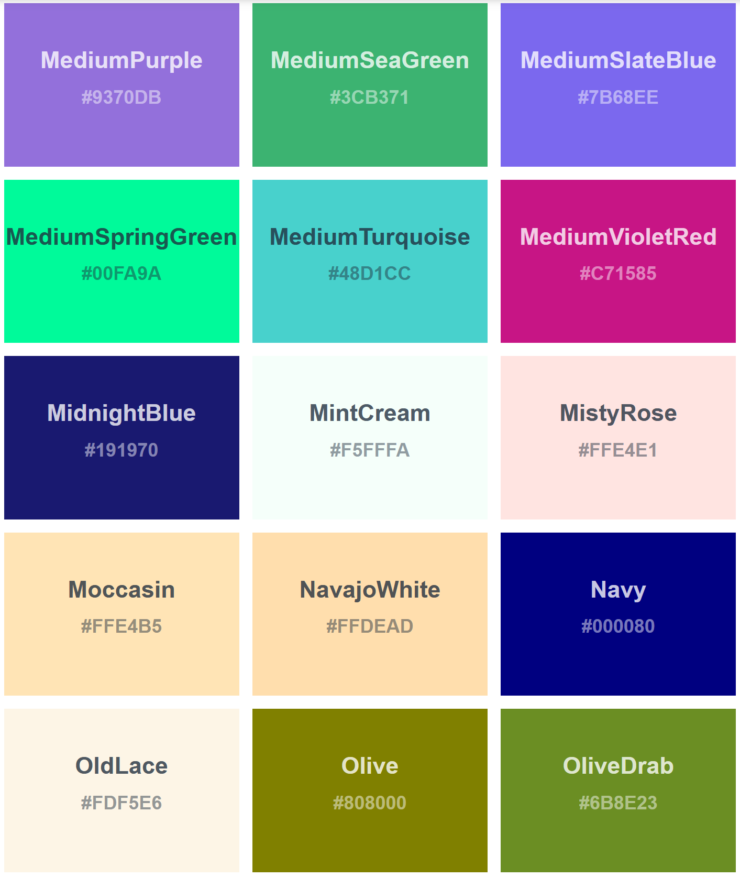
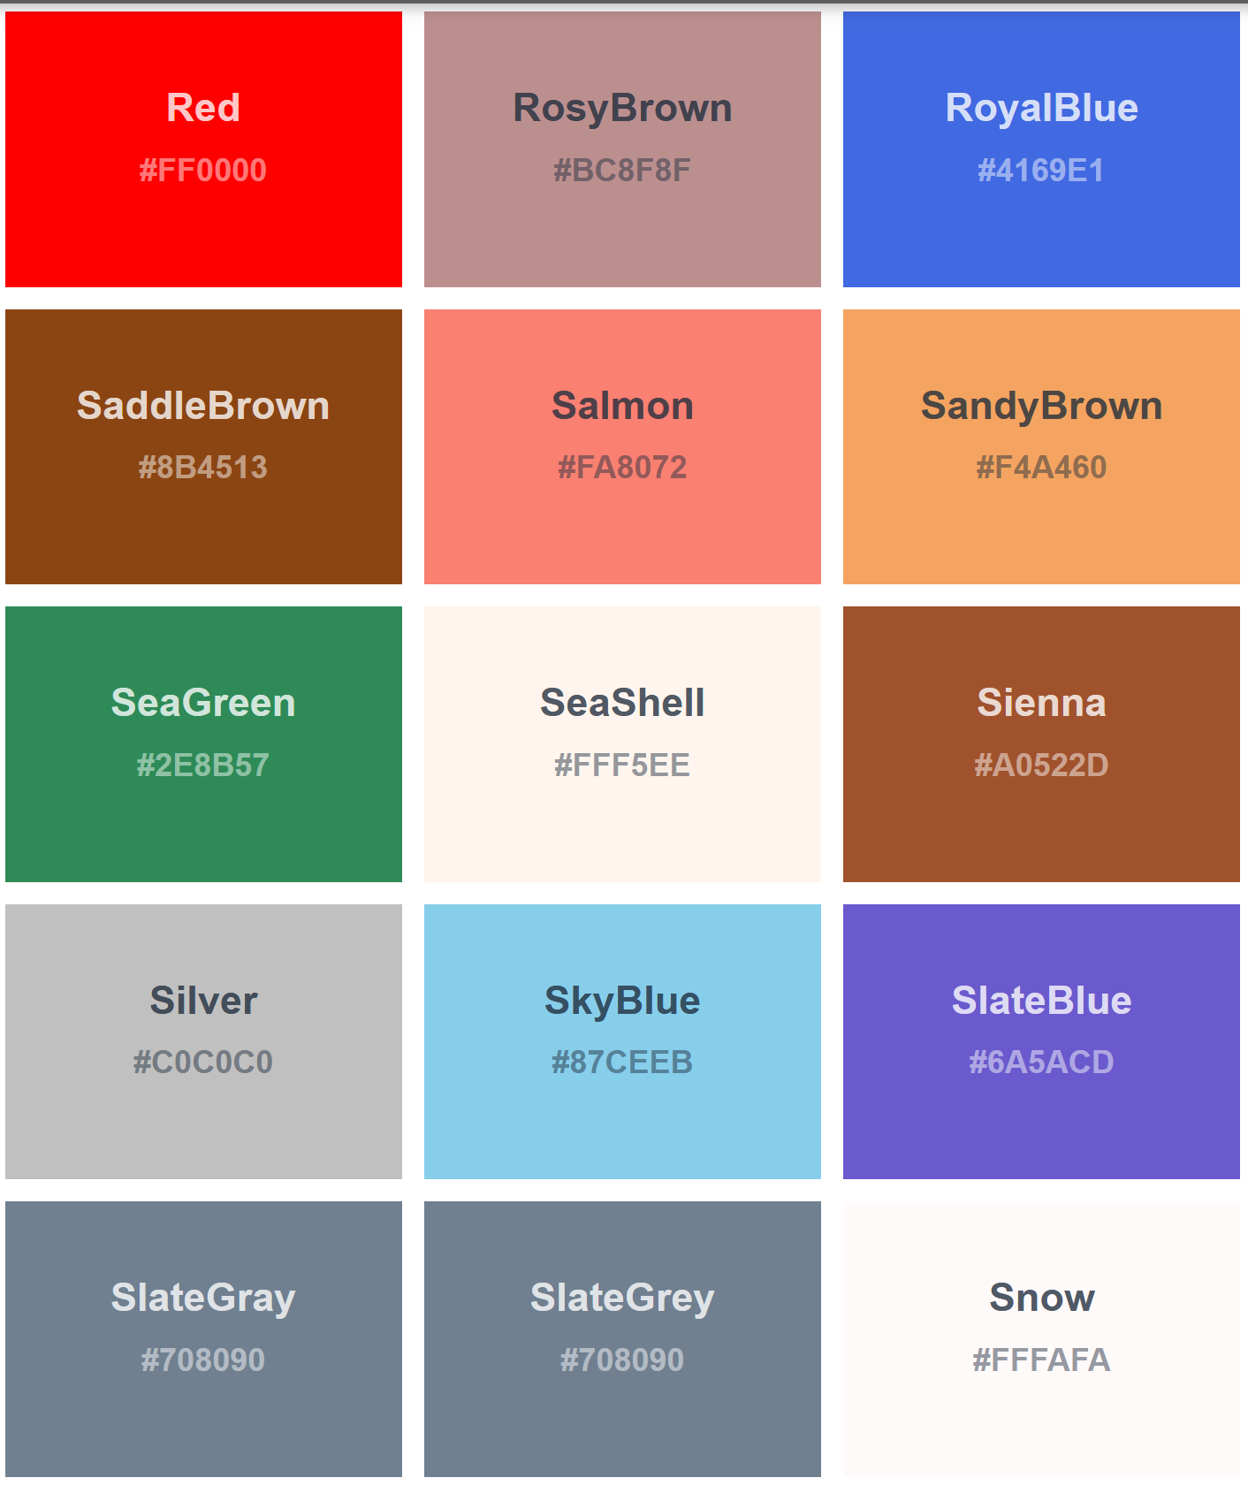
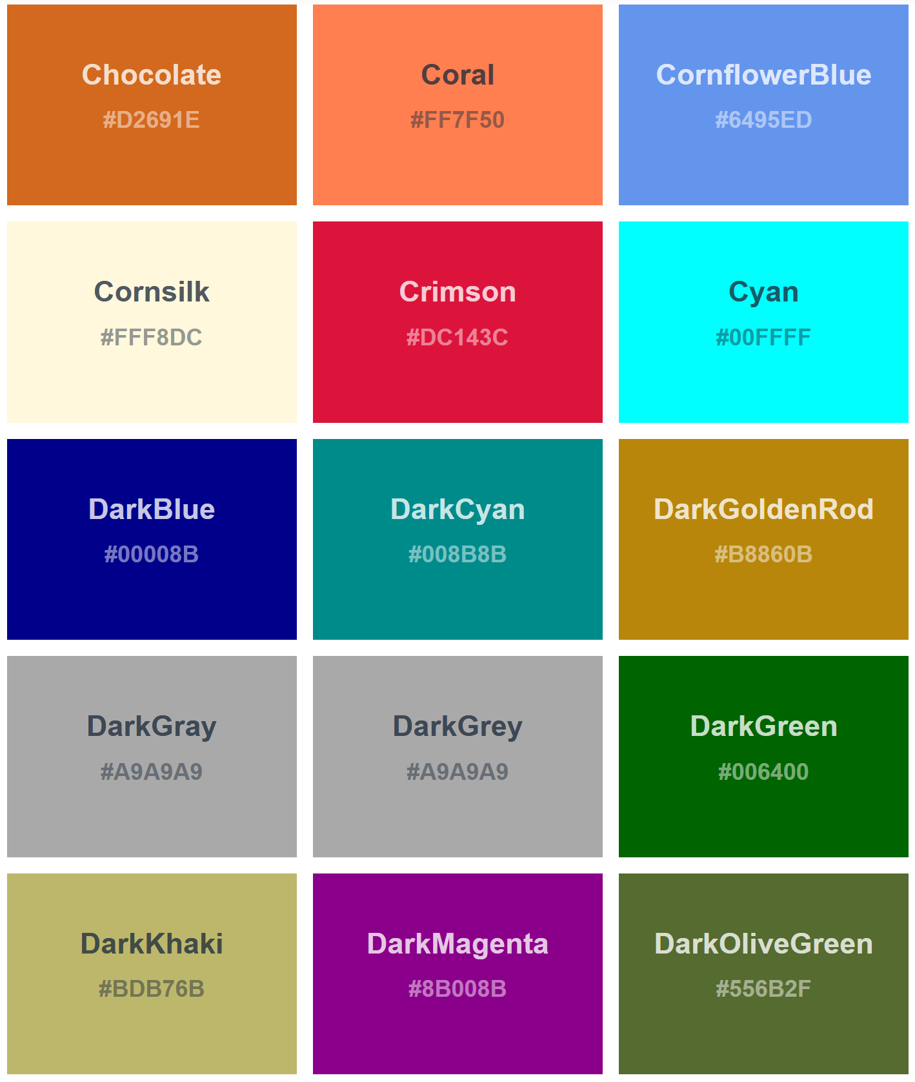
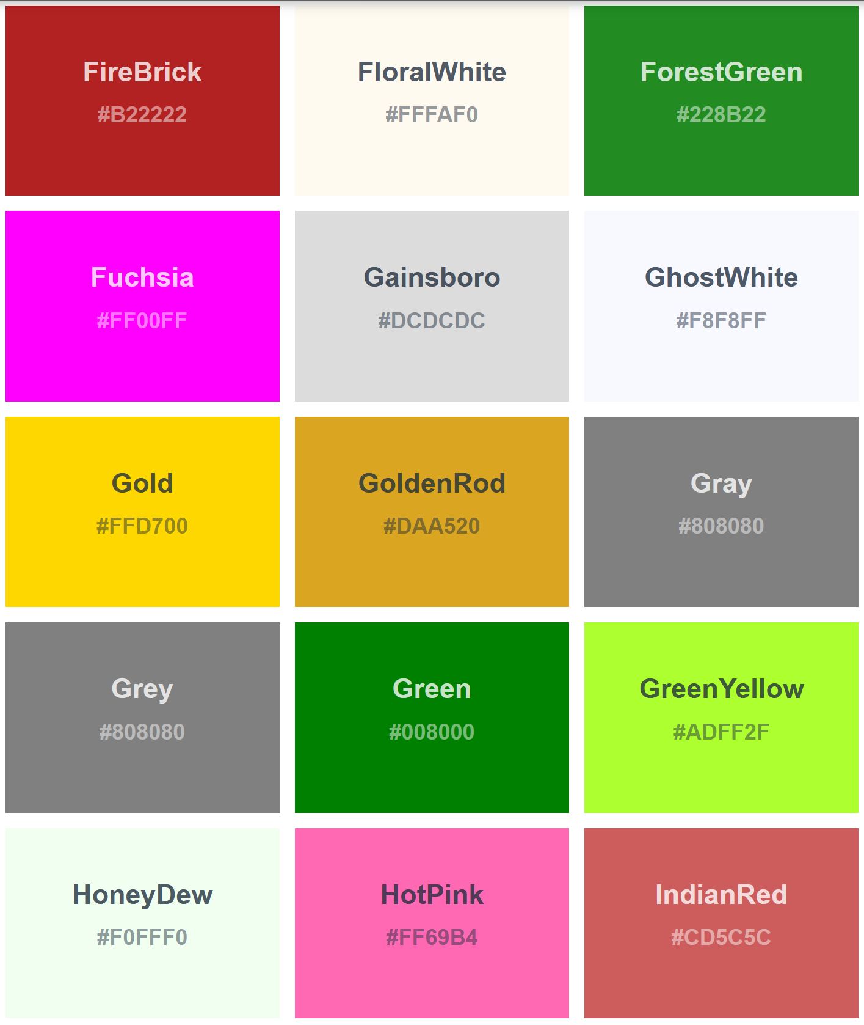
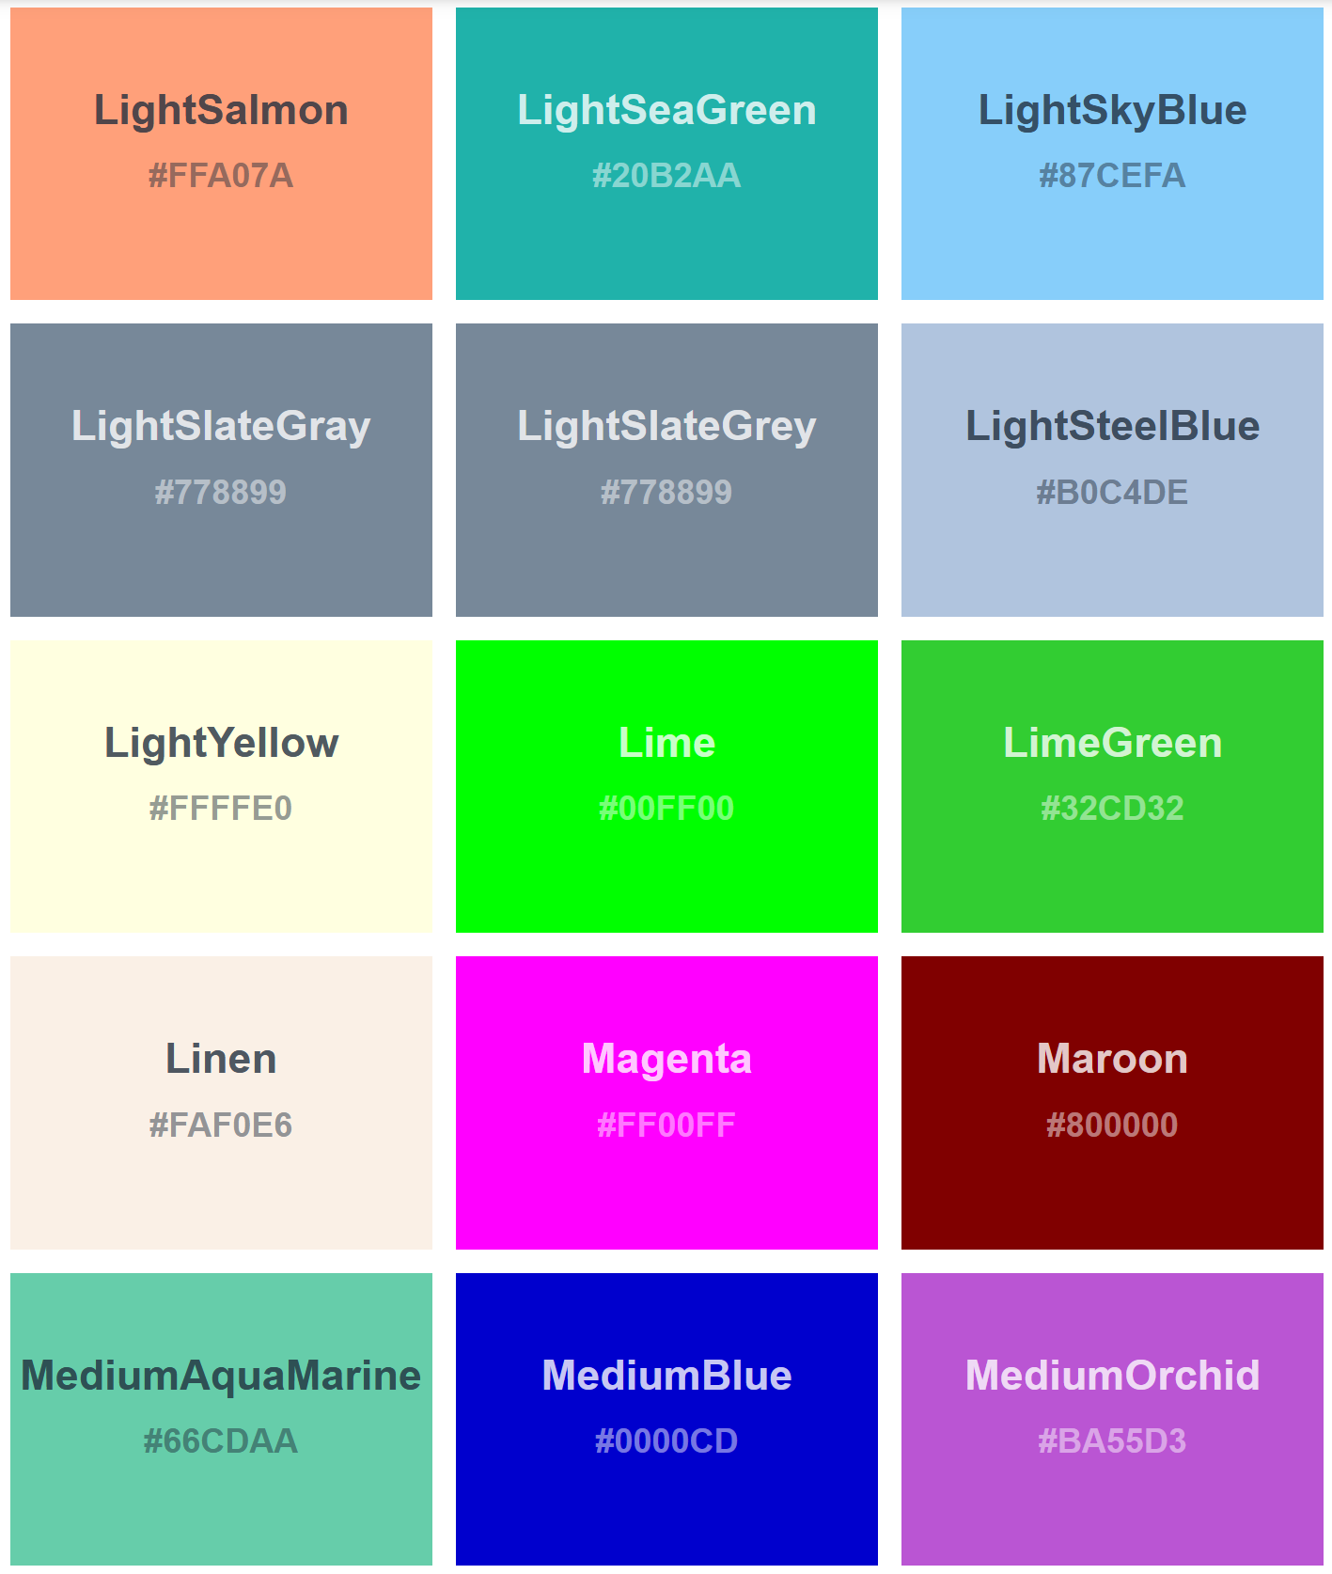
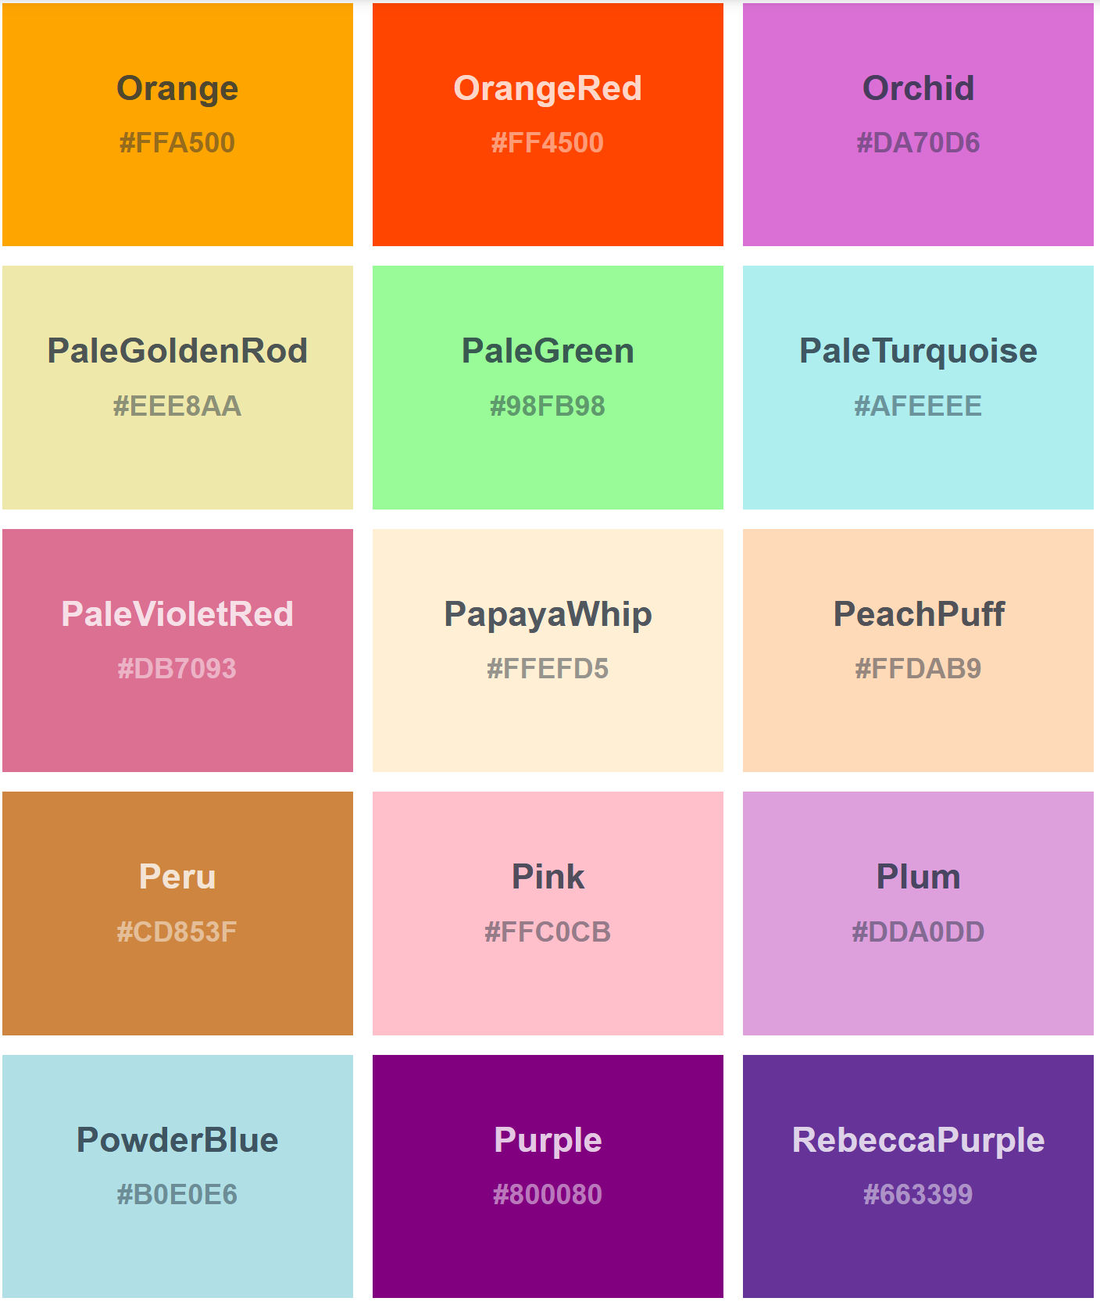
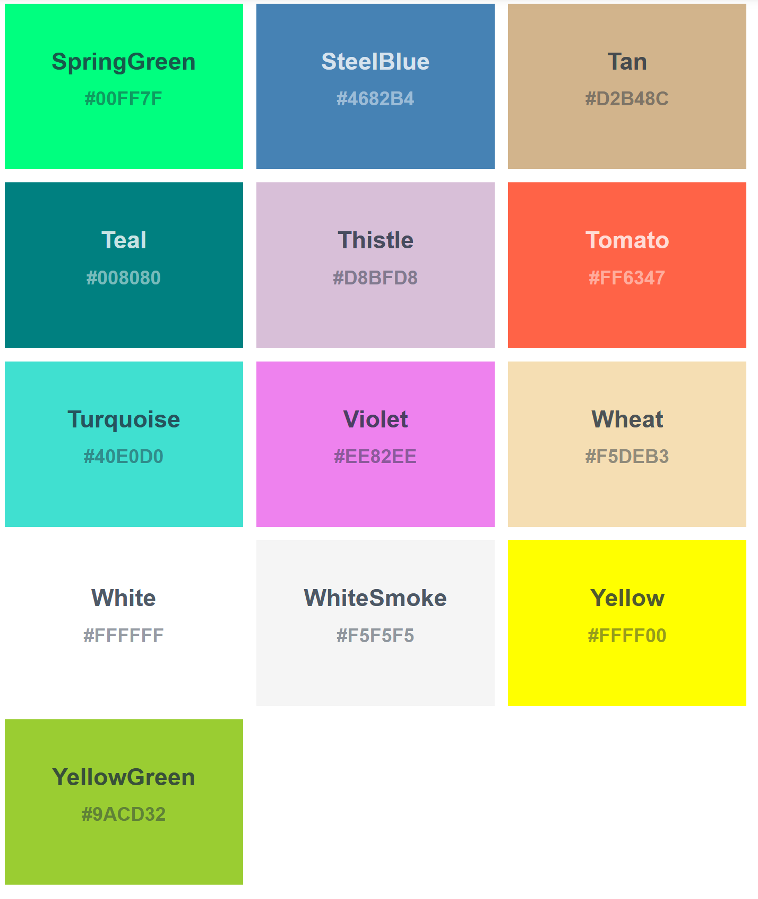
List of predefined colors (you can use any of these names!):

Slide 5
What if you want more colors?
What, the 148 colors on the previous page weren’t enough???
Okay, so, yes, you can be more precise with your color choices
BRIEF overview of color*
RGB:
specify (up to 255) the amount of red, green, and blue
Example: rgb(240,0,32); would be a reddish color with just a smidge of blue undertones
Hex:
more complicated:
count from 0-9, then A-F
0,1,2,3,4,5,6,7,8,9,A,B,C,D,E,F
use 2 of the above for red, 2 of the above for green, and 2 of the above for blue
E.g., #FC0034;
About the same color as the rgb color – a bright reddish color with a hint of blue undertone
# means it’s a hex number
*For more info on RGB and Hex, try the challenge!

Slide 6
TakeAways:
You can make a style for any html tag
name_of_tag { … style definition goes here, between the squiggly brackets…
}
Remember your : and your ; in the right places!
Colors:
There are 148 predefined color names you can use in styling things
Will work with every browser
If you want more, learn about hex and rgb colors

