Slide 1
Fonts
Styling font with CSS

Slide 2
Font styling:
color:font color
You just put color, not font-color
font-family: changes font type
Web-safe font families*:
Arial
Verdana
Helvetica
Tahoma
Trebuchet ms
Times new roman
Georgia
Garamond
Courier new
Brush script mt
*Note: you can embed a font if you want a certain look! We’re covering the basics here, not embedding, but I wanted you to know it’s an option!
Example:
p {
color: orange;
font-family: brush script mt;
}

Slide 3
More font styling: font-size
font-size
Either use %
E.g., 625%;
% is percent of the default size
Or:
xx-small
x-small
small
medium
large
x-large
xx-large
smaller
Larger
You can also set the px size, but…
This cannot be resized by user
A problem for low vision people
Could be an issue on different screen sizes
Thus, best to use one of the first 2 methods.
h1 {
color: navy;
font-family: trebuchet ms;
font-size: 320%;
}
p {
color: orange;
font-size: x-large;
font-family: brush script mt;
}

Slide 4
Font style and weight
h1 {
color: navy;
font-family: arial;
font-style: italic;
font-weight: 100;
}
Font-style:
Italic
That’s pretty much the only style we use
Also normal (the default)
Font-weight:
Normal,
bold,
bolder,
Lighter
Also 100-900 (by 100s)
100 is really thin
900 is really thick
400 is normal
700 is bold
h1 {
color: navy;
font-family: arial;
font-style: normal;
font-weight: 800;
}

Slide 5
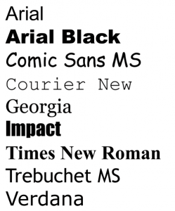
Takeaways: Fonts
Properties:
font-family:
Arial, Verdana, Helvetica, Tahoma, Trebuchet ms, Times new roman, Georgia, Garamond, Courier new,Brush script mt
font-size
% or xx-small to xx-large
Can also do px, but that is absolute and thus the user cannot adjust the font size (so avoid using this!!)
font-weight
100-900 or normal, bold, light, bolder
font-style
italic, normal
color
All those colors from the previous ppt/video

