Slide 1
CSS Intro
Adding Style

Slide 2
ADDING STYLE:
CSS styles the html tags
HTML says,
this is a paragraph
CSS says,
this is what paragraphs should look like on your web page.

Slide 3
Example:
Sets the background color for all paragraphs to purple
Sets the font’s color to blue for all paragraphs
Sets the space between lines of text in a paragraph to be 200% of the default
p { background-color: purple;
color: blue;
line-height: 200%;
}
NOTE:
the squiggly brackets around the paragraph’s style definition
The colon at the end of each style item, and
The semi-colon at the end of each style declaration
(the end of each line)

Slide 4
Where do you put the CSS styles?
CSS Styles need to be associated with a web page in order for the html elements to be styled:
Can do it 3 ways!
Inline
In the head section
In a separate file, and linked!

Slide 5
Inserting CSS style Method 1: inline
<body>
<p style = “background-color: purple; color: blue; line-height: 200%;” > This is a blue paragraph with a purple background color and double the normal space between lines</p>
<p > Yadda yadda yadda second paragraph yadda yadda yadda </p>
You can plop style inside of any html tag
This will only style this one particular paragraph
It will NOT style the yadda yadda yadda paragraph
Things to be careful of: BE VERY CAREFUL ABOUT PLACING : AND ; IN THE CORRECT PLACES!!

Slide 6
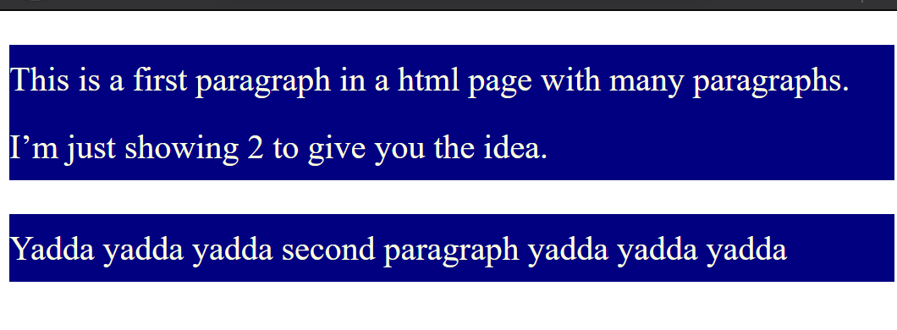
Inserting CSS: Method 2: in the head section
Notes:
When you put a style in the head section of a web page, it styles every one off that tag within that web page
Unless the style is OVERRIDDEN by an IN-LINE style
Good for styling one page
Bad for styling a multi-page web site
You’d have to copy all the style in the head section to every page
When making changes, you have to go in and change the style for each and every page in a web site
<head>
<meta charset=”utf-8" />
<title> The web page </title>
<style >
p { background-color: navy;
color: lightyellow;
line-height: 200%;
}
</style>
</head>
<body>
<p> This is a first paragraph in a html page with many paragraphs. I’m just showing 2 to give you the idea.
</p>
<p > Yadda yadda yadda second paragraph yadda yadda yadda
</p>
(Think if Wikipedia wanted to make their font color pink!! How many pages would they have to modify???) Crazy!!!!

Slide 7
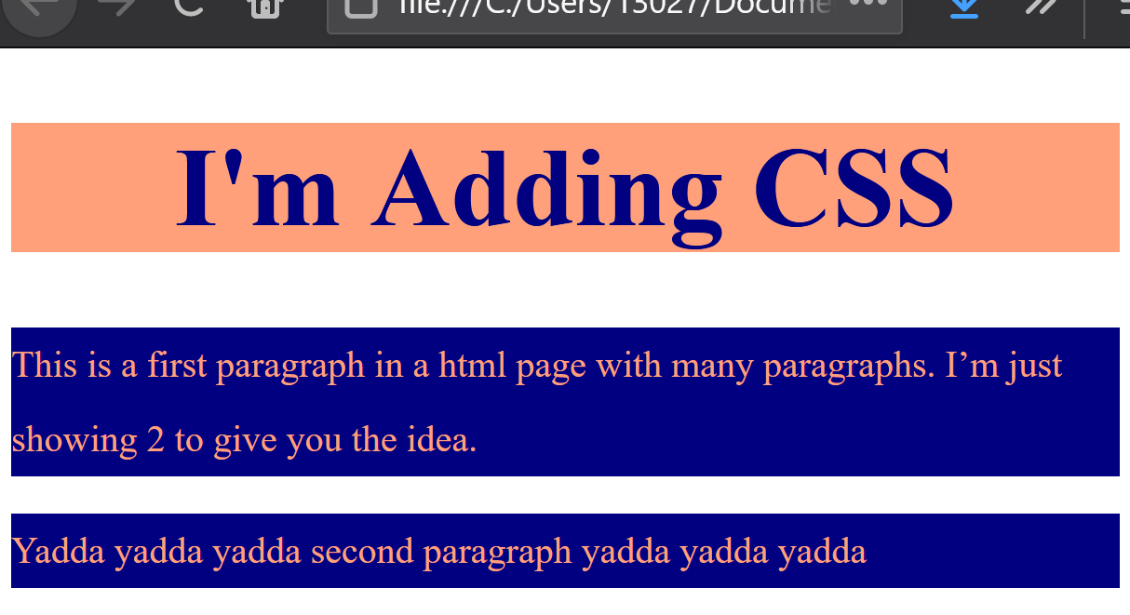
Inserting CSS: Method 3: in a separate file
HTML FILE
The Best Method (Generally)!!!
The html file
SEPARATE .CSS FILE (I named firststyle.css)
Links to separate stylesheet file (with styles in it
<!Doctype html>
<html lang = "en">
<head>
<meta charset = "utf-8">
<title> My First Web Page </title>
<link href = "firststyle.css" rel = "stylesheet">
</head>
<body>
<h1> I'm Adding CSS</h1>
<p> This is a first paragraph in a html page with many paragraphs. I’m just showing 2 to give you the idea.
</p>
<p > Yadda yadda yadda second paragraph yadda yadda yadda
</p>
</body>
</html>
p { background-color: navy;
color: lightsalmon;
line-height: 200%;
}
h1 {background-color: lightsalmon;
color: navy;
text-align: center;
font-size: 300%;
}
Web page looks like this!
Styles these html elements!

Slide 8
Inserting CSS: Notes on Method 3: A Separate File
2 BIG Advantages to separate file method:
1) Many different html files can link to the same .css stylesheet
So multiple files can have a uniform look
Easy to make changes to the look of multiple files by just changing the style in one stylesheet!
2) If you want your web site to have different looks for different groups of people you can have multiple .css stylesheets
(e.g., you want higher contrast and larger fonts for people who are low-vision),
Just switch which stylesheet your html page is currently linked to go switch the style definitions for the web page(s)
The ONLY thing that goes in a .css file are styles -in other words, you don’t need the <!doctype><html>, etc.
The separate file is linked just like all other relative files:
– if not in the same folder, you’ll have to specify the path

Slide 9
Final Notes on Adding CSS
What if you have a style for paragraphs in the head section and in a separate file?
HTMLfile.html
Firststyle.css
In this case, the paragraphs in the web page will be navy
The style definition in the head section comes after the link to the stylesheet (.css)
<head>
<meta charset = "utf-8">
<title> My First Web Page </title>
<link href = "firststyle.css" rel = "stylesheet">
<style >
p { background-color: navy;
line-height: 200%;
}
</style>
</head>
p { background-color: purple;
line-height: 200%;
}
HTMLfile.html
Firststyle.css
In this case, the paragraphs in the web page will be purple
ORDER MATTERS!
<head>
<meta charset = "utf-8">
<title> My First Web Page </title>
<style >
p { background-color: navy;
line-height: 200%;
}
</style>
<link href = "firststyle.css" rel = "stylesheet">
</head>
p { background-color: purple;
line-height: 200%;
}

Slide 10
Final Notes 2:
Inline style overrules both styles in the head section and styles in a separate style file.
In this class, as much as possible, use a separate style sheet unless I specified otherwise!

