Slide 1
Borders
Adding borders using CSS

Slide 2
Border Basics:
Border-width
Usually between 1px and 20px
Or thin, medium, thick
Border-style:
Solid
Dotted
Dashed
Double
Groove
Ridge
Inset
Outset
Border-color:
Color (remember colors?)
h1 {
color: navy;
font-family: arial;
font-weight: 500;
font-size: 300%;
text-align: right;
text-shadow: 3px 3px lightblue;
border-width: thick;
border-style: groove;
border-color: salmon;
}
h1 {
color: navy;
font-family: arial;
font-weight: 500;
font-size: 300%;
text-align: right;
text-shadow: 3px 3px lightblue;
border: thick groove salmon;
}
Abbreviated version

Slide 3
Border Sides
Adjusting the border on one side:
h2 { border-bottom-style: dashed;
border-bottom-width: 2px;
border-bottom-color: purple;
}
Order:
border, then side, then style:
e.g., border-left-width: 5px;
border-top-style: solid;
h1 {
border-top: 10px solid purple;
border-right: 8px dashed blue;
border-bottom: 10px dotted green;
border-left: 8px double yellow;
background-color: black;
color: red;
font-family: arial;
font-size: 400%;
text-align: center;
}

Slide 4
Border-radius
h1 {
border: 10px solid magenta;
border-top-left-radius: 30px;
border-bottom-right-radius: 30px;
background-color: black;
color: pink;
font-family: arial;
font-size: 400%;
text-align: center;
}

Slide 5
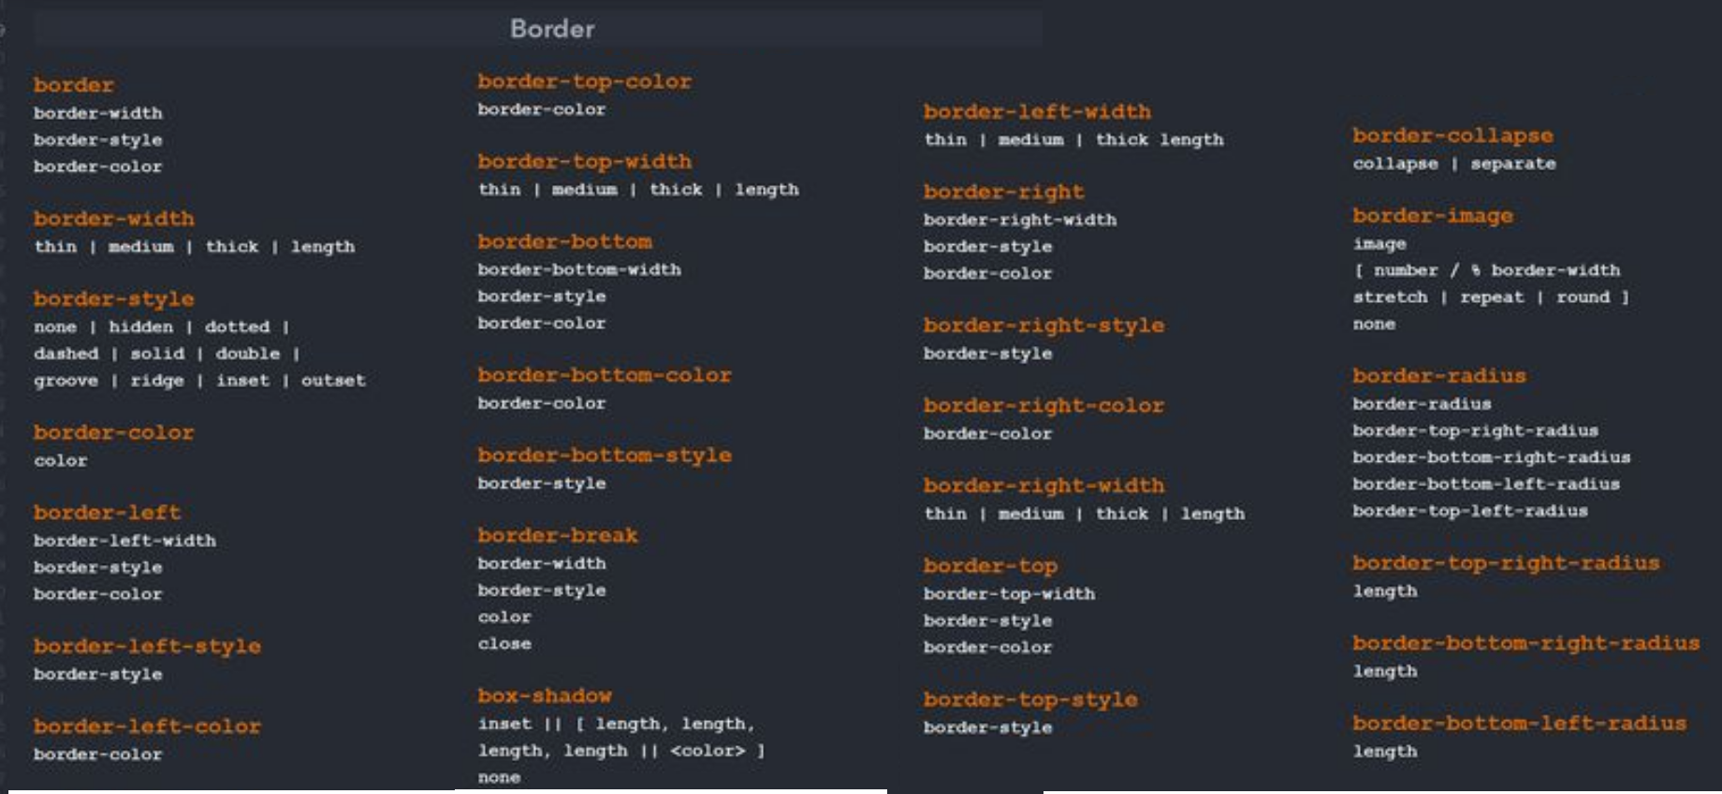
Border Cheat Sheet
All the stuff you can do to borders!!!

