Slide 1
Adding Backgrounds
Using CSS

Slide 2
background-color:
You’ve seen this:
h1 {
background-color: navy;
color: lightgreen;
}
p {
background-color: salmon;
color: teal;
}
IF YOU WANT THE ENTIRE PAGE TO HAVE A BACKGROUND COLOR:
body {
background: chocolate;
color: beige;
}

Slide 3
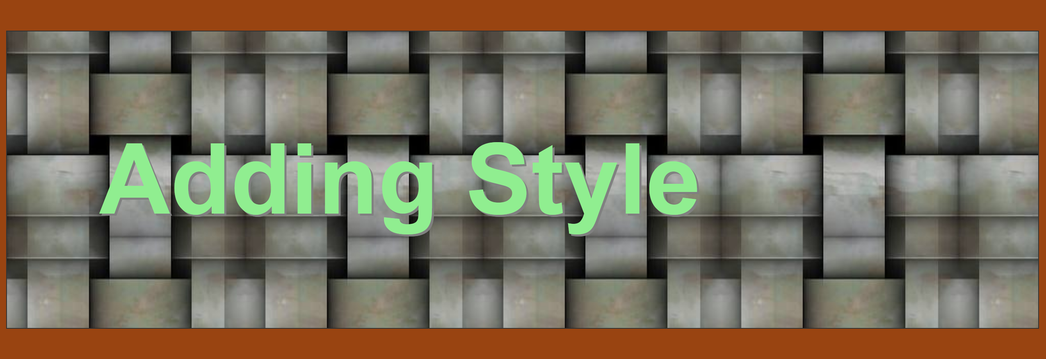
background-image: url(“bgimg.jpg”);
Quick notes on this:
1) url people forget to put that. You need it.
2) the background image shows up better if you add padding to your element,
E.g,:without padding:
3) the background image automatically tiles to fill the background space
That is the default
You can change that (coming up)
h1 {
background-color: navy;
color: lightgreen;
padding: 50px;
font-family: trebuchet ms;
font-size: 300%;
background-image: url("Images/bg3.jpg");
border: 1px inset #333333;
}
bg3.jpg

Slide 4
background-repeat: repeat-y; Tile background image vertically
Smallleaf.png
p { background-image: url("Images/smallleaves.png");
background-repeat: repeat-y;
background-position:0px 0px;
background-color: lightsalmon;
color: teal;
padding: 65px;
padding-left: 75px;
border: 1px solid teal;
}
Repeat-y means repeat up and down
(but not left and right)
Note background-position: 0px 0px;
that’s 0px in from left and 0px down from the top

Slide 5
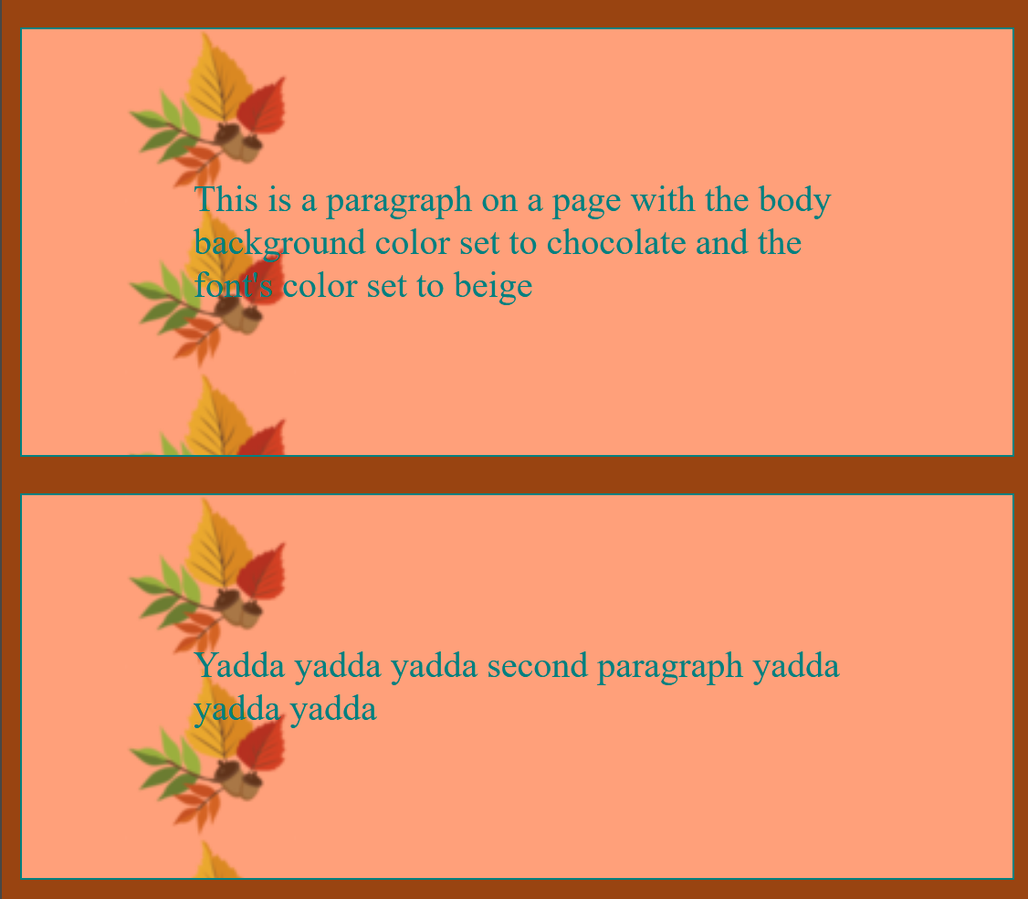
Changing position
background-position: 0px 0px;
that’s 0px in from left and 0px down from the top
p { background-image: url("Images/smallleaves.png");
background-repeat: repeat-y;
background-position:0px 0px;
background-color: lightsalmon;
color: teal;
padding: 65px;
padding-left: 75px;
border: 1px solid teal;
}
p { background-image: url("Images/smallleaves.png");
background-repeat: repeat-y;
background-position:35px 0px;
background-color: lightsalmon;
color: teal;
padding: 65px;
padding-left: 75px;
border: 1px solid teal;
}

Slide 6
background-repeat: repeat-x; Tile background image horizontally
flowers3.png
h1 {
background-color: lightgreen;
color: navy;
padding:30px;
background-image: url("Images/flowers3.png");
background-repeat: repeat-x;
background-position:0px 0px
font-family: arial;
text-align: center;
text-shadow: 2px 2px gray;
font-size:300%;
border: 1px solid #333333;
}
Repeat-x means repeat left and right
(but not up and down
Note background-position: 0px 0px;
that’s 0px in from left and 0px down from the top

Slide 7
background-repeat: repeat-x; Tile background image horizontally
flowers3.png
h1 {
background-color: lightgreen;
color: navy;
padding:30px;
background-image: url("Images/flowers3.png");
background-repeat: repeat-x;
background-position:0px 30px
font-family: arial;
text-align: center;
text-shadow: 2px 2px gray;
font-size:300%;
border: 1px solid #333333;
}
Note background-position: 0px 30px;
that’s 0px in from left and 30px down from the top

Slide 8
background-repeat:no-repeat;
h1 {
background-color: aqua;
color: navy;
padding:30px;
background-image: url("Images/orangeflower.png");
background-repeat: no-repeat;
background-position:0px 0px;
font-family: arial;
text-align: center;
text-shadow: 2px 2px gray;
font-size:300%;
border: 1px solid #333333;
}
No-repeat means happens 1 time only
Note background-position: 0px 0px;
that’s 0px in from left and 0px down from the top

Slide 9
background-repeat:no-repeat;
h1 {
background-color: aqua;
color: navy;
padding:30px;
background-image: url("Images/orangeflower.png");
background-repeat: no-repeat;
background-position:-30px -20px;
font-family: arial;
text-align: center;
text-shadow: 2px 2px gray;
font-size:300%;
border: 1px solid #333333;
}
Note background-position: -30px -20px;
30 px would move the image 30 px to the right
-30 px moves the image 30 px to the left
20 px moves the image 20 pixels down
-20 px moves the image 20 pixels up

Slide 10
Background-size:
You can set the background image’s size using background-size
Options:
Use pixels
Use %
Example:
h1 {
background-color: white;
color: navy;
padding:30px;
padding-bottom: 50px;
background-image: url("Images/fallbg.gif");
background-size: 60% 100%;
background-repeat: no-repeat;
background-position: 90px 0px;
Original Image

Slide 11
Background-size: cover or contain
background-size: cover;
-Stretches the image to cover the element’s background
In other words, the whole thing is resized so that it is stretched to fit in the element area
background-size: contain;
Makes the image fit fully within the element
In other words, the whole thing is resized so that you can see the whole background image

Slide 12
Takeaways
background-images: url(“Images/bgimg.jpg”); remember url!!
If that’s all you put, the background image will tile (both up and down, left and right) to fill the element
background-repeat:
repeat-x – repeats horizontally
repeat-y – repeats vertically
background-position: 0px 0px;
First is for how far in from the left
Second is for how far down from the top
You can use negative numbers (to move left and up, respectively)
background-repeat: no-repeat
Image only happens once
background-size:
Specify size using pixels or %
Or cover:
For stretching to cover the whole element
contain:
For resizing to make the whole image fit within the lement

